Slide 1
Salford Adults
Introduction to Assessed and Support Year in Employment (ASYE)
ASYE coordinator: Shoyley Chowdhury
Notes:
Welcome and introductions.
Introduction to ASYE is provided to help NQSWs, assessors, managers and teams.
What do you hope to gain from this session?

Slide 2


ASYE myth busting
Notes:
What is your knowledge and understanding of ASYE?
Left picture Micheal Keaton/Beetle Juice and right picture Barbie/Scary doll
Pictures in jest and to demystify the myths of ASYE
Commonly asked questions;
Is ASYE an extension of university?
Will I pass or fail ASYE?
Will I survive my first year?
What is the point of ASYE?

Slide 3

Introduction to ASYE:
Part 1 What is ASYE?
Part 2 Who is involved?
Part 3 Support arrangements?
Part 4 ASYE assessment?
Part 5 What’s included in the Salford Adults ASYE programme?
Part 6 ASYE Equality, Diversity and Inclusion?
Resources for ASYE
You can have a look at ASYE handbook and portfolio templates via Social Work Development – Assessed and Supported Year in Employment – Salford Adult Social Care Information Hub

Slide 4
Part 1 – What is ASYE?
Department of Health & Social Care (DHSC) appoint Skills for Care (SfC) to support organizations with the delivery of ASYEThe ASYE framework (skillsforcare.org.uk)
Inception of ASYE 2012 - Employer led programme providing NQSWs extra support in first year;
Consolidate learning and build knowledge, skills, and professional confidence. Reflective Practice. Assessment frameworks include PCF and KSS/PQS
NQSWs complete a portfolio of evidence over 12-month programme which is ratified through an internal moderation process.
Key support arrangements: reduced workload, supervision & ASYE CPD time
Notes:
Background
In place since 2012
Skills for Care (SfC), workforce development body:
Appointed by (DHSC) to ensure consistency in ASYE.
SfC fund and monitor ASYE programmes
Links to recommendations from Munro Report 2011
The ASYE framework (skillsforcare.org.uk)
National Evaluation Criteria all ASYE programmes must follow which are benchmarks for a successful, ethical and value-based programme. The well-being of NQSW is central to the programme
Overview of ASYE Programme
Designed to give NQSWs extra support in first year of employment
Key support arrangements: 1) reduced workload (10% reduction) 2) frequent supervision, and 3) protected time for ASYE related CPD (Half day p/w/1 day/fortnight).
Centers on critically reflective practice
Consolidate learning and builds knowledge, skills, and professional confidence/curiosity.
Celebrate NQSW successes and achievements.

Slide 5
Part 1 – What is ASYE?
Benefits of ASYE
Develop professionally sound and ethical decision-making
Promotes best practice with people
Once in a career opportunity to build professional curiosity, confidence, skills and knowledge
Time to consolidate learning and development
Supports well-being and time to build self-care
Rewarding, promotes self-efficacy, strengths - Celebrate achievements
Inclusivity, not disadvantaged due to protected characteristics or individual needs
Continuation & safe space for critically reflective practice
Support arrangements: supervision, workload reduction and protected time.
Notes:
Completion of ASYE closely links to our social work career progression pathways.

Slide 6
Part 2 - Who is involved?
Newly Qualified Social Worker (NQSW)
ASYE Assessor or Lead Assessor
Line Manager
ASYE coordinator
Principal Social Worker
Senior management
Notes:
Several stakeholders to ASYE.
Further roles and responsibilities included in ASYE handbook and on SfC ASYE website.
In some instances, the ASYE assessor and line managers are the same individuals; some instances these are separate individuals.

Slide 7

Part 3 – ASYE Support arrangements?
Reduced workload
Gradual & progressive
10% reduction
2) ASYE Reflective Supervision
Once per week for the first six weeks
At least fortnightly for up to six months
At least once a month thereafter
3) Protected Time for ASYE related CPD
Half day p/w or 1 day/fortnight
Notes:
Supervision template available in appendix of handbook.
Contact ASYE coordinator if there are concerns re. support arrangements.
Try to maintain supervision frequency as close as possible, its unavoidable if supervisions are missed due to annual leave or absences
Direct information from Salford ASC social work supervision annexe
4.4 Supervision for Newly Qualified Social Workers (NQSWs)
This annexe applies to the professional supervision of all social workers, including newly qualified social workers. However, there are some additional considerations for supervisors and supervisees when the supervisee is a newly qualified social worker.
The Department of Health and Social Care appointed Skills for Care to develop the employer led programme for NQSWs known as ASYE. There is research to suggest NQSW’s achieve the best outcomes when the following components and support arrangements in ASYE are in place:
A structured induction
Appropriate supervision
Reduced and appropriate caseload
Protected time for learning and development
NQSWs need support to:
Make the transition from professional education to practice through ASYE
Receive an effective induction to the organisation as an employee and into the Social Work profession.
Access opportunities to develop skills, knowledge and professional confidence
Consolidate their practice into a specialist context and job role
Receive reflective supervision within a safe and emotionally reassuring space.
NQSW supervisors:
Each NQSW undertaking their ASYE is allocated an ASYE assessor who provides an essential role by supporting and guiding the NQSW in the development of their social work practice. The assessor undertakes an assessment of the NQSW’s progressive development (against the PCF and KSS) leading to a pass/fail recommendation at the end of ASYE. The assessor must be a registered and experienced social worker and does not necessarily need to be Practice Educator trained.
Each NQSW receives both ASYE reflective supervision from their ASYE assessor and workload management supervision from their line manager. In certain instances, the ASYE assessor and line manager is the same individual who undertakes all supervision for the NQSW. On other occasions the ASYE assessor and line manager are different individuals, who work cohesively to ensure the NQSW receives both ASYE and workload supervision according to their individual development needs.
NQSW supervision frequency and requirements:
The supervision for NQSWs must meet the LGA Employer Standards for Supervision and ASYE framework which (as a minimum) is:
Once per week for the first six weeks
At least fortnightly for up to six months
At least once a month thereafter
The duration of ASYE supervision should be a minimum of 1.5 hours with a core focus on critically reflective practice. On commencement of ASYE the assessor and NQSW draw up a support and assessment agreement which contains an outline of supervision arrangements over 12 months of ASYE. The NQSW will also receive workload supervision from their line manager every 4 weeks.
ASYE supervision should focus on:
Well-being and self-care
Learning styles and personal development plans
Reflective practice, critical thinking, and analysis
Discussions of theories, models, and approaches, including application to practice
Reflecting on power relations, bias, values, and ethics.
Reflecting on feedback from supervisor, other professionals, and adults in need of care and support, or their carers.
Monitoring progress in achieving the outcome statements of the PCF and KSS
Checking key support arrangements of ASYE are in place, including protected time and reduced workload, in addition to supervision.
Further information on NQSW supervision during ASYE can be found on the Skills for Care website. ASYE
The ASYE coordinator can provide information on ASYE supervision requirements, including guidance to ASYE assessors as supervisors. A template for ASYE supervision can be found in the Salford Adults ASYE handbook which is accessible via the ASC information hub. If there are signs that key support arrangements for ASYE (including supervision) are not being maintained, please escalate concerns to the relevant senior lead, ASYE coordinator and/or and the Principal Social Worker, who will implement a remedial plan.

Slide 8
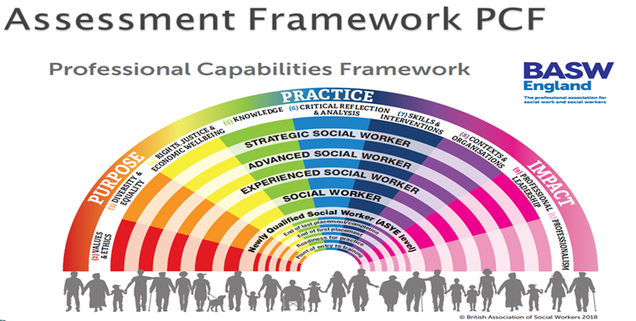
Part 4 - ASYE assessment?
Key Frameworks for Assessment
1) Professional Capabilities Framework (PCF) at NQSW level https://new.basw.co.uk/training-cpd/professional-capabilities-framework/newly-qualified-social-worker-asye-level 2) Post Qualifying Standards (PQS, previously known as the KSS). KSS.pdf (publishing.service.gov.uk)
Notes:
Evidencing key domains within the following frameworks. NQSWs are assessed against the PCF and PCF
PCF at NQSW level - What social workers should demonstrate by end of their first year of qualified practice
The PCF is the overarching framework for social work in England
Pre-qualifying to strategic levels, across all practice areas.
It is a generic, profession-owned framework for all social work that provides guidance and a common understanding of what it means to be a social worker at all stages.
This statement sets out what a social worker working with adults should know and be able to do by the end of their Assessed and Supported Year in Employment (ASYE). KSS 11 has an overall summary
How PCF and PQS link PCF is overarching framework for social work, from pre-qualifying to strategic levels, across all areas. The PQS developed by Chief Social Workers to set out what is expected of qualified social workers in specific practice settings; one set for children/families and another for adults https://basw.co.uk/sites/default/files/basw-pcf-and-kss-joint-statement.pdf
Extra points for including Social Work England Standards (SWEPS)

Slide 9
Part 4 - ASYE assessment?
NQSWs complete a portfolio of evidence over 12-months
Mixture of evidence and assessment methods…
  Direct observations of practice
  Collating and reflecting on feedback
  Review of professional documentation
  Critically reflective pieces (2000 words and or presentation for final)
ASYE internal moderation ratify the outcome at 12 months.
ASYE external and national moderation
ASYE portfolio checklist 2024….let’s have a look
Notes:
Internal moderation
• Upon commencing ASYE, the ASC learning and development team will send a panel date for 12 months time
• Submit your completed portfolio two weeks before the given panel date
• Both NQSW and assessor attend the meeting
• Panel members will read portfolio and offer feedback
• The NQSW and assessor will be informed of outcome on the day
External moderation
• Carried out in partnership with GMSWA and local PVI organisations
• Considers a random 10% sample of work sent by each organisation National moderation
National Moderation
SfC reviews a sample of work from each LA to ensure consistency and quality assurance nationally
Feedback is received on the quality of individual work and on ASYE scheme

Slide 10
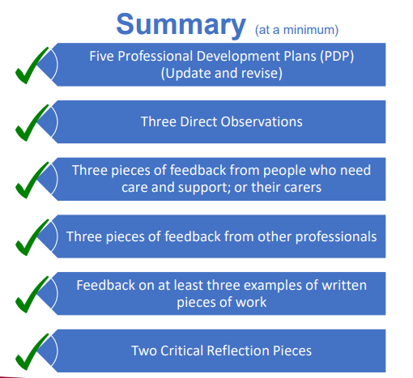
Notes:
A very basic overview.
There are other documents.
Individuals must write post reflections on the feedback obtained from adults & carers in need of care and support.
The final reflection can be in the form of a presentation

Slide 11
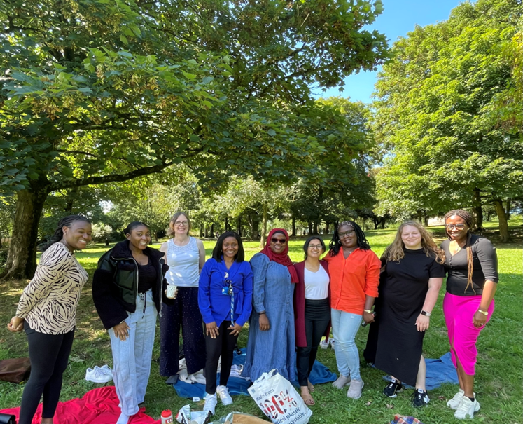
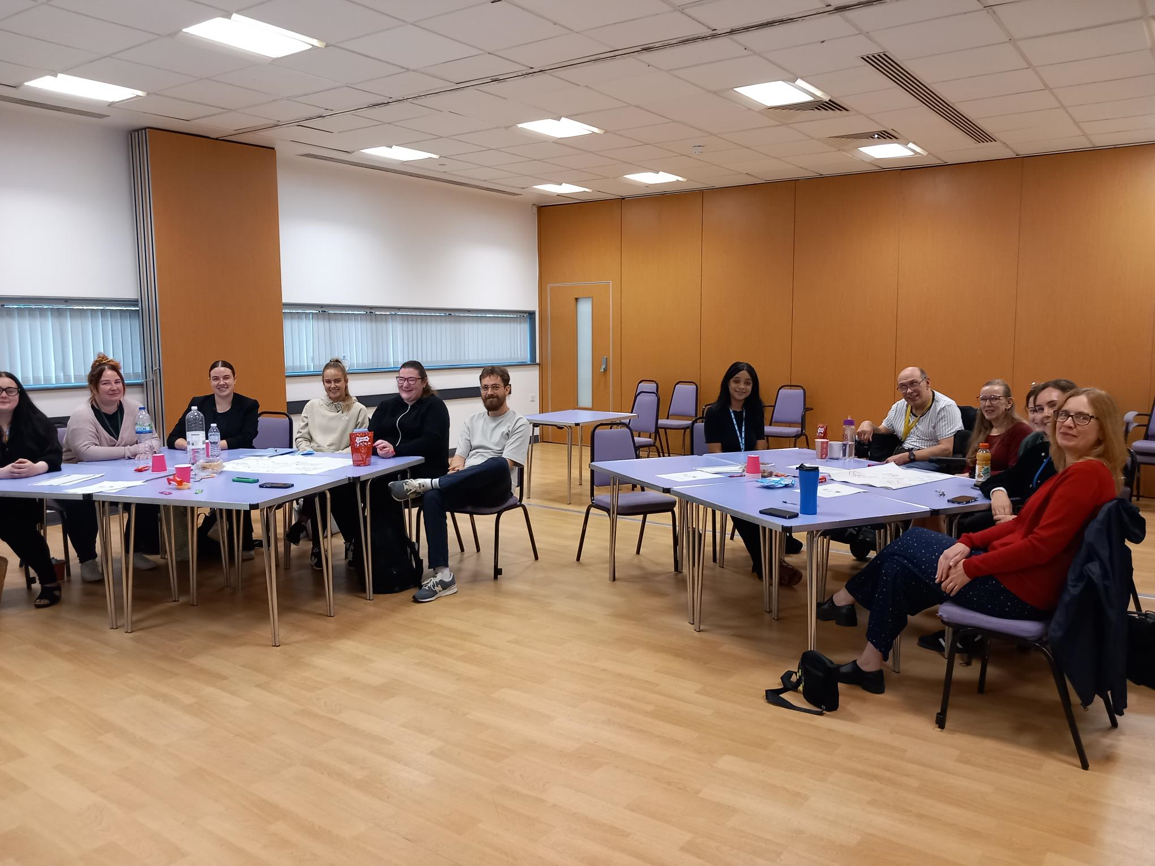
Part 5 - What’s included in Salford Adults ASYE programme?
Three ASYE Core skills day training (must attend)
ASYE Monthly Groups: peer support (must attend)
Great shadowing and learning opportunities for PCF & KSS
Access SfC NQSW forums Events, forums and networks
Mentoring and expertise of ASYE assessor or ASYE lead assessor
ASYE coordinator
Meet Principal Social Worker (PSW)
Self-Care and Well-being
Shadow a local care provider
Research in Practice Create account | Research in Practice
Notes:
NQSWs must attend the ASYE core skills training days and monthly reflective group.
Beecared4 are offering NQSWs the opportunity to spend time at their care branch, gain insight into their procedures, and shadow care visits. This is a good opportunity for individuals to build skills to create personalised support plans and work collaboratively with care agencies. Contact the manager Victoria Barnes-Hudson via victoria@beecared4.co.uk or 0161 743 2081 / 0161 870 9671 if you wish to uptake this shadowing experience.

Slide 12
Part 6 - ASYE Equality, Diversity and Inclusion?
ASYE seeks to foster a diverse community of social workers, inclusive and respectful of individuals from all backgrounds and experiences.
How do we achieve this?
Use ASYE registration & initial meetings to make programme accessible
Anti-oppressive reflective models, Social Graces and MANDELA
Diverse theoretical perspectives & views of lived experiences
SfC NQSW GEMS forums for anti-racist reflection Events, forums and networks
We collate/monitor data reflective of diversity in workforce. Take steps so individuals from diverse background not disadvantaged
All NQSWs can access Salford ASC Equality, Diversity and Inclusion Group via PSW Martin Sexton martin.sexton2@nca.nhs.uk
Notes:
Striving to become more inclusive, valuing strengths of a diverse workforce. Committed to understanding challenges and barriers you and others may face, to learn how to best support you as an individual and groups. Salford ASC workforce EDI strategy in development. Internal EDI commitment statement and Equality policy
Salford is developing into an increasingly diverse and multi-cultural area and the NQSWs joining the organisation reflect this, which is welcomed.
Consider culture, learning needs, disability, other protected characteristics and lived experience.
Continued learning about how to make ASYE inclusive, being allies to marginalised groups.
Guidance in place to support managers to respond if staff face discrimination.

Slide 13
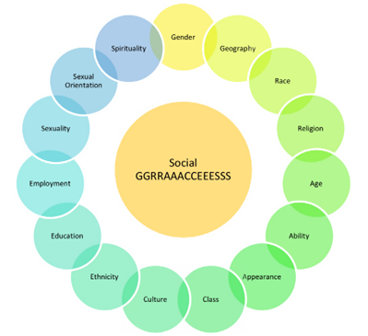
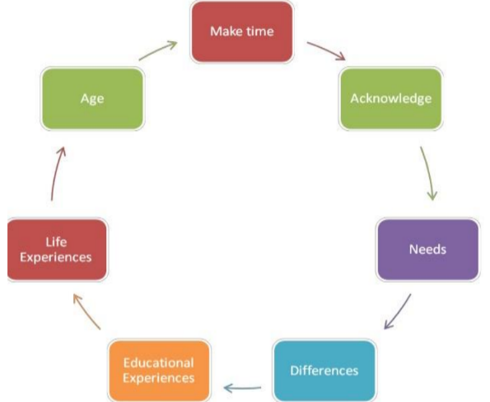
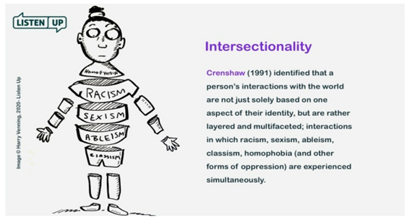
Anti-oppressive theories and models
Notes:
Key anti-oppressive models and theories
The Social Graces framework developed by Burnham (1992, 1993) and Roper-Hall (1998) is increasingly used in training and learning, to explore issues of social difference, power, diversity and bias (Birdsey and Kustner, 2021). Taken from systemic therapy, it is a way to explore differentials in power across different contexts.
Mandela Model - The model was developed to support practice educators to engage more effectively with black African students, however it is a model that can be used to explore similarities and differences between any practice educator and student.
"Intersectionality is a metaphor for understanding the ways that multiple forms of inequality or disadvantage sometimes compound themselves and create obstacles that often are not understood among conventional ways of thinking."

Slide 14


Questions and next steps
Start ASYE portfolio checklist and read handbook
Complete ASYE registration form, return to asclearninganddevelopment@nca.nhs.uk
NQSW to complete KSS self-assessment tool for first Personal Development Plan (PDP)
Arrange Initial Professional Development Plan (IPDM) and Support and Assessment Agreement (SAA); complete both forms.
Start pre-arranging ASYE supervision dates and study days
Invite ASYE coordinator (Shoyley) to 3-month ASYE review, send documents 1 week beforehand
Try and get a team ‘buddy’ in addition to ASYE assessor
Good luck in your ASYE!
Notes:
Use any final PDP from university or apprenticeship programme

Slide 15
Resources for ASYE
Create account | Research in Practice
Professionals Area – Salford Adult Social Care Information Hub (salfordappp.co.uk)
How life has changed in Salford: Census 2021.
Professional standards - Social Work England
Professional Capabilities Framework (PCF) | www.basw.co.uk
https://assets.publishing.service.gov.uk/government/uploads/system/uploads/attachment_data/file/411957/KSS.pdf
https://new.basw.co.uk/sites/default/files/resources/basw_code_of_ethics_-_2021.pdf
Care and support statutory guidance - GOV.UK (www.gov.uk)
Mental-capacity-act-code-of-practice.pdf (publishing.service.gov.uk) Draft MCA Code of Practice: summary - GOV.UK
MCA in practice - SCIE
Professionals | Salford Safeguarding Adults Board
mycity Directory (salford.gov.uk)
SCO_Adult Social Care - Useful Telephone Numbers
Join the Library :: Northern Care Alliance
SCARF Document Library :: Northern Care Alliance
Staff Networks :: Northern Care Alliance
Notes:
RiPFA
Policy and procedures
Census for diversity of Salford
Assessment frameworks, include SWEPS and BASW code of ethis
Stat guides
Safeguarding policies and procedures
Community resources
Library
SCARF well-being
Staff networks – womens, BAME, LGBTQ+

