Slide 1

Monthly Reflective Session
Support Planning
24 November 2025
Facilitator: Shoyley Chowdhury, Social Work Development Lead
Joined by: Beecared4
Notes:
Introductions
Name, role, team
Joined by Beecared4, kindly joined us and have prepared information, activities and resources.
NQSWs and students, quick round of introductions.

Slide 2
Housekeeping
Time for Reflection
Listening and participating
Respecting others' opinions
Self-Care
Confidentiality
Phones on Silent
Notes:
Toilets are outside going towards the entrance on the right
There is a drinks machine and snacks on the table.
Short break half way through

Slide 3
Session Aim & Agendas
Agenda & objectives
Legal Frameworks Assessment & Support Planning
Care Provider Effective Support Planning – Beecared4 (including Q&A)
Support Planning – Helpful Hints, Length of Calls, Writing
Final Reflective Activity
(This session is not specially covering support planning for carers or specific accommodation settings)
Notes:
Good support planning in adult social care is a person-centered and collaborative process that focuses on an individual's needs, goals, and preferences to create a personalized plan for how they will receive support. Key elements include detailed discussions about what is important to the person, identifying what they can do themselves, and agreeing on how their specific needs will be met through services and support, often with a personal budget. A good plan is flexible, regularly reviewed, and ensures the individual feels listened to and in control of their own support.
Pending the outcome of an assessment and determination of eligible needs, everyone should be offered direct payments or the option to have services arranged through the local authority

Slide 4
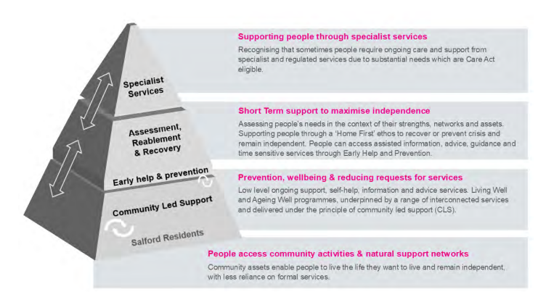
The Vision of Salford Adult Social Care
Our vision is encapsulated in our mission statement:
“Working with communities and partners so every person can lead fulfilling, healthy, safe, and independent lives.”
Notes:
In Salford, we are deeply committed to working in partnership with the people we support and their carers, ensuring that our focus remains on what truly matters to them.
Discuss diagram

Slide 5

Legal Frameworks underpinning
Assessment & Support Planning
Notes:
When considering support planning, we need to consider this in the context of the initial assessment of needs
Shout out what is the key legal frameworks for decision-making?
We have statutory responsibilities under the Care Act 2014 to provide assessment and support to adults and carers (where eligible) in Salford, to help promote people’s independence, wellbeing, their outcomes, and safeguard to minimise the risk of harm.
Legal Literacy
• Helps us to be more person centred and strength based
• Confidence to advocate and challenge, particularly around eligibility and support planning
• Using the law to its full extent – opens the options
• Promotes risk positive decision making
• Framework for decision making
• Enables us to legally defend decisions
• Provide a clear rationale

Slide 6
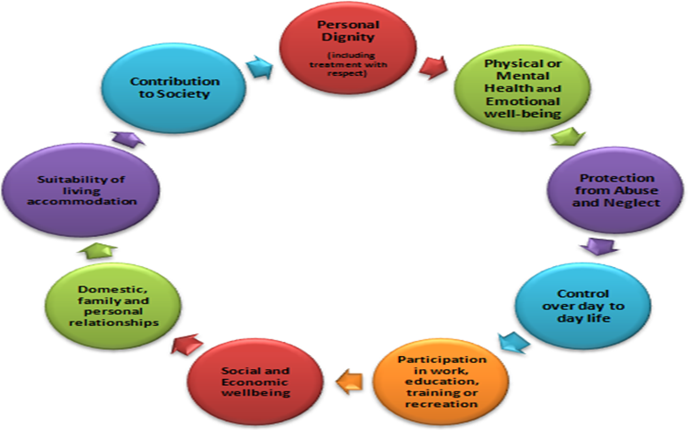
Care Act (2014) Well-being
Section 1 Well-Being (1) The general duty of a local authority, in exercising a function under this Part in the case of an individual, is to promote that individual's well-being.
The core purpose of adult care and support is to help people to achieve the outcomes that matter to them in their life.
Important considerations in promoting well-being
Individual is best placed
Views, wishes, feelings
Prevent/delaying development of needs
Individuals' circumstances (not assumptions)
Full participation of individual
Balancing the individual's wellbeing and those caring for them
Protect from abuse and neglect (not only safeguarding)
Ensure any restriction on individuals rights or freedom of action of the function is kept to minimum necessary (Least restrictive)
Notes:
When thinking about Maslow’s hierarchy, not only physiological needs, includes needs to support people to achieve self actualisaion
Section 1 - Under the Care Act the Wellbeing is a broad concept and al domains are all as important as each other. Any hierarchy can only be determined or described by the adult who's Wellbeing it is. A local authority can promote a person’s wellbeing in many ways. How this happens will depend on the circumstances, including the person’s needs, goals and wishes, and how these impact on their wellbeing. (not judgements based on appearance, age, conditions)

Slide 7
Care Act (2014) Assessment of Need
The assessment and eligibility process provides a framework to identify any level of need for care and support
Section 9 Needs assessment (1) Where it appears to a local authority that an adult may have needs for care and support, the authority must assess—
(4) A needs assessment must include an assessment of-
(a)whether the adult does have needs for care and support, and
(b)if the adult does, what those needs are.
The impact of the adult’s needs for care and support on the matters specified in section 1 (2)
The outcomes that the adult wishes to achieve in day-to-day life, and
(c) Whether, and if so, to what extent the provision of care and support could contribute to the achievement of those outcomes
Notes:
Lots of different sections, do not need to know all, however a good understanding of key sections defining our statutory responsibilities.
So that local authorities can consider how to provide a proportionate response at the right time, based on the individual’s needs
Section 10 Carers assessment (1)Where it appears to a local authority that a carer may have needs for support (whether currently or in the future), the authority must assess—
(a)whether the carer does have needs for support (or is likely to do so in the future), and
(b)if the carer does, what those needs are (or are likely to be in the future).
Section 9 – Even if needs are not eligible, have a responsibility to provide preventative advise.
6.13 Local authorities must undertake an assessment for any adult with an appearance of need for care and support, regardless of whether or not the local authority thinks the individual has eligible needs or of their financial situation. The purpose of an assessment is to identify the person’s needs and how these impact on their wellbeing, and the outcomes that the person wishes to achieve in their day-to-day life. The assessment will support the determination of whether needs are eligible for care and support from the local authority, and understanding how the provision of care and support may assist the adult in achieving their desired outcomes.

Slide 8

Care Act (2014) Support Planning
Section 13 of the Care Act 2014 and the Care and Support (Eligibility Criteria) Regulations 2015 sets out the national eligibility criteria which must be followed to determine if an individual has eligible needs for care and/or support.
Three conditions for determining eligibility are:
The adult’s needs arise from, or are related to, a physical or mental impairment or illness.
As a result of the adult’s needs, the adult is unable to achieve two or more of the specified outcomes
As a consequence of being unable to achieve these outcomes there is, or there is likely to be, a significant impact on the adult’s wellbeing.
Notes:
The national eligibility criteria set a minimum threshold for adult care and support needs (to overcome lack of clarity from previous legislation)
Local authorities must consider at this stage if the adult has a condition as a result of either physical, mental, sensory, learning or cognitive disabilities or illnesses, substance misuse or brain injury. Broad, some people may not have a formal diagnosis
(2) The specified outcomes are—
(a)managing and maintaining nutrition;
(b)maintaining personal hygiene;
(c)managing toilet needs;
(d)being appropriately clothed;
(e)being able to make use of the adult’s home safely;
(f)maintaining a habitable home environment;
(g)developing and maintaining family or other personal relationships;
(h)accessing and engaging in work, training, education or volunteering;
(i)making use of necessary facilities or services in the local community including public transport, and recreational facilities or services; and
(j)carrying out any caring responsibilities the adult has for a child.
2) Unable to meet without assistance (can physically, needs prompting), could endanger own health or safety, significant pain, distress or anxiety, or would take longer than ordinarily expected. (thinking about what could help individuals to be independent)
An eligibility determination can only be made based on an assessment of needs.
When determining eligibility, LA consider whether all three conditions are met.
LA must ignore care and support provided by a carer when determining eligibility for an adult. (Carer Blind)
If an individual’s needs fluctuate, LA must take account of this and ensure that all needs have been accounted for.
LA must establish whether the individual is ordinarily resident.
LA must provide a record of the eligibility determination and the reasons for it.
Local authorities must provide information and advice considering what is available to prevent the need for care and support for all the needs identified as non-eligible for support.

Slide 9
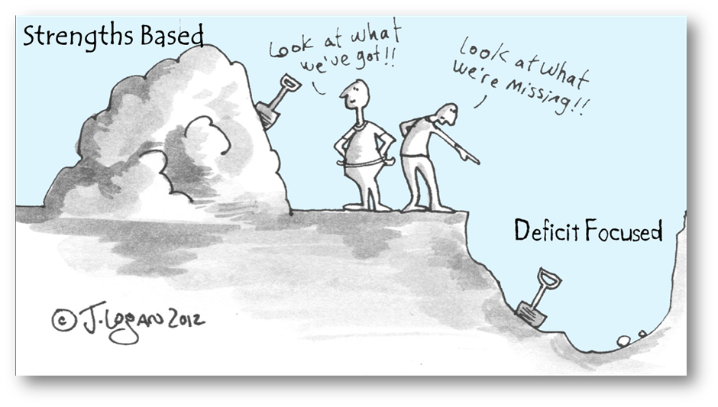
How can identified needs and outcomes be achieved:
Building on persons own strengths
Wider support Networks
My City Directory
Community Led Approach
Well-being services
Assistive technology
Reablement
Signposting, info, advice
Requesting a health review
Input from other professionals….
(Not all assessments lead to a commissioned/funded service)
Let’s look at our Strengths-Based Statement of Principles……
And latest Winter Offer 2025…..
Notes:
The statutory guidance for the Care Act 2014 embeds strengths-based working as a requirement when it directs practitioners to: ‘consider the person’s own strengths and capabilities, and what support might be available from their wider support network or within the community to help’ in considering ‘what else other or alongside the provision of care and support might assist the person in meeting the outcomes they want to achieve’ (Romeo, 2017). Wide range of needs, risks and strengths that may require a coordinated response from a variety of statutory and community services
CHC Primary Health Need
• Be human – the strengths will emerge
• Conversations leading the process
• Deliberate use of relationships
• Independence and interdependence
• Meaningful Belonging – Bonding and Bridging (Rothuzen, & Harbo, 2017)
• Understanding rather than assessing (mindset)
• Using extrinsic and intrinsic resources
• Well-being and Strength Based intrinsically linked

Slide 10
Care Act (2014) other relevant sections…..
Other sections…..
Section 8 How to meet needs
Section 25 Care and support plan, support plan (1)A care and support plan or, in the case of a carer, a support plan is a document prepared by a local authority
Section 27Review of care and support plan or of support plan (1)A local authority must— (a) keep under review generally care and support plans, and support plans, that it has prepared.
Section 67 Involvement in assessments, plans etc (4) The individual would experience substantial difficulty in doing one or more area: understanding, retaining, weighing up and/or communicating, without an independent advocate
Notes:
Section 18-21
Section 21 which—
(a)specifies the needs identified by the needs assessment,
(b)specifies whether, and if so to what extent, the needs meet the eligibility criteria,
(c)specifies how the LA is going to meet needs
(d)specifies to which of the matters referred to in section 9(4)
(e)includes the personal budget for the adult concerned (see section 26), and
(f)includes advice and information about—
(i)what can be done to meet or reduce the needs in question;
(ii)what can be done to prevent or delay the development of needs for care and support or of needs for support in the future.

Slide 11
Other Legal Frameworks….
Mental Capacity Act (2005) - Protect and empower who may lack capacity to make certain decisions
Data Protection Act (2018) - Controls how personal information is used by organisations.
Mental Health Act (1983 amended 2007) and Care Programme Approach
Human Rights Act (1998) Article 8 Right to Privacy and Family Life
Standard Operating Procedures and Practice Guidance A-Z – Salford Adult Social Care Information Hub
Support Planning Guidance for Practitioners May 24
Review of Care and Support Plans July 24
Notes:
MCA – If someone has been assessed as lacking capacity to make decisions about their care and support needs (including how these would be met), we need to provide due regards to Best Interests and least restrictive care planning (promoting liberty, independence and choice)
Data Protection - Important to gain consent from the adult about how information is shared and who it is shared with. Appropriate information sharing with agencies is vital as it enables shared risk management and responsibility.
The Mental Health Act (1983) is the main piece of legislation that covers the assessment, treatment and rights of people with a mental health disorder. Section 117 -If detained under section 3 (& other sections of Act) individuals are eligible for free aftercare. Also, those detained under 37, 45A, 47 and 48.
CPA an overarching system for co-ordinating the care of people with mental disorders. CPA care plan aim to ensure a transparent, accountable and coordinated approach to meeting wide ranging physical, psychological, emotional and social needs. A few areas covered in CPAs include:
Treatment plans and therapeutic support
Actions to address physical health problems
Support to achieve persons goals
Social Care needs
Support for carers
Contingency planning
Further reading about CPA is under chapter 34 of Mental Health Act code of practice
The Human Rights Act (1998) gives us legal protection of our basic human rights in the UK. The legislation ensures that the rights set out in the European Convention on Human Rights (ECHR) are enjoyed by us all, which includes things like dignity, fairness, equality, tolerance, and respect.
SOP Key Points
Support planning;
All options to meet assessed eligible needs, least restrictive, promote independence
Where there are residual needs (not met through other alternatives), individuals must be made aware of potential charges for services (collaborative and understanding, as discussions about finances scare people)
Indicative about personal budgets
Managing needs and meet their outcomes
We can consider cost-effective ways to meet needs, but not at detriment to well-being and presenting assessed needs.
Workflow to brokerage who support to arrange care.
Review
Reviews of support planning can be scheduled, unscheduled or annual
Use different sources to complete a review, people's views, care logs,
Reviewing the support planning is outcome focused (not static that the person still has the same needs)

Slide 12

Effective Support Planning
Beecared4
What do you think is needed for effective support planning?
Notes:
Looked at legal frameworks, how does this apply in practice when completing a support plan, what do you need to do and apply to create an effective support plan, hearing from views of a care provider
5 min activity
Victoria & Sally

Slide 13
Helpful tips when Support Planning
What info needs to be included before sending social care assessment and support plan to manager?
What do brokerage need to source the care?
How does social care relate to health care, i.e. medication regimes, wound care, pressure relief, diabetes management……
Is the support plan reflective of current needs? Changes following hospital admissions…..
Any ongoing/historic safeguarding enquires? Are care staff aware if they need to form part of protection plans?
Risks / Hazards? Substance and/or alcohol misuse…
Does adult have means of summoning help in event of emergency in between visits?
Contingencies in event of concerns

Slide 14

Length of care visits
What needs to be considered when determining length of calls?
Well-being, achieving outcomes
Person-centred
Dignity
Communication
Fluctuation in needs (daily, short or long term)
Nature of care & support needs
Degree of assistance, prompts, encouragement
Use of moving and handling equipment
Care staff reading support plan, record keeping,
Safely entering, exiting, leaving property secure
Implications of rushing….risks
Equality and diversity considerations
Eligibility and reasoned judgement
Notes:
local authorities must consider whether the individual’s current level of need is likely to fluctuate and what their on-going needs for care and support are likely to be.
People with cognitive impairments, communication difficulties or sensory loss may need home care workers to spend more time with them to ensure effective communication and to ensure the person can be fully included in their care.
EDI – individual differences, not a one size fits all, religious, dietary considerations, language

Slide 15
Length of care visits
Care & Support Statutory Guidance (C&SSG) 4.101…………
Short home-care visits of 15 minutes or less are not appropriate for people who need support with intimate care needs, though such visits may be appropriate for checking someone has returned home safely from visiting a day centre, or whether medication has been taken (but not the administration of medicine) or where they are requested as a matter of personal choice.
Quality statement 4: Length of home care visits | Home care for older people | Quality standards | NICE
Fifteen-minute care calls criticised by Ombudsman as ‘rarely enough’ - Local Government and Social Care Ombudsman
Notes:
The Care Act 2014 and Care and Support Statutory Guidance; and the Care and Support (Eligibility Criteria) Regulations 2015.
Local authorities should ensure that where they arrange services, the assessed needs of a person with eligible care and support needs is translated into effective, appropriate commissioned services that are adequately resourced and meet the wellbeing principle of the Act.
NICE guidelines Home care visits should be long enough to ensure that the person's identified outcomes can be achieved in a way that does not compromise their dignity and wellbeing. There is a risk that visits of less than 30 minutes will be rushed and not meet the person's needs and could compromise safety and dignity. The need to include short visits in a person's care package should therefore be carefully considered
'Ending 15-minute care': Department of Health response - GOV.UK

Slide 16

Individuals who could be involved in development & review of support plan
The individual (who provides consent to others)
Relative, friends, NoK, LPA, EPA or Legal Deputy
Care Act Independent advocate (s67 of Care Act 2014)
Care provider (commissioned service)
Professionals: GP, Occupational Therapists, Speech
& language therapy, Physiotherapists……
Nurses: District Nurses (DNs), Community
Psychiatric Nurses (CPN), Learning Disabilities Nurses…….
Private Voluntary Independent (PVI) sector
Community Networks
Notes:
Local authorities must consider whether the adult would experience substantial difficulty in any of these 4 areas: understanding the information provided; retaining the information; using or weighing up the information as part of the process of being involved; and communicating the person’s views, wishes or feelings.

Slide 17


Writing Support Plans
Evidence-based, focus on well-being
The views of adult should be central
Language that humanises
Trauma-Informed ways of writing (mindful of triggers)
Negative connotations of using certain words
  “”challenging”, “non-engaging” or “reluctant”
Use of professional jargon – disempowering to individual
Use of motivational, aspirational empowering language
Research in Practice War on Words Reflecting on the descriptive language and labels in society given to those with complex or multiple support needs. Put the person before problem.
War on words | Research in Practice
Notes:
Reflecting on the descriptive language and labels in society given to those with complex or multiple support needs.
The negative connotations attached to certain terms used to describe individuals.
Although we use labels as descriptors, the blog describes that ‘war on words’ as terminology which suggests conflict and reinforces stigma and oppression.
Examples such as ‘hard to reach’ or ‘service users’
What labels and descriptors would we use to describe ourselves? How would we like this ourselves.
Debates the use of “clean” for someone not using substances: inference an individual is dirty when using substances.
Does the terminology of ‘a person’ become lost?
To consider putting the person before an issue or a problem.
Move towards more aspirational labels and asking individuals how they wished to be referred.

Slide 18
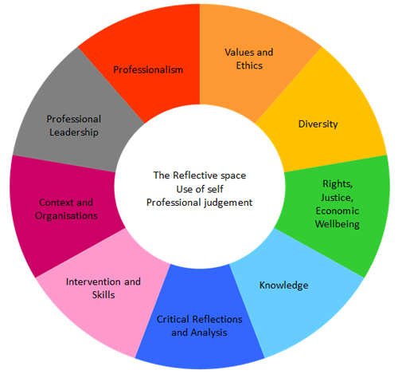
Final Exercise -
Look at the scenario and discuss how you would evidence the PCFs when completing a support plan.
Also, what theories and models can be applied….
Notes:
Reflective donut using the PCF

Slide 19
Direct Payments Learning Resources
The following hyperlink contains several coproduced learning videos and resources by Think Local Act Personal (TLAP) to support your development and knowledge of Direct Payments (DPs).
A direct payment allows adults with assessed eligible needs under the Care Act (2014) to receive money in the form of a ‘personal budget’, directly from the Council. The promotion of DPs forms part of a personalisation agenda and enables adults and family’s flexibility and choice in their care planning arrangements.
DP Standard Operating Procedure (SOP) on the Information Hub https://www.salfordappp.co.uk/wp-content/uploads/2024/07/SOP-direct-payments-and-contacting-Penderels-July-2024.pdf
Notes:
Assessment: You must first be assessed by social services and determined to have eligible social care needs.
Personal budget: A "personal budget" is calculated, which is the amount of money set aside to pay for your care and support.
Direct payments: You can choose to receive this amount as a direct payment to manage yourself.
Support plan: You will create a support plan that outlines how you will use the direct payment to meet your needs.
Funding: The money is often paid via a pre-paid card, though you may have to pay a financial contribution depending on your circumstances and the local authority's policies.

Slide 20
Thank you all for attending and to Beecared4
Feel free to share any feedback for the development of future sessions Shoyley.Chowdhury@nca.nhs.uk

