Slide 1


Effective Care Planning
A Domiciliary Care Perspective
Notes:
Explain why we are there, what's it all about

Slide 2
Core Objectives
Essential Requirements
Individualised Care
Time Management
Expectations Vs Reality
Hidden Extras
What to expect from US!
Notes:
Introduce the themes of the presentation

Slide 3
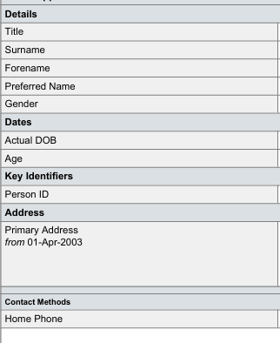
Essential Requirements
Basic information
Required to input onto the agency Electronic Monitoring System
CQC requirement
Notes:
Explain what and why we require the crucial fields to be completed

Slide 4
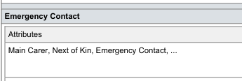
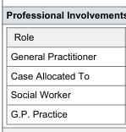
Notes:
Explain what and why we require the crucial fields to be completed

Slide 5
Individualised Care
Basic outline of what care is required and why
Brief history of background of Individual
What is working well
What is not working well
Family involvement
RISK FACTORS!
Medical conditions
Sensory or Mental Health Concerns
Notes:
Why we need specific information

Slide 6
Time Management
Each Individual is just that an Individual
Timings for tasks will vary
Mobility is Key – realistic expectations of tasks and timings
Impact of Dementia – Understanding, reluctance to receive care, time for gentle persuasion
Timings and requirements change regularly
Realistic Time Values – Remember a set time cannot be assigned for a task due to individual differences
Notes:
Each individual will require assessment for different timings for each task required, regular reviews. Include the hidden extras!

Slide 7



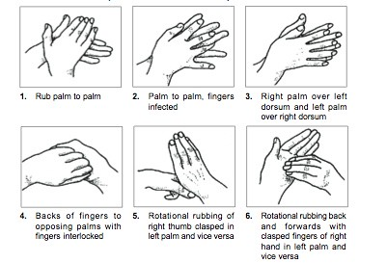
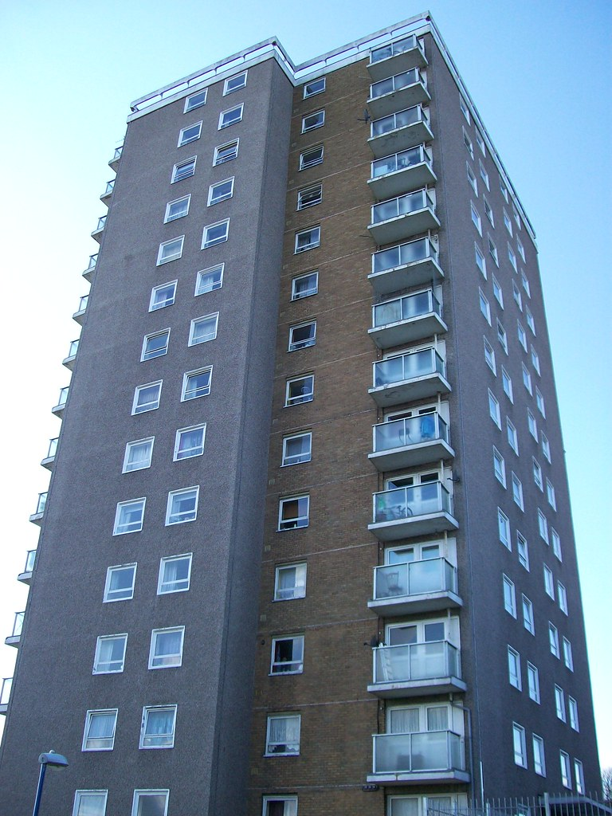
Hidden Extras
What are the Hidden extras?
Notes:
PPE, Donning and Doffing, Handwashing, log in, out and notes and gaining entry. These all take time and are rarely included in calculation of visit timings

Slide 8
Expectation VS Reality!
Let's Look at Good and Poor Careplans!
Poor – Can you see what's missing?
Good – What makes this good?
Notes:
Hand out examples of a good and poor careplan, open discussion on both with feedback.

Slide 9

What to Expect From US!
Excellent care provision
Personalised Care – Individual at the Core
Attendance at Reviews
Transparent Communication
Provision of care notes when Requested
Collaborative Working
Notes:
Explain what we provide and what we will ensure is available

