Slide 1


Social Work Careers Session
Job Applications & Interviews
Salford Adults & Childrens

Slide 2
Agenda for today’s session
1. Applying for Social Work jobs
2. Job Application forms
3. Interview Preparation
4. Social Work job roles in an Adults setting
5. Social Work job roles in a Childrens setting
6. Questions & Reflections
Notes:
Please free to share any comments or questions during the session, keep it interactive.
What are you hoping to gain from this session?
This session is based on perspectives in Salford; however, you can also take this into any social work jobs you apply for.
Kept information from Salford Childrens, should any of you have an interest in this area.

Slide 3

1. Applying for Social Work Jobs
What do I need to consider when applying?
When is the right time to apply for jobs? During or after the course's finish?
Practice area of interest? Adults, Children, Learning Disability, Mental Health…
Where do I want to work? Location, area, travel, work-life balance
Contracts? Permanent, Temporary or Agency
Working Hours and Salary? Caring responsibilities and finances
Job description? Expectations of the role and responsibilities
Person specification? Meeting all the essential criteria. Transferrable skills from integrated training programme and placement experiences
What will this post offer me? Learning and development opportunities, progression and staff benefits, reasonable adjustments, how are Newly Qualified Social Workers (NQSWs) supported in the organisation?
Notes:
Apply at a time that feels right for you
Do you have a particular area of interest? Speak to peers and colleagues if you’re undecided. Or keep an open mind.
Location can be important, given the commute times. Think about public transport links if you don’t drive.
Check contract arrangements of the job role, think about if you want something permanent or flexibility to move around
Working hours, some jobs may require you to work in evenings or over the weekend.
More on JD and PS in next slides
What will the post offer you? How will it support your future professional goals.

Slide 4

1. Applying for Social Work Jobs
Where do I search for jobs?
Northern Care Alliance (TRAC):
Search and apply :: Northern Care Alliance Careers
Personal Social Services job search | trac.jobs
Salford City Council:
Job vacancies at Salford City Council•Salford City Council
Greater Manchester Jobs:
greater.jobs - Home Page | greater.jobs
Other options:
Indeed
Total Jobs
Reed
Jobsite
Agencies:
Liquid Personnel
Social Work Recruitment
Notes:
Student careers fair has now passed, and these are excellent opportunity to find out more information
EMPLOYABILITY WORKSHOPS
INTERVIEW SIMULATION
WORKSHOPS
Q&A PANELS WITH NQSW
AND EMPLOYERS
ASYE WORKSHOPS
GM EMPLOYER STALLS

Slide 5
2. Job applications forms
Helpful pointers
Read everything carefully before you write anything: Job Advert, Job description, Person Specification and additional documents
Pay focus to Job Description and Person Specification: Skills, knowledge, work and life experiences, and personal qualities/attributes
Sell yourself: What you’ve professionally and personally achieved
Be relevant: Answer questions fully, but succinctly, don’t waffle
Language: Use anti-oppressive language
Gather your information: Certificates, academic achievements, employment history, referees
Research the organisation: Understand the organisational aims, values, ethos, direction, Ofsted reports
Honesty and Integrity: Experience and DBS disclosures
Speak to the employer: Job adverts have a point of contact for further details and to arrange an informal visit
Check the Closing Date: Late applications are not accepted
Let's look at example job descriptions and person specifications…
Notes:
Completing a job application is the first stage where employers get an opportunity to view applicant’s skills, experience, and knowledge relating to the advertised position. This process helps hiring managers to make judgements on candidates they wish to select for the next stage which is the interview. Therefore, it is important at this stage that students sell themselves, demonstrating their abilities that will help them to stand out in a competitive market.
Organisations receive lots of job applications. It’s useful to understand how these are evaluated, here’s some helpful points to consider.
Activity Provide handout – example job description and person specification for Adults and Childrens.
Provide 5 mins and ask group what stands out and if they have any questions or need further clarity.

Slide 6

2. Job applications forms
What do Social Work employers look for?
Commitment to people, voice of child, voice of adult, promoting empowerment
Personal attributes, empathetic, calm, respectful, reliable, can practice self-care….
Passion for social work, core values, enthusiasm, motivation, professionalism….
Skill set good communication, analytical, written, time management, multidisciplinary working….
Social work knowledge, understanding of legislation, statutory duties, role, responsibilities;
Evidence-informed practice, understanding of theories, models, approaches and research.
Practice examples, or hypothetical if you have not had the experience yet
Value based practice anti-oppressive, person-centred, strengths-based, Equality and diversity
Continuing Professional Development (CPD), reflective practice, awareness of strengths and development, use of supervision
Assessed and Supported Year in Employment (ASYE), some understanding of what the ASYE programme is
Don’t worry you aren’t expected to know everything
E.g. “I am a good communicator”, how, example, outcome?
“I understand the Care Act 2014”, how, key principles, impact?
“I’ve completed child and family assessments”, how, key principles, impact?
Notes:
Practice Examples - Or where you have not had direct practice show your knowledge and understanding.
Share analogy for STAR method https://www.vawizard.org/wiz-pdf/STAR_Method_Interviews.pdf Situation - Task - Action – Result (resource is at the end of presentation)
Understanding of key social work standards, Professional Capabilities Framework (PCF), Social Work England (SWE) Standards, Post Qualifying Standards (PQS) (Adults & Childrens)
You will be bringing lots of transferrable skills and experience from completing the Integrated Course (Learning Disability Nursing & Social Work)

Slide 7


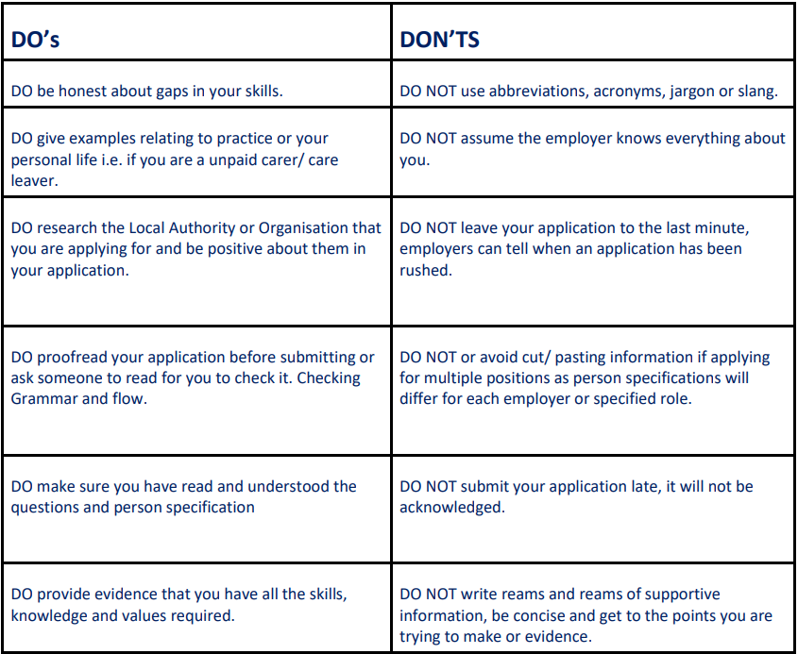
2. Job application forms
Do’s and Don'ts
Notes:
What employers are looking for in an application
Your skill set, communication, written, analytical skills, and evidence of these skills in your application.
Your knowledge of Social Work, information relevant role, legislation, values, responsibilities, and duties required, evidence of these in your application.
Case examples relating to the question eg: I am a good communicator- HOW. Back this up with a brief example. I understand the Care ACT- HOW?
Sounds simple but answer the question! You will be surprised how many applicants don’t get shortlisted as they have missed the point of the question.
What would make an employer reject an application?
Not enough effort
Poor spelling and grammar throughout
Not having the correct credentials ie: the right qualification, driving license if essential car user
Disrespectful language or use of ‘slang’ or abbreviations (these differ in each local authority/ organisation)

Slide 8
3. Interview preparation
Helpful pointers
Read contents of job application (job advert, description, person specification and other attachments); make notes on areas you will be measured in interviews
Be clear about interview process, location, duration, who is interviewing, format of interview (questions/answers, written task, presentation…)
Practice test questions, rehearse beforehand
Prepare examples using star technique Situation, Task Actions, Results. If asked about something you haven’t done, use a hypothetical example (transferrable skills/knowledge)
Don’t be modest – sell yourself, be positive, enthusiastic, engaging
Prepare example questions to ask interviewees at the end: ASYE, future training, career opportunities, direction of the organisation
Leave a good final impression – Thank everyone on interview panel and that you look forward to hearing from them
Notes:
Keeley
Interviews are a key opportunity for you to show hiring managers that you are the best person for the job, and equally for the interviewer, there is pressure in ensuring they find the right person for the role.
Where supportive statements are requirement a useful model to use is the CAR Model (Bluesteps (2011) CAR Interview Techniques). Supporting statements need to provide evidence of the skills, attributes and knowledge the employer is looking for. The CAR model is useful for this: • Context: What was the situation or your understanding of the issue, what was the task/process were you required to carry out? Keep it brief, but specific. • Action: What did YOU do? What was YOUR role? What actions did YOU take? Give practice examples using active language. – link theory/research as well as knowledge, skills and values to your practice examples • Result: What was the outcome? What did you achieve? What was improved? Qualify and quantify. – link to knowledge skills, values
USE your examples to demonstrate how you can do something as well as understand it

Slide 9

3. Interview preparation
Practical pointers
Body language, keep open, smile and good eye contact
Ask for question to be repeated if needed, you can return to a question
Keep speech clear, confident and at a moderate pace
Keep your phone and email alerts on silent
Dress to impress
Check you have any requested documents (CV, ID…)
Try and get a good night sleep beforehand
Virtual interviews, check connection/log ins/devices
Use paper, pens, notepad
Try and keep calm – practice breathing exercises and mindfulness prior to attending
Arrive at least 10-15 mins early if face to face. Not too early or late
Take a bottle of water – keep hydrated
Be aware of your own triggers
Notes:
A virtual interview should be treated the same as a face-to-face interview. Individuals needs to be presenting themselves in a professional way, i.e. not slouching on a sofa.
“Mindfulness and breathing techniques can help you enter your body and mind into a state of calm, helping you to relax and focus.”

Slide 10
3. Interview Preparation
Mock/example questions
Why have you chosen a career in Social Work? What knowledge, skills and experiences will you bring to the role.
Could you tell us about an occasion where you have managed a difficult situation? How were positive outcomes achieved and what was your key learning.
What is the role of a Social Worker in a safeguarding process?
Can you explain what the Social Work role is in a multidisciplinary team (MDT) setting and what are the benefits of MDT working?
What is your understanding of working in a strength’s-based way?
Notes:
Shoyley
15-minute exercise – Pair up with someone, pick a question and plan how you would answer your chosen question.

Slide 11
Experience of recent NQSW Helpful pointers
Start applying jobs at a time that is right for you, there is plenty of jobs out there!
Make a list of all things you need or want to complete on your final placement in preparation.
Book spoke placements and shadowing experiences with as many different teams as possible, it all counts!
Think about your transferable skills from all of the different placements. These are all helpful in social work.
Feeling unsure is normal, you have a lot of skills to bring to the world of social work.
When applying for jobs, try to use examples from placement to demonstrate you meet the essential or preferred criteria.
Ask at interviews about what support is offered when completing the ASYE program. This is vital for your growth as a practitioner.
When in post, utilise your supervision and all training opportunities. It really helps

Slide 12
5. Social Work job roles in an Adults settings
The Adult Social Care (ASC) workforce is made up of a variety of professionals who work in Community and Hospital settings.
We have statutory responsibilities under the Care Act 2014 to provide assessment and support to adults and carers (where eligible), to help promote people’s independence, wellbeing, their outcomes, and safeguard to minimise the risk of harm.
The Care Act well-being principles are central to our practice, to:
Key legal frameworks underpinning our statutory duties, legal interventions, and professional decision making include the:
Work in partnership with the people we support
Empower people to make their own decisions
Keep people safe without being risk averse or RESTRICTIVE
Have high aspiration for people
Provide people choice and control over their lives
Maximise independence AND strengths
Prevent and reduce the need for support
Care Act 2014
Mental Capacity Act 2005
Mental Health Act 1983
Human Rights Act 1998
Equality Act 2010
Data Protection 2018
Notes:
Shoyley

Slide 13
5. Social Work job roles in an Adults settings
Key roles & responsibilities:
Carrying out Social Care functions, in accordance with legislation, policies, procedures & best practice.
Social care assessments for Adults in possible need of care and support; and for their Carers
Arranging and reviewing care and support (for eligible needs)
Outcome-based support planning
Duty to carry our safeguarding enquires for adults who are at risk of abuse or neglect
Providing access to advocacy services
Mental capacity assessments, Best interests planning, knowledge of Deprivation of Liberty Safeguards
Strengths-based & person-centred practice
Relationship based practice
Prevention and early intervention, i.e. use of community led support, assistive technology, equipment
Multidisciplinary working and professional leadership
Effective risk management and conflict resolution
Reflective practice, supervision and on-going CPD
Contribute towards the development of services to benefit adults, their children & families
Notes:
The statutory guidance for the Care Act 2014 embeds strengths-based working as a requirement when it directs us to: consider the person’s own strengths or if any other support might be available in the community to meet the outcomes they want to achieve. We have a responsibility to identify ways to reduce, delay, or prevent their need for future care and support, and improve wellbeing.
CHC, court work, appointeeships, deputyships, direct payments…

Slide 14
5. Social Work job roles in an Adults settings
Types of Adult Social Care and Mental Health teams include –
Integrated Neighbourhood Teams (Generic Adults Teams)
Learning Disability Team
Sensory Team
Transition Team
Contact Team (Front door service)
Community Mental Health Teams (from 18 to Older Adults)
Forensic Social Work Team
Hospital Social Work Teams (Acute, Neuro)
Intermediate Care Team (Rehabilitation, Home First, Step down)
Deprivation of Liberty Safeguards (DoLS)
Safeguarding Teams
Notes:
Shoyley
The statutory guidance for the Care Act 2014 embeds strengths-based working as a requirement when it directs us to: consider the person’s own strengths or if any other support might be available in the community to meet the outcomes they want to achieve. We have a responsibility to identify ways to reduce, delay, or prevent their need for future care and support, and improve wellbeing.
Forensic social workers are generally based within secure hospitals, with community support for offenders discharged from secure hospitals being provided by multi-disciplinary workers in mental health teams.

Slide 15
6. Social Work job roles in a Childrens settings
Children’s Services workforce is made up of a variety of professionals and teams.
We have statutory responsibilities under the Children Act 1989/2004 which places a duty on Local Authorities to safeguard and promote the welfare of children in their area who are in need.
This includes working with partners to promote prevention and early intervention and offer early help so that emerging problems are dealt with before risks increase.
Key legal frameworks underpinning our statutory duties, legal interventions, and professional decision making include the:
Children Act 1989/2004
Children and social work Act 2017
Working together to safeguard children 2023
Human Rights Act 1998
Children Act (Leaving care) 2000

Slide 16
6. Social Work job roles in a Childrens settings
As a children’s social worker You will work directly with children and their carers using a range of knowledge, skills and interventions as required, in accordance with statutory responsibilities to secure positive outcomes for children.
• You will build effective relationships with children, young people and their families enabling full participation in assessment, planning, review and decision making.
• You will effectively manage a caseload, with varying degrees of complexity dependent upon skills and length of experience, with appropriate supervision, guidance and support.
• You will work in accordance with national and local policies and procedures, and use the law, regulatory and statutory guidance to inform practice decisions.
• You will prepare and producing a variety of high quality professional written documentation including child and family assessments, risk assessment, court documents fostering assessments, child permancy reports .
• You will work with partner agencies at a range of meetings, proceedings and reviews as required. You will secure access to services, negotiating and challenging other professionals and organisations to provide the help required
• You will provide support based on best evidence, which is tailored to meet individual child and family needs and which addresses relevant and significant risks.

Slide 17
6. Social Work job roles in a Childrens settings
Types of Children’s Social Care teams include –
Duty and Assessment
Child protection and child in need team
Children with Disabilities team
Cared for children’s team
Leaving care service (next steps in Salford)
Youth justice team
Fostering team
Adoption
Complex Safeguarding
CAMHS
Early Help and Parenting services

Slide 18

Recap of today's agenda & questions
1. Applying for Social Work jobs
2. Job Application forms
3. Interview Preparation
4. Social Work job roles in an Adults setting
5. Social Work job roles in a Childrens setting
6. Questions and reflections
Any questions & reflections?

Slide 19

Good Luck
Remember employers want you….
Just as much as you want the job

Slide 20
Resources
Student Hub – GMSWA
STAR method https://www.vawizard.org/wiz-pdf/STAR_Method_Interviews.pdf Situation - Task - Action – Result
Adult Social Work Interview Tips Update 2024
Child and Family Post Qualifying Standards
Adult Services Post Qualifying Standards
Contact us and Useful Information – Salford Adult Social Care Information Hub (Salford specific)
Search results | Prospects.ac.uk

