Slide 1
Salford Adults Social Work Student Reflective Session
Tuesday 3 February 2026
Facilitated by the ASC Learning and Development Team
Notes:
Student connectedness
Reflective practice
Develop knowledge and confidence
Non-judgemental safe space, to share experiences and ideas

Slide 2
Housekeeping
Time for Reflection
Listening and partaking
Respecting others' opinions
Self-Care
Confidentiality
Phones on Silent
Notes:
Explain role and ask everyone to introduce self – name, university and number of days in placement.

Slide 3

Introductions
Who is here?
Notes:
Name, team and university
Number of days into placement

Slide 4
Today's session
Well-being reflective activity
Adult Learning Styles
Training and Developmental opportunities
Salford Adult Social Care Vision & Organisational Structuring
Greater Manchester (GM) Social Work Careers Fair March 2026
Notes:
We have a mixture of activities today

Slide 5

Reflective Activity
Notes:
Choice between Jelly Baby tree or Emotions/Pictures

Slide 6
Adult Learning Styles There are many definitions and theoretical perspectives about adult learning, a couple include;
“One must learn by doing the thing; though you think you know it, you have no certainty until you try”. (Sophocles, 495-406 BC – taken from Race, 2002)
Adult Learning Theory or andragogy is the concept or study of how adults learn and how it differs from children. It aims to show how adult learning is distinct and identify the learning styles which suit them best. (Malcolm Knowles, 1970)
Notes:
Adult learning theories differ to that of children
Different models of learning have a different focus, and different preoccupations,
People learn differently, and this can be dependent on internal factors – such as a person’s level of aptitude and motivation – or external factors, like the person’s learning environment
The First Example is from the work of Malcolm Knowles. Knowles described 5 assumptions about the characteristics of adult learning
Self Concept (becoming dependent to self directed/independent)
Adult Learner Experience (growing reservoir of knowledge)
3. Readiness to learn (to become more confident and familiarised with own role)
4. Orientation to learning (learning shifts)
Motivation (Becomes internal and Intrinsic)

Slide 7
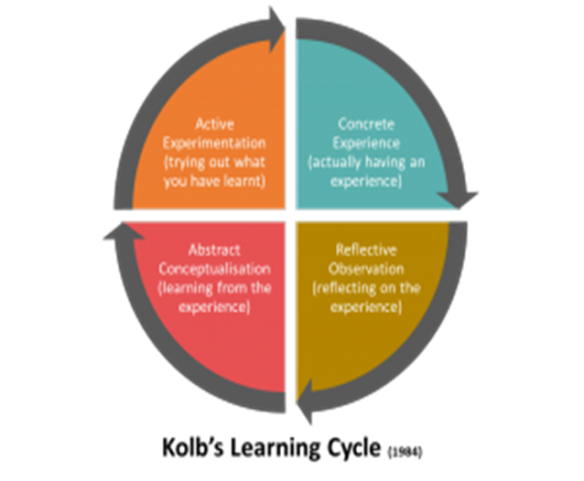
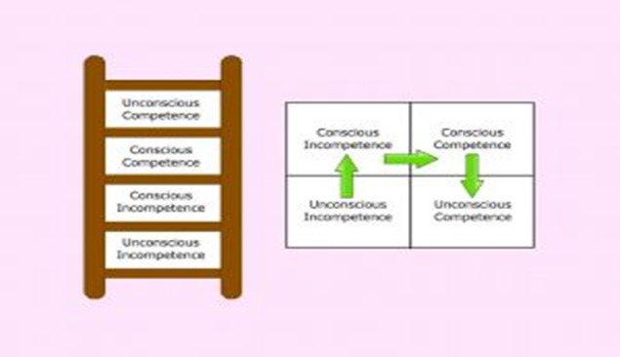
Learning Styles
Experiential Learning (Kolb, 1984)
Going through the cycle to learn
Spending time reflecting on the experience
Ladder of Learning
Used to understand how cognitive dissonance can be created during a learning process
4 phases when asked to learn something new
Can feel uncomfortable at phase 2 – Consciously incompetent. Steps needed to restore balance.
Notes:
Kolb (1984) – It's not just enough for someone to have an experience; without reflecting on these. Kolb suggests you have to go through the cycle to promote learning and growth. Educators can deploy coaching conversation techniques to draw learning. Some learners could become ‘stuck’ at certain parts of the learning cycle for example “active experimentation”, what would I do differently next time.
Experience: Provide a relevant experience for them and encourage them to value the experience
Reflection: What was happening? How did you feel?
Conceptualisation: support to see bigger picture and create meaning. Link to organisation, legislation, theories, values/ethics and PCF
Active Experimentation: Using learning in new experiences and plan what to do next time, how would you approach the same situation again.
Ladder of Learning – Longstanding model used in understanding learning. We use it to understand how cognitive dissonance can be created in a learning process, which is a theory that people feel a sense of dissonance when there is conflict attitudes, beliefs and behaviours.
Unconscious incompetence – blissful ignorance
Conscious incompetence – Becoming aware we don’t know. Can be a painful and uncomfortable stage, some people give in and other take actions to take control and restore balance
Consciously competent – learnt a new task and quite conscious of it.
Unconsciously competent – familiar with a task and confident about task. Could potentially become dangerous if we do not check we are still doing it right?
Understanding of dissonance is useful if a NQSW is struggling with something.

Slide 8
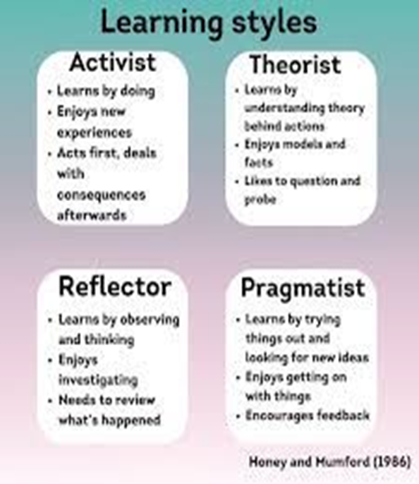
Learning Styles
The Honey & Mumford (1986) Learning Styles questionnaire is a useful tool to complete at the beginning, middle and end of placement
Each learning style is characterised by certain traits and preferred methods of learning
There are advantages and pitfalls to all these learning styles; a balance of all four is useful
Let's give it a try……..which learning style do you have?......how can you use this?
Notes:
Most of us have a preferred and dominate learning style, it can be useful to ascertain and determine what this is. Awareness can help us understand how we learn best
When people working together have very similar learning styles can be problematic if these are not acknowledged and conscious steps to manage, both activists and like a hands-on approach, but do not focus on reflecting or understanding theoretical perspective
The questionnaire holds limited validity and should be used with cautious. The tool was created on findings from a small homogenous group of male business managers (Swailes & Senior, 1999); reducing it applicability to individuals of different educational backgrounds, gender and ethnicity.

Slide 9

Learning Styles Activity
Cross your arms
Notes:
Task- Say doing activity “please can everyone cross your arms”– auditory, then show instruction on screen “cross your arms text” and picture visual, do- kinestheic, then ask to cross the other way (left/right or right/left)
Learning Styles: It illustrates that people have a preferred learning style (e.g., visual, auditory, kinesthetic). When forced to learn in a different modality (like being a kinesthetic learner and being given a leaflet to read), it can feel as awkward and inefficient as folding your arms the "unnatural" way.
Change Management: It's a powerful, quick metaphor for showing why learning new things can be difficult and that changing established habits/behaviours is difficult, even when the new way is theoretically just as valid as the old.
Empathy: It helps build empathy for others who do things differently, showing that their way is not "wrong," just different

Slide 10
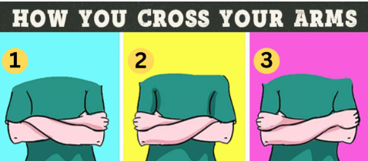
Learning Styles Activity

Slide 11

Notes:
5 minutes

Slide 12

Mandatory Training and CPD
Learning Hub- Mandatory Training and CPD My Hub :: Northern Care Alliance
Upcoming Training | Salford Safeguarding Adults Board
SSCP Training Programme | Salford Safeguarding Children Partnership
Research in Practice Dashboard | Research in Practice
Training Bulletin

Slide 13

SCARF Health and Wellbeing
Courses Available Find learning
Trussell Trust Foodbank Voucher Request Form

Slide 14
Organisational Context
Adult Social Care in Salford is part of the Northern Care Alliance (NCA) Foundation Trust and Greater Manchester Mental Health (GMMH) Trust
We are the only fully integrated organisation in Greater Manchester.
Our workforce is made up of a variety of professionals who work in Community and Hospital settings. There are approximately 400 staff in several roles across the service.
We have statutory responsibilities under the Care Act 2014 to provide assessment and support to adults and carers (where eligible), to help promote people’s independence, wellbeing, their outcomes, and safeguard to minimise the risk of harm.
The Care Act well-being principles are central to our practice, to:
Work in partnership with the people we support
Empower people to make their own decisions
Keep people safe without being risk averse or RESTRICTIVE
Have high aspiration for people
Provide people choice and control over their lives
Maximise independence AND strengths
Prevent and reduce the need for support
What other legislation do we use to inform our statutory duties, roles and responsibilities?
Notes:
PCF 8 Engage with, inform, and adapt to changing organisational contexts, and the social and policy environments that shape practice. Operate effectively within and contribute to the development of organisations and services, including multi-agency and inter-professional settings
We are committed to high standards in social care and to working closely in partnership with the people of Salford, other professionals, carers, care providers and the voluntary and community sector.
Adult Social Care in Salford is part of the Northern Care Alliance (NCA) Foundation Trust and Greater Manchester Mental Health (GMMH) Trust, which means we are employed and work for the NHS. Adult Social Care in Salford used to be directly in Salford City Council until 2016, when health and care partners in Salford created Salford Integrated Care Organisation (SCO), with the NCA as the primary provider of health and social care in Salford. The Director of Adult Social Services (DASS) remains with Salford City Council which retains the statutory duties and responsibilities. However, the NCA and GMMH carry out the provision and operational delivery of Adult Social Care and Mental Health functions, on behalf of Salford City Council pursuant to a legal agreement, including assessments, case management and safeguarding. We are the only fully integrated organisation in Greater Manchester.
Key legal frameworks underpinning our statutory duties, legal interventions, and professional decision making include the:
Mental Capacity Act 2005
Human Rights Act 1998
Equality Act 2010
Mental Health Act 1993
Data Protection Act 2018

Slide 16
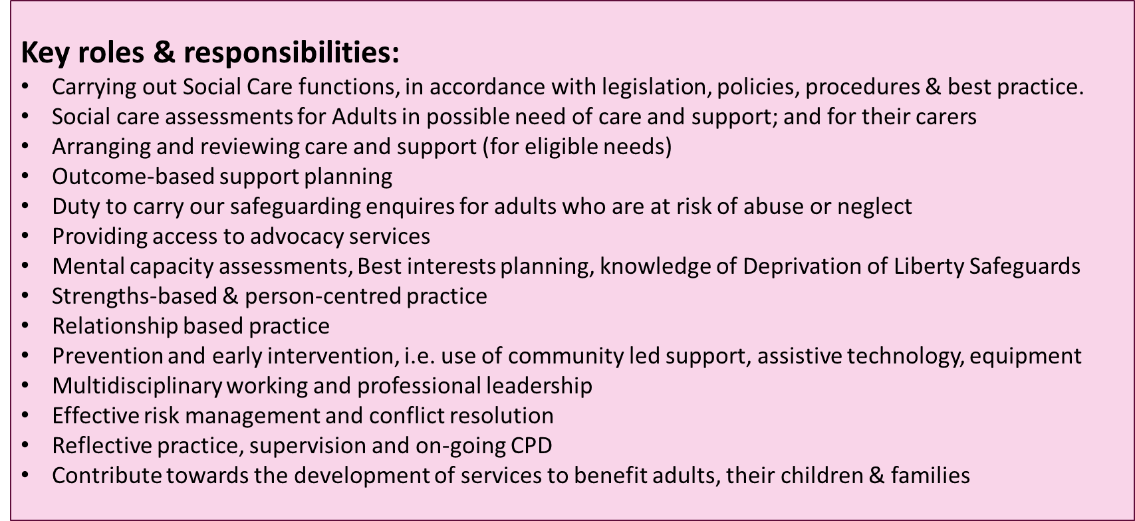
This is not everything, but it helps to provide an overview of our varied roles

Slide 17
Types Salford Adult Social Care and Mental Health teams include –
Integrated Neighbourhood Teams (Generic Adults Teams)
Learning Disability Team
Sensory Team
Transition Team
Contact Team (Front door service)
Community Mental Health Teams (from 18 to Older Adults)
Forensic Social Work Team
Hospital Social Work Teams (Acute, Neuro)
Intermediate Care Team (Rehabilitation, Home First, Step down)
Deprivation of Liberty Safeguards (DoLS)
ASC Learning and Development Team

Slide 18

Greater Manchester Social Work Academy Careers Fair
The event will include:
GM employer stalls
ASYE workshops and
Q+A with Newly qualified social workers
Employability workshops
Q+A with employer partners
Principal Social Worker Messages
And much more …..
Date and Time: Thursday 5 March 2026, 10am-4pm (registration from 9.30am)
Venue: University of Salford, Maxwell Building, 43 Crescent, Salford, M5 4WT
GMSWA Social Work Careers Fair 2026. Student Registration
Notes:
Our annual Careers Fair is an opportunity for Social Work students to find out what career opportunities are on offer across all our partners in Greater Manchester. The GMSWA Careers fair 2026 will be hosted by The University of Salford on 5th March 2026. PSWs from Salford Adults and Childrens will be doing the opening
When is the right time to apply for jobs? During or after the course's finish?
Practice area of interest? Adults, Children, Learning Disability, Mental Health…
Where do I want to work? Location, area, travel, work-life balance
Contracts? Permanent, Temporary or Agency
Working Hours and Salary? Caring responsibilities and finances
Job description? Expectations of the role and responsibilities
Person specification? Meeting all the essential criteria. Transferrable skills from integrated training programme and placement experiences
What will this post offer me? Learning and development opportunities, progression and staff benefits, reasonable adjustments, how are Newly Qualified Social Workers (NQSWs) supported in the organisation?

Slide 19
Thank you for attending
What do feel would be helpful for future sessions?
Notes:
Ideas;
Social Graces
Theories and models to practice
Direct Observations of Practice
Interview prep
Find out more on ASYE
Mini session on safeguarding

