Slide 1
Self Neglect and Hoarding
ASYE Reflective Session – February 2026
Notes:
Topic will cover self neglect in the context of Adult safeguarding.
Self neglect can be in many different forms:
Hoarding is a behaviour which may lead to safeguarding concerns.
In Salford there is a high prevalence of hoarding concerns, so that is why there is more of an emphasis of this area during our session.

Slide 2
Housekeeping
Time for reflection
Listening and contributing
Respecting other’s views and opinions
Self care
Confidentiality
Phones on silent
Notes:
Self-care, certain discussions could invoke or trigger certain emotions either on a professional basis or due to your own lived experiences. Reminder to take care of selves and know we are here to support in a safe space. If any discussions are having an impact, please step away and take a break as needed.
Are there are any other housekeeping matters you feel need adding?
Toilets are outside to the right. There will be short break halfway through

Slide 3
Parts | Agenda Points
Part 1 - Definitions and causes of Self Neglect | What is self neglect? Types of self neglect What can lead to self neglect
Part 2 - Hoarding (in context of Self-Neglect | What is hoarding? Possible signs of self neglect and hoarding Why might someone hoard? When hoarding becomes a problem Clutter Image Rating Tool
Part 3 –Working with people who Self-Neglect | Ways to support someone who self neglects or hoards Theories and models
Part 4 – Legal Frameworks, policies, procedures | Self-neglect, hoarding and the law Mental capacity Additional legislation Is it a safeguarding concern? Partnership working and information sharing Salford High Risk Advisory Panel Policies and Procedures
Part 5 – Key principles | Advocacy Risk assessment Professional curiosity Cultural competence

Slide 4
Exercise
Let’s start with a quick self check
On a scale of 1 to 10, how confident are you in your knowledge of self neglect and hoarding?
1 – I know nothing about these topics
10 – I’m highly knowledgeable and could explain them to others
What made you choose that number? (Think about your experience, previous training, or what you’ve encountered in this or other roles).

Slide 5
What is self neglect?
Part 1 - Definitions and causes of Self Neglect
Statutory Guidance (Paragraph 14.17):
“A wide range of behaviour neglecting to care for one's personal hygiene, health or surroundings and includes behaviour such as hoarding.”
Before 2014
Self-neglect was outside adult safeguarding systems.
Guidance at the time (DH, 2000) focused on abuse and neglect by others, not self-neglect.
Many Safeguarding Adults Boards (SABs) excluded self-neglect from their remit.
Result: In some areas, agencies worked together on risk management, but elsewhere, self-neglect became nobody’s responsibility (Braye et al., 2014).
After the Care Act 2014
The Act introduced a broad definition of adults in need of care and support.
SABs now have a statutory duty to help and protect adults who:
Have care and support needs.
Are experiencing or at risk of abuse or neglect.
Cannot protect themselves because of those needs.
Self-neglect is explicitly included in statutory guidance (DHSC, 2020) as a form of abuse and neglect.
This places self-neglect firmly within the safeguarding arena.

Slide 6
Types of self neglect
Personal Hygiene
Neglecting basic cleanliness such as bathing, grooming, and changing clothes.
Impact: Increased risk of skin infections and other health problems.
Health
Failing to seek medical attention for illnesses or injuries, manage chronic conditions, or take prescribed medication.
Impact: Worsening health and preventable complications.
Surroundings
Living in unsafe or unsanitary conditions, including hoarding.
Impact: Fire hazards, pest infestations, and increased risk of falls.
Nutrition
Not eating properly or relying on spoiled food.
Impact: Malnutrition and related health issues.
Social Isolation
Withdrawing from social contact and support networks.
Impact: Decline in mental and physical well-being.
Homelessness
Self-neglect can both contribute to and result from homelessness, especially when safety and stability are absent.
Impact: Increased vulnerability and health risks.

Slide 7
What can lead to self neglect?
Mental Health Conditions
Depression, anxiety, dementia, and other mental health disorders can reduce motivation and ability to maintain self-care.
Physical Illnesses
Chronic illnesses and physical disabilities can make everyday tasks challenging.
Substance Use
Alcohol and drug use can impair judgment and motivation, leading to neglect of basic needs.
Trauma
Past or ongoing trauma can result in social withdrawal and difficulty maintaining self-care routines.
Lack of Support
Individuals without strong social networks are more vulnerable to self-neglect.
Homelessness
Homelessness increases vulnerability due to lack of stability, safety, and security. Often, multiple risk factors are present in these situations.

Slide 8
What is hoarding?
Part 2 - Hoarding
Definition (NHS):
A hoarding disorder is when someone acquires an excessive number of items and stores them in a chaotic manner, creating unmanageable clutter. These items often have little or no monetary value.
Why is Hoarding a Concern?
Hoarding is increasingly recognised as a significant challenge for social care and allied professionals. Its consequences can include:
Severe emotional distress and/or relationship breakdown
Restricted social and home living activities
Poor sanitation and related health risks
Increased fire hazards
Risk of eviction
Legal and Safeguarding Context
Care Act 2014 Guidance: Hoarding is specifically listed as a behaviour that can constitute self-neglect.
Self-neglect is recognised as a form of abuse or neglect that may trigger safeguarding concerns.
Hoarding situations may be escalated to safeguarding where appropriate and/or supported through a Section 9 Care Act assessment.
Mental Health Perspective
Hoarding disorder is now recognised as a psychiatric diagnosis, reinforcing its status as a mental health issue. The definition is contained in DSM-5 (Diagnostic and Statistical Manual of Mental Disorder)
Notes:
'A psychiatric disorder characterised by persistent difficulty discarding or parting with possessions, regardless of their actual value resulting in significant clutter that obstructs the individual's living environment and produces considerable functional impairment.' (GMFRS Hoarding, Prevention and Protection). DSM-5 (Diagnostic and Statistical Manual of Mental Disorders, 5th Edition)

Slide 9
Possible signs of self neglect and hoarding
Self-neglect can manifest in various ways. Here are key indicators to watch for:
Unsanitary or Hazardous Living Conditions
Example: blocked toilet with faeces, accumulation of rubbish, vermin infestation.
Neglect of Household Maintenance
Hazards such as broken flooring, unsafe wiring, or uncleanliness to the point of causing risk.
Obsessive Hoarding
Leading to mobility restrictions and increased fire risk.
Animal Collecting
Resulting in poor hygiene and neglect of animals’ basic needs.
Significant Lack of Personal Care
Causing a decline in health or physical well-being.
Poor Diet and Nutrition
Little or no food, mouldy food in the fridge, or reliance on expired items.
Social Isolation
Failure to maintain contact with family, friends, or community.
Financial Mismanagement
Bills unpaid, inability to manage money effectively.
Refusal or Neglect of Medical Care
Declining prescribed medication or essential healthcare support (e.g., diabetes management, wound care, podiatry).
Barriers to Professional Support
Refusing access to health or social care staff, or unwillingness to attend appointments.

Slide 10
Why might someone hoard?
Hoarding can occur for many reasons. For some, it feels useful, pleasurable, or serves as a coping mechanism. This means individuals may not always want to make changes. Practitioners must strike a balance between respecting personal choices and addressing risks collaboratively.
Common reasons for hoarding reported by individuals with lived experience (Braye et al., 2014; Kellett et al., 2010)
Childhood Experiences
Examples: not being allowed to keep possessions, emotionally distant relationships, abuse.
Ethical Concerns
Avoiding waste or ensuring responsible disposal of items.
Emotional Attachment to Objects
Strong identification with possessions or what they represent, possibly as the result of a bereavement.
“Just in Case” Thinking
Keeping items in case someone else might need them.
Perceived Value
Belief in potential monetary or practical worth of objects.
Sense of Achievement or Self-Worth
Collections as accomplishments or reminders of past successes.
Notes:
Other reasons someone might hoard:
Perfectionism
Partial sorting feels worse than none; organising only seems worthwhile if completed perfectly in one go.
Limited Space
Lack of adequate storage or living space.
Different Standards
Personal norms of tidiness and order differ from societal expectations.
Objects as Memory Anchors
Items linked to past or present relationships.

Slide 11
When hoarding becomes a problem
Hoarding becomes problematic when the amount of collected items:
Interferes with daily activities
Causes significant distress
Negatively impacts quality of life for the person or their family
It becomes a safety issue when clutter:
Creates hazards such as fire risks or vermin infestations (public health risk)
Blocks exits
Leads to self-neglect and poor health due to unsafe living conditions
Signs Clutter Is Affecting Daily Life
Restricted Use of Space
Rooms cannot be used for their intended purpose (e.g., sitting in a chair, cooking in the kitchen, sleeping in a bed).
Inability to Maintain Hygiene
Cleaning becomes impossible; cooking and personal hygiene are severely restricted.
Social Isolation
Shame and embarrassment lead to avoidance of contact with others.

Slide 12
Clutter Image Rating Tool
Salford Safeguarding Adults Board have the clutter image rating tool sat within the Self Neglect Guidance on their web pages. ​
​
clutter-images.pdf​
​
ACTIVITY​
Working in groups of three of four have a look at the images you are given and discuss:​
​
What risks are present?​
Does this meet the threshold for self-neglect?​
What immediate and longer-term actions might be appropriate?

Slide 13

This Photo by Unknown Author is licensed under CC BY-SA

Slide 14
Ways to support people who self neglect or hoard
Early Intervention
Identify and address self-neglect early to prevent serious harm.
Multidisciplinary Approach
Collaborate with healthcare professionals, housing providers and other support services to meet complex needs.
Respect and Choice
Uphold the individual’s right to make their own decisions while ensuring safety and well-being.
Building Trust
Develop a trusting relationship to encourage engagement and cooperation.
Practical Support
Offer assistance with tasks such as cleaning, cooking, and accessing healthcare.
Advocacy
Help individuals understand their rights and options to make informed decisions.
Make it Personal
Work with the individual to create a plan that respects their wishes, makes the most of their strengths and promotes well-being.
Part 3 –Working with people who Self-Neglect

Slide 15
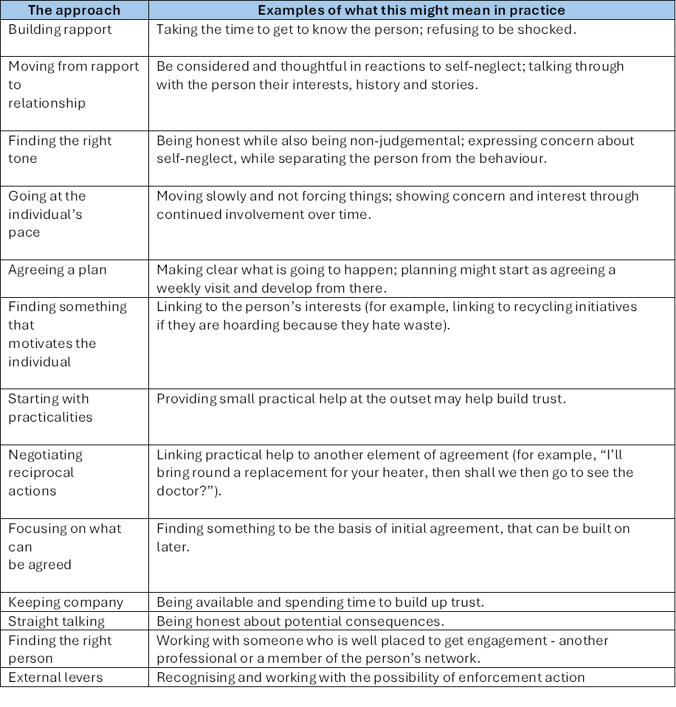
Notes:
Braye et al. (2015)

Slide 16
Ways to support people who self neglect or hoard
Monitoring
Regular visits to maintain contact, build trust, and monitor capacity and risk.
Fire Risk Minimisation
Provide safety equipment and practical advice to reduce hazards. Your Safety - Greater Manchester Fire Rescue Service
Adaptations and Repairs
Make changes to the home environment to enhance safety and reduce risks. Consider OT, handman repair services, tenancy support etc. Salford's Handyperson Service•Salford City Council
Provision of Equipment and Furniture
Improve food hygiene, fire safety, and cleanliness while strengthening relationships. Salford Assist Household Support Fund, Aldi vouchers, food banks etc.
Attention to Health Concerns
Address health issues that the individual identifies as problematic. Liaise with GP, District Nurses.
Family, Neighbours, and Community Involvement
Recognise and engage supportive networks that can contribute positively.
Safe Drinking Schemes
Support individuals in reducing alcohol intake. Achieve Salford | Greater Manchester Mental Health NHS FT
Emergency Alternative Accomodation
Offer temporary alternative accommodation to improve home conditions or test new environments where appropriate.

Slide 17
Ways to support people who self neglect or hoard
Hospital Admission
Address acute health concerns that require immediate medical attention.
Change of Living Environment
Offer a fresh start with reduced risks and access to care and support.
Deep Cleaning
Make key areas of the home safe and hygienic.
De-Cluttering
Remove selected items with the individual’s agreement to reduce hazards.
Life Management Skills
Support with setting priorities, managing finances, cleaning, and food preparation.
Care Packages
Begin with small steps to build trust and encourage acceptance of support.
Therapeutic Activities
Introduce meaningful activities to replace what is lost through giving up hoarded items or making lifestyle changes. Salford Health Improvement Service•Salford City Council
Wellbeing Matters | Salford CVS
Mental Health Services
Provide counseling and therapies to address underlying issues contributing to self-neglect.
Family and Social Connections
Engage trusted individuals to support motivation and task completion.
Peer Support
Connect individuals with others facing similar challenges for shared understanding and encouragement. Greater Manchester | Hoarders Helping Hoarders

Slide 18
Research has shown these are often common responses by people deemed to self-neglect:
I can take care of myself
I do my best to make ends meet
I prioritise and let other things go
Managing the balance between:
Protecting adults at risk of self-neglect
AND
Respecting their right to self-determination
is one of the most serious challenges for services.
This tension highlights the need for careful, ethical decision-making and person-centred approaches.

Slide 19
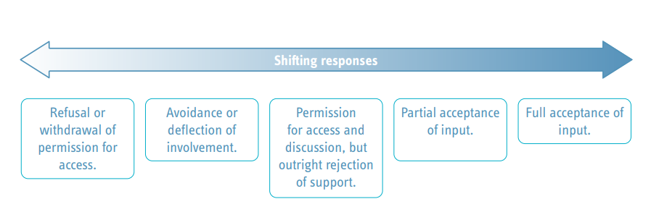

Slide 20
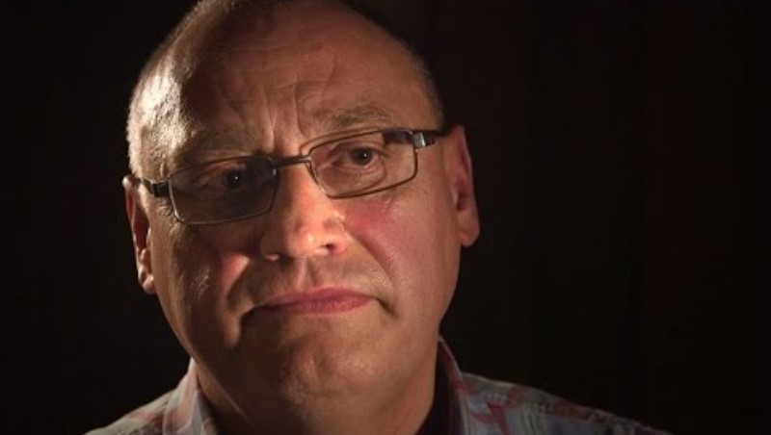
Keith’s Story – Lived Experience
How would you support someone like Keith?

Slide 21
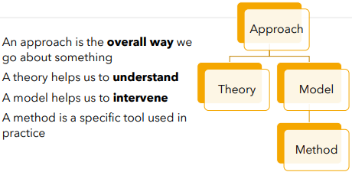
Theories and Models
Understanding Self-Neglect: Key Social Work Theories & Models
Attachment Theory
Explains how early relationships impact trust, care-seeking, and self-care behaviours.
Neil Thompson’s PCS Analysis (Oppression)
Highlights how Personal, Cultural, and Structural factors contribute to marginalisation and neglect.
Maslow’s Hierarchy of Needs
Self-neglect is often linked to unmet basic needs (physiological, safety) before higher-level needs.
Grief and Loss
Loss of relationships, health, or independence can lead to withdrawal and neglect.
Systems Theory
Considers the individual within interconnected systems (family, community, services).
Labelling Theory
Impact of stigma and labels on identity and behaviour, reinforcing neglect patterns.
Crisis Intervention
Framework for immediate support during acute episodes of self-neglect or where there is significant risk.

Slide 22
Activity
Exercise: Linking Theory to Practice in Self-Neglect
Scenario:
An adult living alone is found in a home with poor hygiene, no heating, and limited food. They refuse help, saying they “don’t want to be a burden.” They have a history of bereavement and limited family contact.
Small Group Discussion (10 minutes)
We will give you two theories per group, Identify how each theory might help us to understand or respond to this situation
Attachment Theory: How might early relationship patterns influence their reluctance to accept help?
Maslow’s Hierarchy of Needs: Which needs are unmet? How does this affect motivation?
Grief and Loss: How could bereavement contribute to self-neglect?
Neil Thompson’s PCS Analysis: What personal, cultural, and structural factors might be at play?
Systems Theory: Which systems (family, community, services) are influencing this situation?
Labelling Theory: How might stigma or labels affect engagement?
Crisis Intervention: What immediate steps could be taken if the situation becomes life-threatening?
Feedback (10 minutes)
After discussion you will be asked to feedback one key insight per theory and one practical intervention linked to that theory.

Slide 23


Slide 24
The Care Act 2014
The Care Act 2014 sets out the local authority’s powers and duties towards adults with care and support needs. The statutory guidance (DHSC, 2020) specifies that self-neglect is included in definitions of abuse and neglect, thus linking self-neglect to statutory safeguarding duties​.
Statutory Guidance (Care Act 2014, Chapters 1 & 14)
Well-being Principle (Section 1)
Concerns about self-neglect do not override the principle that any restriction on an individual's rights should be kept to the minimum necessary.
Case-by-Case Decisions
Whether safeguarding intervention is required depends on the individual’s ability to protect themselves by controlling their own behaviour. Whether a self neglect situation meets the threshold for safeguarding intervention should be decided on an individual basis in discussion with an Advanced Practitioner of Team Manager.
Multi-Agency Working
Collaboration between agencies is often the most effective way to address self-neglect. This could be via safeguarding meetings or through MDT working and information sharing.
Not all hoarding or self neglect situations need to enter safeguarding procedures. This decision needs to be made based on the individual’s circumstances, the risks involved and how able the individual is to protect themselves from that risk. Other parts of the Care Act can be used as well as or instead of safeguarding.
What sections of the Care Act do you think are most relevant to self-neglect?
Part 4 –
Legal Frameworks, policies, procedures

Slide 25
Section 1 – Well-being
Section 2 – Prevent, Reduce or Delay
Section 9 – Needs Assessment
Section 11 - Refusal of Assessment
Section 42 – Safeguarding Enquiry
Section 68 - Independent Advocacy (Safeguarding enquiries / reviews) Home - Mind in Salford
Notes:
Section 1 The general duty of a local authority, in exercising a function under this Part in the case of an individual, is to promote that individual's well-being.
A broad concept which includes
personal dignity (including treatment of the individual with respect)
physical and mental health and emotional wellbeing
protection from abuse and neglect
control by the individual over their day-to-day life (including over care and support provided and the way they are provided)
participation in work, education, training or recreation
social and economic wellbeing
domestic, family and personal domains
suitability of the individual’s living accommodation
the individual’s contribution to society
How safeguarding practices can promote well-being -
Always assume that the adult is best placed to judge their own Wellbeing;
Enable the adult to participate as fully as possible in the process and in decision making;
Always seek and take into account the views, wishes and feelings of the adult before making any decision or taking any action;
If a person is unable to express a present view, wish or feeling always take into account any past views, wishes or feelings they have expressed;
Ensure that decisions made have regard for the things that are important to the person and are not based on assumptions, preconceptions or judgements;
Never advocate risk management measures that do not take account of individual Wellbeing;
Section 2 - A local authority must provide or arrange for the provision of services, facilities or resources, or take other steps, which it considers will—
(a)contribute towards preventing or delaying the development by adults in its area of needs for care and support;
(c)reduce the needs for care and support of adults in its area;
Section 9 and Section 11 - The Local Authority must undertake a needs assessment, even when the adult refuses, where:
it appears that the adult may have needs for care and support
and is experiencing, or is at risk of, self-neglect.
This duty applies whether the adult has the capacity or lacks the capacity to refuse an assessment.
Where an adult refuses a needs assessment, the local authority concerned is not required to carry out the assessment (and section 9(1) does not apply in the adult's case).
(2)But the local authority may not rely on subsection (1) (and so must carry out a needs assessment) if—
(a)the adult lacks capacity to refuse the assessment and the authority is satisfied that carrying out the assessment would be in the adult's best interests, or
(b)the adult is experiencing, or is at risk of, abuse or neglect.
Section 42 The Local Authority must make, or cause to be made, whatever enquiries it thinks necessary to enable it to decide what action should be taken in an adult's case, when the Local Authority has reasonable cause to suspect that an adult in its area:
has needs for care and support,
is experiencing, or is at risk of, self-neglect
and, as a result of those needs, is unable to protect himself or herself against self-neglect, or the risk of it.
Section 68
Advocacy is often under used in safeguarding situations.
It is important for practitioners working with adults to understand the requirements for advocacy.
The adult should be consulted if and who they wish to represent them
Advocacy is a way to ensure the person’s voice is heard; to empower and support represent views.
Advocates spend time with the adult before and after meetings, to support them understand the events.
They can challenge the professionals involved in the safeguarding process to make sure decisions are checked with the person.
Advocacy also links to the “I” statements when MSP.
Different advocates, depending on different circumstances
Advocacy principles 1. Clarity of purpose 2. Independence 3. Person-centred approach 4. Empowerment 5. Equal Opportunity 6. Accessibility 7. Support 8. Accountability 9. Confidentiality 10. Complaints 11. Safeguarding.

Slide 26
Mental capacity in self neglect or hoarding situations
Key Question:
Does the adult have capacity to access or agree to help for their self-neglect?
(Do they understand the consequences of their behaviours, such as refusing care or remaining in unsafe living conditions?)
Mental Capacity Act 2005 – Section 1 Principles
Presumption of Capacity – Assume capacity unless there are reasonable grounds to doubt.
All Practicable Steps – Support the person to make the decision.
Unwise Decisions – Making an unwise choice does not equal lack of capacity.
Best Interests – Apply if the person lacks capacity.
Least Restrictive Option – Interventions must be proportionate and minimally restrictive.
(Best Interests and Least Restrictive apply only if capacity is lacking.)
Three-Stage Test
Diagnostic – Is there an impairment or disturbance in the mind or brain?
Functional – Can the person understand, retain, weigh, and communicate the decision?
Causative Nexus – Is the inability to decide because of the impairment?
Good Practice
Define the specific decision(s) in hand.
Provide relevant and salient information, including options and consequences.
Apply the Protective Imperative – Avoid setting the decision-making threshold too high.
Be aware of executive dysfunction – mismatch between words and actions

Slide 27
Additional legislation
Primary Legislation
Care Act 2014 – First point of reference for safeguarding and well-being.
Mental Capacity Act 2005 – For decisions where capacity is in question.
Other Relevant Legislation
Mental Health Act 1983 – For mental health interventions.
Human Rights Act 1998 – Articles 2 (Right to Life) and 8 (Right to Private and Family Life).
Housing Act 2004 – Empowers local authorities to assess and address hazards (fire risks, pests, poor heating) through improvement notices or prohibition orders.
Environmental Protection Act 1990 (Sections 79 & 80) – Allows local authorities to tackle statutory nuisances (rubbish, pests, insanitary conditions).
Public Health Act 1936 (Sections 79, 83, 84) – Powers for interventions in cases of overcrowding, filth, or disease risk.
Anti-Social Behaviour, Crime & Policing Act 2014 – Used against tenants whose hoarding impacts housing management or others.
Police and Criminal Evidence Act 1984 (PACE) Section 17 – Police can force entry if there’s risk to life or limb, often with a warrant or AMHP application.
Common Actions & Tools
Injunctions / Possession Orders – For tenants with capacity, usually a last resort.
Warrants – For entry under PACE or Mental Health Act.
Improvement / Prohibition Notices – Under Housing Act 2004 for hazardous conditions.
Notes:
Public authorities, as defined by the Human Rights Act 1998, must act in accordance with the requirements of public law. In relation to adults perceived to be at risk because of self-neglect, public law does not impose specific obligations on public bodies to take particular action.
'Duty of Care' (established through common law) can be summarised as 'the obligation to exercise a level of care towards an individual, as is reasonable in all circumstances, by taking into account the potential harm that may reasonably be caused to that individual or his property'.
Mental Capacity Act (2005) s.16(2)(a) – the Court of Protection has the power to make an order regarding a decision on behalf of an individual. The court’s decision about the welfare of an individual who is self-neglecting may include allowing access to assess capacity.
Mental Health Act (2007) s.135 – if a person is believed to have a mental disorder and they are living alone and unable to care for themselves, a magistrate’s court can authorise entry to remove them to a place of safety.
Article 2 & 8 of the Human Rights Act 1998 gives us a right to respect for private and family life. However, this is not an absolute right and there may be justification to override it, for example, protection of health, prevention of crime, protection of the rights and freedoms of others. However, the Human Rights Act gives primacy to the Right to Life (HRA 1998 article 2). However, a decision may sometimes be overridden due to public safety concerns.
Data Protection Act (2018) controls how personal information is used by organisations. Important to gain consent from the adult about how information is shared and who it is shared with. Appropriate information sharing with agencies is vital as it enables shared risk management and responsibility. There could be circumstances where information has to be shared proportionately or shared, due to certain risks to the adult or it is in the public interests (risk to others); even if the adult has not consented. If in doubt speak to your supervisor. The principle of confidentiality apply. Caldicott Principals exist to protect agencies sharing information on a need-to-know basis in order to prevent harm.

Slide 28
Is it a safeguarding concern?
Not Every Case Triggers a Safeguarding Enquiry
The duty applies only if the individual appears unable to self-protect by controlling their behaviour.
Case-by-Case Approach
Practitioners must consider whether the individual’s situation and associated risks meet the threshold for safeguarding intervention. They must also consider needs under the Care Act and ensure appropriate involvement from relevant agencies.
Explore Hidden Risks
Self-neglect can sometimes mask other forms of abuse or neglect, either by or towards someone else. Practitioners must investigate this possibility.
Time for Relationship Building
Building rapport and engagement often takes longer than standard allocations. Ending work prematurely can compromise risk management and successful interventions.
Professional Resources
Salford Safeguarding Adults Board:
  Self-neglect policy
  Safeguarding policy and procedure
  Multi-agency escalation policy
  High-risk advisory panel information (including referral process)
  Professionals | Salford Safeguarding Adults Board

Slide 29
Making Safeguarding Personal
Interestingly Making Safeguarding Personal is not referred to in the Care Act itself but is detailed in the Care and Support Statutory Guidance. The guidance states that MSP means safeguarding enquiries should be person-led and outcome-focused. It is about engaging the person in a conversation about how best to respond to their safeguarding situation in a way that enhances involvement, choice and control as well as improving quality of life, wellbeing and safety. ​
​
Core Features of MSP​
Listening to the adult’s views, wishes, feelings, and beliefs​
Recording desired outcomes throughout the enquiry​
Balancing risk and choice – ensuring proportionate responses​
Partnership working across agencies to achieve the desired outcome where possible​
Builds trust and promotes dignity, autonomy, and resilience
What good is making someone safer if it merely makes them miserable? (Munby, 2007)
Notes:
Person-led and outcome-focused
Involvement, choice and control
Identifying ways for adults to protect themself
Adults are treated as the expert of their situation
Not a one-size fits all approach
Trust needed or people withdraw
Avoiding risk averse approaches
Promoting self-determination and autonomy
Being non-judgemental and showing empathy
Taking positive risks and proportionately What good is making someone safer if it merely makes them miserable? (Munby, 2007)
Previously the MPS was missing in safeguarding.
Denotes that the person is at the centre throughout
Engaging the person in conversation about how best to respond to their situation in a way that enhances involvement, choice and control as well as improving quality of life, wellbeing and safety.
Unfortunately, a lot of research has shown adults have not felt they have been listened to when enquiries have been undertaken; worse off.
Point of reflection – As practitioners we need to be aware of our own beliefs, values and bias to adopt an MSP approach. How can we achieve this?

Slide 30
Salford example of MSP
Safeguarding Case Summary – Derek​
Provided by Helen Harvey. ​
​
Derek’s situation was identified as a safeguarding concern following a police welfare check initiated by his neighbour. He was admitted to hospital with poor foot hygiene and leg ulcers. Police visits to his two properties – one a City West tenancy, the other a privately owned property that is subject to a prohibition order -revealed significant hoarding, disrepair, and a strong smell. Derek was found unkempt, with poor mobility, and reported being asked for money by others. He had also experienced recurrent falls, one requiring ambulance attendance.​
​
Making Safeguarding Personal​
I visited Derek in hospital to explore his views. As Derek has autism and tends to dominate conversations, I provided small prompts and redirected him when needed. This approach revealed:​
• His awareness of declining health and frequent falls​
• Recognition that his generosity was being exploited​
• Desire to remain at his own property and repair it​
• Acceptance that his tenancy property was cluttered but embarrassment about support​
​
Planning and Options​
Ahead of a safeguarding/discharge meeting, I sent Derek a letter outlining concerns, potential risks (e.g., falls leading to prolonged immobility and health/property decline), and discharge options: respite with cleaning, For Housing guest room with cleaning, community support at home, or no support. He was asked to reflect and share his views.​
At the meeting, although he hadn’t completed the form, Derek demonstrated understanding of the options and discussed pros and cons. He agreed to limited support on his terms, including referrals for smoke detectors, a key safe, and tenancy sustainment.​
​
Ongoing Work​
Through relationship building, Derek agreed to consider decluttering support. However, following further hospital admissions with similar symptoms, he declined cleaning services on discharge. Concerns grew about his ability to weigh information, leading to advocacy involvement and BI decisions. Despite this, Derek remained consulted and involved. Trust built through our relationship enabled practical interventions (heating repair, kitchen and fridge tidying) while he was in hospital, with his consent. He was discharged with Home First support.
Notes:
Provide example for group to read and share key ideas.

Slide 31

Partnership working and sharing information
Self-neglect is multi-dimensional, requiring coordinated responses from different agencies. Safeguarding Adult Reviews often highlight failures in multi-agency working as a key factor in poor outcomes.
Key Challenges and Solutions
Shared Understanding of Thresholds
Agencies must agree when collective concern and action are warranted.
Tools:
  Clutter-rating images to gauge severity
  Salford Safeguarding Adults Board Multi Agency Safeguarding Policy and Procedure
Duties of Cooperation
Refer explicitly to Care Act 2014 Sections 6 & 7.
Use escalation policies to resolve inter-agency disputes – SSAB have an escalation Policy
Clear Lead Agency & Coordinated Plan
Agree on a lead agency and ensure all perspectives on risks and motivations are considered.
(Braye et al., 2015; Brown & Pain, 2014; Koenig et al., 2010)
Forums for Information Exchange
Different agencies often hold different views on self neglect—forums such as safeguarding or MDT meetings help align approaches.
Social workers may act as mediators, bridging positions and advocating for the person.
Proportionate Information Sharing
Especially important when legal measures (e.g., safeguarding, environmental health, tenancy, animal welfare) are being considered.
THINK FAMILY
Safeguarding children and young people is everyone’s responsibility. When working with adults, be alert to issues affecting children in the household. Ensure appropriate referrals and support for the whole family. Think Family | Salford Safeguarding Adults Board

Slide 32
Salford High Risk Advisory Panel (SHRAP)
If you are interested in shadowing a SHRAP meeting, then please contact adultpanel@nca.nhs.uk to request this.
The Salford High Risk Advisory Panel (SHRAP) is to support professionals working with adults who have complex needs and are at high risk of harm.​
Panel introduced following learning from Safeguarding Adult Reviews ‘SAR Andy’ & ‘SAR Eric’
​
The panel provides a multi-agency risk enablement approach to advice and support in situations where:​
​
1) The adult has care and support needs under the Care Act​
2) The adult is at risk of death, severe harm, or self-neglect​
AND ​
3) Single agency / multi agency responses have been unable to reduce the level of risk ​
If the adult lacks capacity in decisions causing the risk, then action should be taken under the Mental Capacity Act in the adults’ best interests.​
​
The Panel has an advisory and supportive function and ensure all statutory responsibilities have been met – the agency statutory duties and responsibilities remain with the relevant agencies. ​
​
Following this link High Risk Advisory Panel | Salford Safeguarding Adults Board you will be able to access the SHRAP:​
​
Terms of reference​
7 Minute Briefing​
Referral Form​
Checklist
Notes:
The Care Act 2014 recognises that self-neglect is a potential safeguarding matter and there are occasions where adults who have care and support needs and mental capacity will self-neglect and/or put themselves at risk of harm or even death.​
Whilst empowering the adult and recognising their human rights.​

Slide 33
Self neglect and hoarding policies and procedures
Following this link Professionals | Salford Safeguarding Adults Board you will be able to access:​
​
Safeguarding Policy and Procedure​
Self Neglect Policy​
Multi Agency Escalation Policy and Procedure​
High Risk Advisory Panel information​
​
There is also a Self Neglect and Hoarding section on the A-Z in the Information Hub with additional resources to support in this complex area of work.​
​
Standard Operating Procedures and Practice Guidance A-Z – Salford Adult Social Care Information Hub​

Slide 34

Advocacy in self neglect and hoarding
Part 5 – Key principles
What is Advocacy?
Advocacy ensures individuals’ voices are heard and their rights upheld, especially when they face barriers to decision-making or accessing services.
Care Act 2014 (Sections 67 & 68)
Duty to arrange an Independent Advocate if a person has substantial difficulty in understanding or contributing to social care processes. Applies to needs assessments, care planning, and safeguarding enquiries.
Mental Capacity Act 2005 (Sections 35–41)
Independent Mental Capacity Advocate (IMCA) required when:
    Person lacks capacity for serious medical treatment or accommodation decisions
    No appropriate family/friends to consult
Why Advocacy Matters in Self-Neglect & Hoarding
Supports informed decision-making and understanding of options.
Ensures rights and wishes are respected.
Facilitates engagement with multi-agency plans.
Reduces risk of exclusion or coercion.
Types of Advocacy
Care Act Advocacy – statutory requirement for adults with care and support needs.
IMCA – for those lacking capacity in key decisions.
Notes:
Human Rights Act 1998
Article 8: Right to respect for private and family life
Advocacy helps uphold these rights during interventions.

Slide 35
Focus on risk
When working with hoarding or self-neglect, the priority is to identify risks and explore ways to reduce harm.
Common Risks
Fire Hazards
Accumulated items can block exits and entrances, increasing fire risk and preventing escape.
Structural Issues
Excessive weight from possessions can cause damage to the home’s structure.
Health Problems
Poor sanitation and clutter can lead to pest infestations (rats, vermin) and health issues from damp and mould.
Falls and Injuries
Clutter increases the risk of slips, trips, and falls. Items may shift or collapse, trapping the person.
Self-Neglect
A cluttered environment can make self-care difficult, worsening health and well-being.

Slide 36
Risk assessment
Likelihood + Potential Consequences = Risk
Key Principles for Risk Assessment
Establish Impact and Severity
Assess actual or potential hazards thoroughly.
Consider Timeframes
Past, current, future, and foreseeable risks (risk is non-static).
Strengths-Based Approach
Identify mitigating factors and the person’s ability to safeguard themselves.
Least Intrusive Risk Management
Grounded in the desired outcomes of the individual, not risk-averse practice.
Consider Risks to Others
Including children and household members.
SMART Goals
Shared accountability and professional judgment.
Risk Enablement / Positive Risk-Taking
Recognise that risk is a normal part of everyday life.

Slide 38

Risk assessment
Factors to Consider in Risk Assessment
Person’s Awareness and Attitude
Do they recognise the risks and their implications?
Environmental Risks
Fire hazards, sanitation, hygiene, structural safety, and blocked exits.
Impact on Daily Life
How much does hoarding interfere with essential activities?
Health
Mental or physical health issues that may increase risk.
Strengths and Protective Factors
What resources or supports can reduce risk?
Risks to Others
Household members, neighbours, or carers.
Relationship Dynamics
With carers or other involved parties.
Mental Capacity
Ability to make decisions about hoarding and self-neglect.
(Brown & Pain, 2014)
Risk Assessment Tools
Clutter Image Rating
Chronologies
Self-Neglect Policy
STOP and Reflect
When assessing self-neglect, remember:
Context Matters
Determining self-neglect depends on the individual circumstances and the severity of risks posed to the person or others.
Check Your Bias
Always be mindful of personal assumptions and judgments—they can influence decision-making.

Slide 39


Slide 40
Professional Curiosity
What Is Professional Curiosity?​​
Professional curiosity involves looking beyond surface-level information, challenging assumptions, and asking thoughtful questions to understand the full picture of a person’s life.​​
​
It’s a proactive stance that helps social workers identify hidden risks, unmet needs, or signs of abuse, neglect, or coercive control.​​
​
In practice it is actively questioning, exploring, and seeking deeper understanding of individuals' circumstances to safeguard and support them effectively.​​
​
Why It Matters​​
Safeguarding: It plays a crucial role in protecting vulnerable adults and children by uncovering concerns that may not be immediately visible. We may be working with an adult, but we should always Think Family.​​
Holistic understanding: Helps practitioners grasp the lived experiences of individuals, enabling more accurate assessments and tailored interventions.​​
Improved outcomes: Encourages better decision-making and more effective support plans by ensuring no critical detail is overlooked.

Slide 41
Professional Curiosity
How It’s Practiced​​
Questioning and listening: Asking direct but respectful questions, observing behaviour, and listening actively.​​
Cross-checking information: Validating facts from multiple sources to avoid taking things at face value.​​
Reflective practice: Taking time to think critically about the information received and its implications.​​
​
Barriers to Professional Curiosity​​
Time pressures and high caseloads can limit opportunities for deep inquiry.​​
Assumptions and biases can cloud judgment and reduce curiosity.​​
​
Enablers of Curious Practice​​
Supportive leadership that fosters a culture of inquiry.​​
Training and supervision that emphasise reflective thinking.​​
Collaborative environments where professionals feel safe to challenge and explore concerns.

Slide 42
Professional curiosity – Case example
Background​
Mr. Ahmed, a 72-year-old man, lives alone in his council flat. He has a history of diabetes and arthritis. Neighbours have raised concerns about his wellbeing, noting that he rarely leaves the property, his bins are overflowing, and there is a strong smell coming from his flat.​
Initial Contact​
A social worker visits Mr. Ahmed. He appears polite but dismissive, saying:​
“I’m fine, I don’t need any help. I like things the way they are.”​
At first glance, it might be tempting to accept his statement and close the case. However, professional curiosity prompts the worker to look beyond the surface.​
Applying Professional Curiosity​
Observation: The worker notices Mr. Ahmed’s clothes are stained, his skin looks sore, and there are unopened letters piled up.​
Gentle questioning: Instead of challenging directly, the worker asks open questions:​
“How do you usually manage your meals?”​
“What’s been most difficult for you recently?”​
“I see you’ve got quite a few letters—are they hard to keep on top of?”​
Exploring contradictions: Mr. Ahmed says he eats well, but the fridge is empty except for milk. This prompts further exploration.​
Seeking wider perspectives: The worker contacts the GP and housing officer, who confirm missed medical appointments and complaints about pests in the flat.​
Outcome​
Through curiosity and persistence, the worker learns that Mr. Ahmed’s arthritis makes cooking and cleaning painful, and he has been too embarrassed to ask for help. He has been rationing food and avoiding medical care.​
Intervention​
Arranging a home care package for meal preparation and cleaning support.​
Linking him with a community befriending service to reduce isolation.​
Supporting him to attend GP appointments with transport assistance.

Slide 43

Professional Curiosity
Key Learning Points for Staff​
Don’t accept “I’m fine” at face value.​
Notice the environment and non-verbal cues.​
Ask open, curious questions to uncover hidden needs.​
Cross-check with other professionals and sources of information.​
Balance respect for autonomy with safeguarding responsibilities.​
This example shows how professional curiosity helps staff move beyond surface-level interactions, uncovering risks and unmet needs that might otherwise remain hidden.
Notes:
Reflection could be on surface level, but to add layers it like peeling the back the layers of an onion.
Consider wider socio-political context of power.
On the surface a situation may appear stable, however there could be more occurring than what meets the eye.
Gut feelings and intuitions, what are these telling you?

Slide 44
Reflective questions which support professional curiosity
What is the person’s own view of the self-neglect? ​
Is the self-neglect important to the person in some way? ​
Is the self-neglect intentional, or an unintended consequence of something else? ​
Is the self-neglect a recent change or a long-standing pattern? ​
Does the person have mental capacity in relation to specific decisions about self-care and/or acceptance of care and support? ​
What strengths does the person have – what are they managing well and how might this be built on? What motivation for change does the person have? ​
Have there been recent changes of experience, attitude or behaviour that might provide a window of opportunity for change? ​
Are there links between the self-neglect and health or disability? ​
Is alcohol consumption or substance use related to the self-neglect? ​
How might the person’s life history, family or social relations be interconnected with the self-neglect? ​
Does the self-neglect play an important role as a coping mechanism? If so, is there anything else in the persons life that may play that role instead?

Slide 45
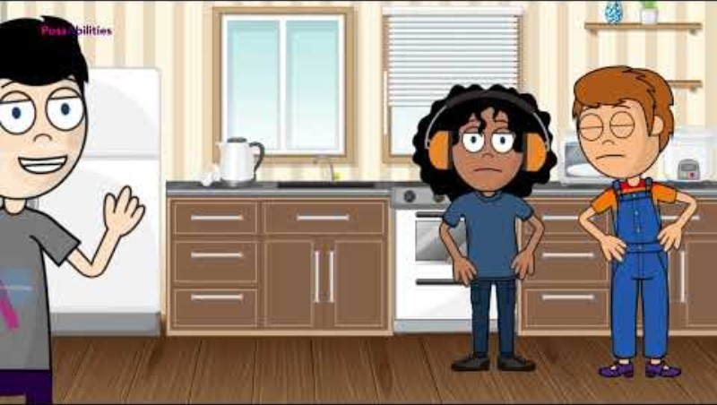

Slide 46
Cultural Competence
Cultural competence is vital in addressing self-neglect by helping professionals accurately assess risk, build trust, and develop effective interventions tailored to an individual's cultural background, beliefs, and values. A lack of cultural understanding can lead to inaccurate risk assessments and a failure to recognise or address the root causes of self-neglect, such as mistrust of services or difficulty asking for help, thereby hindering effective support and safeguarding. ​
​
Why Cultural Competence Matters in Self-Neglect​
Accurate Assessment: ​
Professionals must have a basic understanding of diverse cultural and faith backgrounds to avoid overlooking safeguarding issues or making inaccurate assessments of risk. ​
Building Trust: ​
Culturally competent practice involves understanding an individual's life history, social and economic situations, and potential reluctance to seek help due to cultural or personal reasons, which helps build the crucial rapport and trust needed for intervention. ​
Understanding the Context of Self-Neglect: ​
Self-neglect can be a complex socio-cultural phenomenon, and a cultural perspective helps practitioners understand the "meaning of the mess" for the individual and the coping mechanisms at play. ​
Effective Intervention: ​
Culturally competent care involves adapting practices to be more inclusive and effective. This can include learning key phrases in a person's language, respecting their beliefs, and using varied sources of information, such as family and community perspectives.

Slide 47
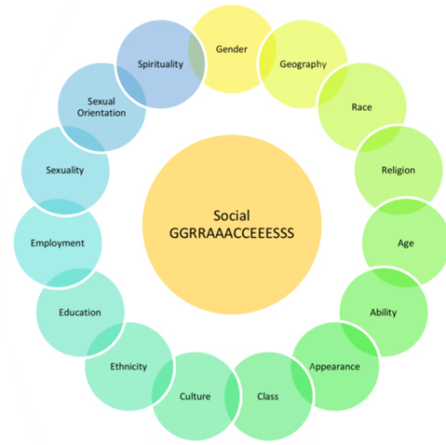
Supporting cultural competence
1) Building awareness of own Graces
2) Use Graces to Guide Curiosity and Engagement
3) Apply GRACES to understand Resistance of Reluctance
4) Use Graces to Guide Curiosity and Engagement
Notes:
The Social GRACES model is a powerful framework for social workers to reflect on identity, power, and difference when working with individuals. It helps you stay professionally curious and culturally sensitive by considering the multiple dimensions that shape a person’s experience.​
​
How to Use the Social GRACES in Practice​
1. Build Awareness of Your Own GRACES​
Before engaging with an individual, reflect on your own identity and biases:​
How might your background influence your assumptions?​
Which aspects of your identity are visible or invisible in this interaction?​
​
ACTIVITY:​
Using the blank wheel handout fill the spokes of the wheel with the Graces that resonate most with you. For each Grace you note down also make a comment on whether this aspect of your identity is visible or invisible and whether you feel that you experience privilege or disadvantage in relation to it.
2. Use GRACES to Guide Curiosity and Engagement​
When working with someone—especially in complex situations like self-neglect—use the GRACES to explore their context without judgment.​
Example Questions:​
Age: “What does ageing mean to you? How do you feel about getting older?”​
Culture/Ethnicity: “Are there cultural or family traditions that are important to you?”​
Spirituality/Religion: “Do you have any spiritual or religious beliefs that help you cope?”​
Class/Socioeconomic status: “Has money or housing ever made it harder to access support?”​
​
These questions help uncover values, barriers, and strengths that might otherwise be missed.​
​
3. Apply GRACES to Understand Resistance or Reluctance​
In cases of self-neglect, a person’s reluctance to engage may be shaped by:​
Past trauma or discrimination​
Cultural norms around independence or privacy​
Religious beliefs about suffering or care​
Class-based mistrust of institutions​
​
Professional curiosity means exploring these gently, not assuming or pathologising.​
4. Use GRACES to Inform Safeguarding and Advocacy​
Understanding someone’s GRACES can help you:
​
Advocate for culturally appropriate services​
Avoid stereotyping or over generalising​
Tailor interventions that respect identity and autonomy

Slide 48
Cultural competence activity
Going back to the case study on Mr. Ahmed, work in pairs or small groups to identify which elements of the Social Graces model are most relevant in this scenario.​
​
Aim to discuss how these factors might affect: ​
The adult’s willingness to engage with services ​
The professional’s assumptions or biases ​
The interventions​
​
We'll then have some feedback and discussion so please be prepared to share a couple of insights from your discussion with the group.

Slide 49
Practitioner wellbeing
Supporting individuals who self-neglect can have a profound impact on practitioners.
This work often leads to:
Emotional strain – feelings of distress, vulnerability, and exhaustion
Physical reactions – triggered by sensory exposure
Health and safety risks – due to challenging environments
Strategies to Mitigate Challenges
Reflective Supervision
Encourages reflection, fosters innovation, and nurtures creativity.
Peer Support
Opportunities to share and discuss practice approaches with colleagues.
Access to Specialist Advice
Legal, medical, and other expertise through formal liaison with partner agencies.
Clear Policies and Procedures
Provide a framework for accountable and consistent practice.
Protective Equipment
Essential for roles involving high-risk environments.
Personal Well-being Resources
Supportive networks and self-care strategies beyond the workplace.
SCARF Health and Wellbeing

Slide 50

Wellbeing Exercise
Purpose:
To help us decompress, refocus, and leave the session feeling calm and positive.
Step 1: Grounding (2 minutes)
Sit comfortably and close your eyes if you wish.
Take a slow, deep breath in… and out. Notice your feet on the floor. Feel the chair supporting you. Let your shoulders drop. Take two more deep breaths.
Step 2: Gratitude Reflection (2 minutes)
Think of one thing they are grateful for today—it could be something small like a good cup of coffee or a supportive colleague.
Hold that thought for a moment. Notice how it feels to focus on something positive.
Step 3: Positive Closure (1 minute)
We’re going to go around the room and would like you all to share one word that describes how you want to leave the session (e.g., “calm,” “hopeful,” “energised”).
Thank you all for your contributions to the session today, we hope you got a lot out of it. Remember to consider your wellbeing and make self care a priority.
This Photo by Unknown Author is licensed under CC BY-ND

