Slide 1

Practice Education PEPS Stage 1 Supervision
Salford Adults Social Care (ASC)
Learning & Development Team
Notes:
A time for you to come together and share your experiences
The PE 5-day training is the first step and now you are assessed in practice.
We will be going through steps for PEPS Stage 1.

Slide 2
Agenda
Well-Being & Reflective Activity
Importance of Practice Education
Practice Educator Professional Standards (PEPS) & Statement of Values
Preparing for PEPS Stage 1 Assessment
CPD opportunities for PEs
Q&A
Notes:
Aims of the Practice Educator Training Programme across GMSWA:
Following this programme, participants will be able to:
Plan, deliver and critically evaluate practice-based learning opportunities which support a student’s personal and professional development.
Assess and make judgements about the student’s performance in the workplace against agreed criteria using evidence from a range of sources.
Manage the student’s learning environment whilst ensuring the quality-of-service provision.
Demonstrate an understanding and application of adult learning theories in practice.
Apply and demonstrate a critically reflective approach to your own practice particularly regarding the application of an appropriate and professional value base.
Critically evaluate and integrate professional values in all aspects of practice-based teaching and assessment.
Clarity about your role as Practice Educator and the expectations and requirements of the role.

Slide 3

How are you feeling in your role as a Practice Educator and which Jelly Baby best represents you and why?
Would you like to be at a different part of the tree and how could you get there?
How do you feel your students could relate this model? Could you use as a well-being activity with them?

Slide 4
The importance of Practice Educators

Slide 5
Passion for Social Work & Giving Back
Diverse & Dynamic Role – Mentoring, Nurturing& Coaching
Bringing Theory, Models and Approaches to Practice
Individual Differences in Learning Styles
Sharing Knowledge
Supporting the well-being of adults, childrens, families & communities
Teaching, Facilitating & Assessing Practice
Values & Ethics, AOP, ADP & Anti-Racism
Supporting Student Well-Being
Promotes a Strong Professional Identity & Solidarity
Raising Good Standards of Social Work Practice
Supporting the new generation & workforce
Promoting Strengths
Notes:
Think back to when you were a student, positive and negative experiences…..
Passionate about social work and want to mentor others.
Giving back and helping the newer generations of social workers entering the profession, future workforce
Support students to bring theory-based learning into practice to develop confidence, critical thinking, knowledge and practical experiences
Developing skills for supervision, coaching and facilitating practice-based learning.
Promotes reflective practice and ethical principles
Helps students to build emotional resilience and self-care
Raising the standards of social work education and builds a strong professional identity; values, ethics, responsibilities and sense of solidarity for profession.
Promotes our own self growth

Slide 6

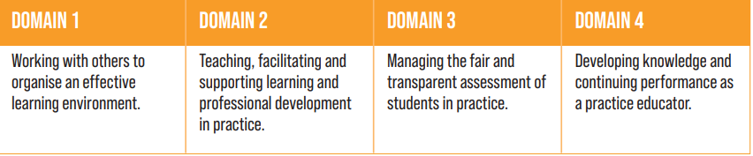
BASW Practice Educator Professional Standards (PEPS)
All Practice Educators uphold the Practice Educator Professional Standards (PEPS) and Statement of Values as set out by BASW
Notes:
BASW England Practice Educator Professional Standards for social work (PEPS) 2022 | BASW
Following social work reform, the development of PEPS in social work came into effect in 2013.
Refreshed and regulated, both in 2019 & 2022 by BASW, to promote the development of professional standards and inclusion of PWLE.
The refresh of PEPS has aimed to reflect contemporary challenges in social work including the impacts of poverty and sustained periods of austerity on individuals with lived experience, social work students in training, and the organisations supporting them
It is a document that explains to all stakeholders what is the role and development of Practice Education

Slide 7
BASW Practice Educator Statement of Values
All Practice Educators uphold the Practice Educator Professional Standards (PEPS) and Statement of Values as set out by BASW
Commitment to embed principles of Equality, Diversity and Inclusion (EDI) across Practice Education which align with BASW Code of Ethics (2021).
To promote anti-oppressive and anti-discriminatory practices, practice educators and supervisors supporting students will uphold the statement of values.
Notes:
BASW England Practice Educator Professional Standards for social work (PEPS) 2022 | BASW
Following social work reform, the development of PEPS in social work came into effect in 2013.
Refreshed and regulated, both in 2019 & 2022 by BASW, to promote the development of professional standards and inclusion of PWLE.
The refresh of PEPS has aimed to reflect contemporary challenges in social work including the impacts of poverty and sustained periods of austerity on individuals with lived experience, social work students in training, and the organisations supporting them
It is a document that explains to all stakeholders what is the role and development of Practice Education

Slide 8
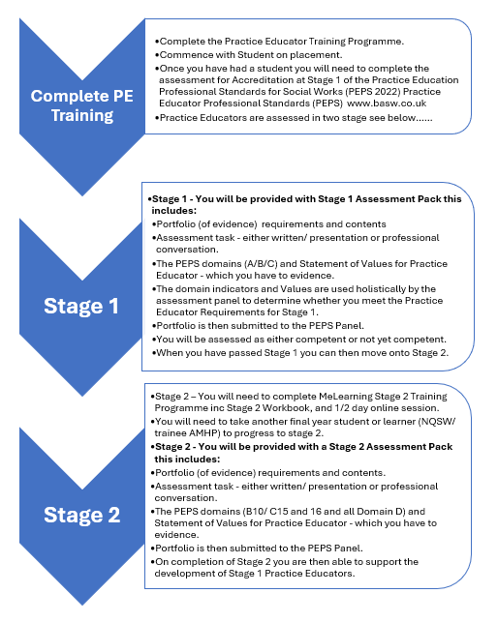

Slide 9
Meeting Stage 1 PEPS
To meet assessment requirements for Stage 1 of the PEPS, candidates are required to provide a portfolio of evidence and undertake an assessment task to meet Domains A, B and C
You will be assessed as competent or not yet competent.
The domain indicators and values will be used holistically by the external assessment panel to determine if you meet the requirements at Stage 1.
The placement must be ratified by a stage 2 qualified PE.

Slide 10

Role of Stage 2 Mentor/Assessor
Is ‘a registered social worker qualified to PEPS 2 who will develop the skills and knowledge of the Trainee Practice Educator.
Completes three supervisions with the trainee Stage 1 PE, however we take a flexible approach as this can be met by attending other PE CPD events (more detailed later)
Provides information and advice to the trainee Stage 1 PE, including when there are concerns.
Completes a Direct Observation of PE practice and assesses against PEPS and Value Statement
Provides advice on completion of the final assessment report.
Ratifies the overall assessment
The ASC Learning and Development Team, including the Social Work Development Lead (Shoyley Chowdhury), can also support to provide information, advice, and respond to concerns.

Slide 11
Stage 1 involves the Practice Educator taking a final level student on placement; being observed in their supervision with the student, submitting a portfolio of their practice with the student and undertaking an assessment task. There is a total of 35 hours of CPD to be completed.
• Front sheet
• Contents Page
• Ratification form
• Statement of confidentiality
• Evidence of completion of the Practice Education Training
• Learning agreement form
• Interim assessment form
• Final assessment report
• One direct observation report
• Direct observation of your PE supervision with a student
• One example of supervision notes
•Assessment task – 1500 word written piece, professional discussion or presentation

Slide 12
Direct Observation of PE Supervision
What is the purpose of the observation?
It is an opportunity for the PE candidate to gain developmental feedback about their professional practice and an opportunity for discussion and reflection with the observer.
What makes a suitable observation?
A suitable observation is a formal, planned supervision session of a social work student which lasts for around one – one and half hours.
What is involved?
Observing practice typically has 4 stages of development. (See Direct Observation form in the assessment pack)
briefing between observer and candidate. Preparation write up.
observation
feedback
completion of the Direct Observation report
Notes:
Remember this observation is about you and how you manage the session and enable the student to share their knowledge, ask questions, understand ……
The observed session might include:
Assessment of the student by looking at the PCF domains, discussing a piece of work, asking them about their interpretation of an event/piece of work (reflective supervision)
Feedback to the student
Teaching
Discussion and analysis of an issue, theory, piece of legislation etc
Reflection about something

Slide 13
Assessed Task - Academic references should be included in each answer. (1500 words if in essay form)
Evidence how you have promoted anti-discriminatory practice during the student’s placement with reference to the Statement of Values for Practice Educator Professional Standards. Incorporate your reflection on the Values and how you have integrated them into your practice with the student and into your answers to each of the following 3 questions:
Please explain how you worked with others to organise an effective learning environment (Domain A).
Please explain how you have taught, facilitated and supported learning and professional development in practice (Domain B).
Please explain how you have managed the fair and transparent assessment of students in practice (Domain C)

Slide 14
Domain A - Working with others to organise an effective learning environment
Discuss with manager/team prior to a decision being made to accept a student, to think about the team culture, roles and responsibilities?
Devise and develop learning opportunities that involved others? (To meet PCFs and SWEPS)
Involve the team/other practitioners in the placement i.e. offering shadowing, co-working?
Plan where the student would be based and how support would be offered?
Provide opportunities for regular team reflective discussions? How did you help the student learn from others?
Consider if the student had any form of disability, health condition, caring responsibilities, a job, specific learning needs etc?
How was the students background and experience, interests acknowledged
How were the expectations of the placement for both student and PE shared and discussed, was a supervision agreement completed?
How were the learning opportunities made available and discussed with the student?
Was dress code, boundaries, confidentiality, mobile phones, use of face book etc discussed?
What did induction look like and how was it communicated to the student and were they involved in the process?
Were training opportunities offered, access to RIP etc?
Were learning styles discussed?
Who was responsible for giving work to the student and how was it done?
How was the work monitored, reviewed and managed
How did observational/shadowing opportunities take place
Was the student protected in terms of work-load
How did the student evidence work and their reflection and learning
Were yours and the student expectations regularly reviewed and the working environment discussed

Slide 15
Domain B –Teaching, facilitating and supporting learning and professional development in practice
How have you demonstrated and shared expertise in your role? i.e knowledge of contemporary issues in research and policy, legislation and practice?
How did you teach and support the learning of relevant social work knowledge and research, and the integration of theory and research in practice?
Did you discuss and plan with the student the learning and assessment programme, the student’s particular needs and capabilities and how to meet those needs?
How did you make sound reasoned judgements about the level of work the student could be allocated, and the support required to achieve both learning and work goals?
How did you demonstrate an understanding of, and critical engagement with theories, to make professional educational judgements about the students needs and how to meet them?
How have you helped your student to understand their own learning processes and to develop different models and strategies for critical reflection and analysis?
How did you establish a climate for reflection, including clarifying with the student why reflection is important.
Did you use supervision to discuss and share the students reflective log
Did you use reflective questions and prompts.
Did you give the student tools to use and examples of models of ‘structured reflection’.
How did you provides a forum to inform, evaluate, assess and encourage the student

Slide 16
Domain C – Manage the fair and transparent assessment of students in practice
How have you ensured that holistic assessment decisions are the outcome of informed evidence-based judgements, drawing on evidence which is relevant, valid, reliable and sufficient and clearly explained the decisions to students?
How did you assess practice to the PCFs and SWEPS?
How have you encouraged your student to self-evaluate and seek service users, carers and work based colleagues feedback?
How have you provided timely, honest and constructive feedback on your students performance in an appropriate format?
How did you make sure that the student had a clear understanding of what you expected – and how it would be measured, judged and recorded?
How have you reviewed student progress throughout the assessment process, identifying strengths and any areas requiring improvement.
How have you ensured that all assessment decisions, and the supporting evidence, are documented and recorded according to the required standard.
How have you engaged your student in the design, planning and implementation of methods to assess their performance against the appropriate standards.
How have you ensured that disagreements about assessment judgments and complaints made about the assessment process are managed

Slide 17

Triangulation in Holistic Assessment Triangulated evidence is collected from more than one source and over a period of time. This means offering a range of learning opportunities and using a variety of assessment methods and involving several people in the assessment.
Notes:
Triangulated evidence is collected from more than one source and over a period of time. This means offering a range of learning opportunities and using a variety of assessment methods and involving several people in the assessment.

Slide 18
Practice Educator Values In order to promote anti-oppressive and anti-discriminatory practice
Notes:
This might be integrated into supervision so that learners are clear about processes and systems and what to do if they see or experience discrimination
Clear Supervision agreements and agendas, discussion about role and responsibilities
Show understanding of adult learning styles and how this understanding has impacted on the assessment and supervision process
Show how you have been respectful of service users in terms of the work of the student
This is your own values and prejudices not the students - this might be relevant in terms of the initial consideration of the student coming to you on placement, were there any concerns? were you worried? How did you show value to the students ‘uniqueness’?
Links into 5 - so what did you do to make sure the students learning experience was appropriate and fair so that they were able to develop their knowledge and skills in a supportive and developmental way
How did you make sure the learning opportunities were varied and diverse and how did you manage the assessment process so it was fair and transparent

Slide 19

Notes:
Designed by a group of NQSWs.
Putting practice in the spotlight so that it can be carefully considered
Pass through prism which represents power
After having a look at the PE value statements how do you feel these areas could impact power dynamics and relationships for a student on placement? What would promote students to feel empowered and what might disempower them? What could reduce disparities in power.

Slide 20

Next Steps for PEPS Stage 1
Practice Educator Preparing for stage 1 Assessment Lisa Cassidy | Automate.video (Watch full video)
Read Stage 1 assessment pack Stage-1-PE-Assessment-Pack-Sept-25.docx
Plan your own direct observation of PE supervision with your Stage 2 assessor/mentor. PLEASE REMEMBER TO DO YOUR OBSERVATION BEFORE PLACEMENT FINISHES
Stage 1 PE candidates need to access three supervisions, today counts as one. Supervisions can be with your Stage 2 assessor/mentor or the GMSWA CPD sessions:
GMSWA Practice Educator Masterclasses 2025 / 2026 | Eventbrite
GMSWA PE/ OSS/ Mentor Forums by Greater Manchester Social Work Academy (GMSWA) | Eventbrite
Attend the Siobhan Maclean Reflective Supervision Training Event on Tuesday 3 February
Start preparing your PEPS portfolio for submission after your student's placement finishes
Don’t forget the information and reading available through your completed PE workbook
Plan your submission date….details available on next slide…...
Notes:
- Reflective supervision, models, tools, and well-being​
- Theories, models, approaches to practice​
- Individual differences, anti-racism in practice education and supporting neurodivergent students

Slide 21
Portfolio Submission Dates
Submit portfolio to ASC Learning and Development Team for checks | Portfolio Submission Date | Panel Date
26th June 2026 | 10th July 2026 | 22 July 2026
25th September 2026 | 9th October 2026 | 21st October 2026
4th January 2027 | 8th January 2027 | 20th January 2027

Slide 22

Question & Answers

