Slide 1



Salford Adults ASYE
Portfolio Requirements
& Reflective Practice
Monday 16th March 2026

Slide 2
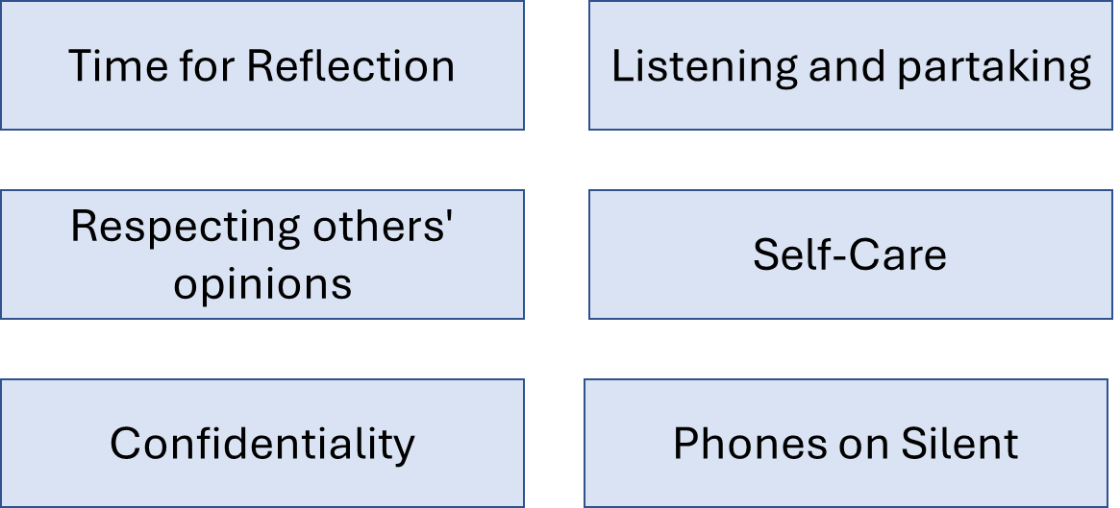
Housekeeping
Notes:
Are there are any other housekeeping matters you feel need adding?
Location of toilets, kitchen facilities and drinks machine.

Slide 3
Agenda
World Social Work Week Celebrations! – Harambee 2026
ASYE - Critically Reflective Practice
ASYE - Use of Social Graces for Anti-Oppressive Practice
ASYE - Portfolio Requirements
ASYE - 2000 Word Reflective Piece
Notes:
It would help if you could have a think about what you want to focus your critical reflective piece on….you’ll be working in pairs to share ideas and create a plan

Slide 4

What is World Social Work Day?
Highlight achievements of social work and raise visibility
Defending social justice and human rights
Social workers globally celebrating contributions of the profession; to individuals, families, communities and wider society.
First WSWD in 2007, theme “social work making a world of difference”
The initiative of having WSWD was approved by IFSW in Adelaide, in 2004
Origins predate. In 1983, IFSW united nations representatives, led by Jack A, Kamaiko proposed a project to bring social workers into UN headquarters in New York, commencing Social Work Day.
The ideas behind WSWD were to create an event that interprets work of the UN to the social work profession and collaborating with NGO on humanitarian issues.
https://www.ifsw.org/history-world-social-work-day
Notes:
WSWD third Tuesday of March
Celebrate achievements of social work, raise the visibility for future societies, innovate
Principles of empowerment, social justice and human rights which bind/unify our profession on a local and global level.
Come together & recognise the solidarity we have with our adults, families, communities and key partners of Salford, common aim to enhance well-being (Section 1 of Care Act).
Highpoint in social work calendars all around the world.
In 1983, IFSW United Nations Representatives in New York, led by Jack A. Kamaiko proposed a project to bring social workers of the area into the UN Headquarters in New York. This was the beginning of an annual celebration called Social Work Day at the United Nations.
IFSW achieves on website

Slide 5

Who is World Social Work Day for?
IFSW produces a poster announcing WSWD
Last year this was translated to 100+ languages
Highlighting international solidarity
Posters presented to governments, political bodies
Pinned on notice boards, in social work classrooms, offices
WSWD celebrations extend across the week & month
WSWD & week is aimed at all those with an interest in social work , including:
social workers
all staff working in the sector
people with lived experience of social work
social work students
employers of social workers
Social work educators
Organisations with an interest in or influence on social work
Government and policy officials
Stakeholder and partner organisations

Slide 6

WSWD 2026 Theme – Harambee
Vital role of Social Work to bring together communities, cultures and systems.
Shape more sustainability & inclusivity
Draws inspiration from African philosophy of Harambee, Kenyan philosophy
Based on unity, mutual support and shared responsibility
In a world increasingly fractured by conflict, inequality, ecological crisis;
Theme is a reminder and a challenge – sustainable way forward is through cooperation and solidarity
Harambee is deliberate and symbolic – literal meaning ‘Pulling together’ or ‘all for one’
WSWD 2026 is a global call to heal division and strengthen resilience and shape a fairer/sustainable future
Notes:
Globalization – learning from other cultures . Harambee is a Swahili word
Social work is a profession rooted on values of human dignity, social justice and community participation
No society cam thrive when people are divided or excluded
Theme underscores the need to rebuild bonds of belonging in fractured communities.
Amplifying marginalized voices, and facilitating dialogue across social, cultural, and political divides.
Harambee has long served as a rallying call in Kenya and across Africa, mobilising communities for self-help and collective development – good for all and resonates with African ethics of Ubuntu “I am because we are” joint action/shared effort
Invoking Harambee, 2026 theme calls on social workers, governments, institutions, and communities worldwide to join hands in co-building spaces of hope and harmony. Move beyond charity towards solidarity, systems change, and towards unity. Peace is not merely the absence of violence; justice and inclusion
World Social Work Day 2026 is therefore a global call: to heal divisions, to strengthen resilience, and to shape a fairer and more sustainable future.

Slide 7

As a Kenyan proverb teaches us: “Sticks in a bundle are unbreakable.” In the same spirit, this theme affirms that when humanity unites in Harambee – pulling together as one, no adversity is too great to overcome, and no dream of justice, peace, and dignity is beyond reach.
Activity –What does Harambee mean to you and how we are trying to adopt this approach Salford for people in our communities? What have been your successes in ‘pulling together’ to achieve positive outcomes
Notes:
5-10 min activity – flip chart and pens Collective Strengths
Harambee’s focus on “pulling together” mirrors strengths‑based practice, which centres on identifying and using the strengths of individuals, families, and communities rather than focusing on problems.
Empowerment and Co‑Creation
Both the theme and strengths‑based practice emphasise empowering people to take part in shaping solutions. Change is created collaboratively, through shared effort and mutual respect.
Resilience and Hope
The theme’s focus on “hope and harmony” reflects strengths‑based practice, which builds resilience and helps people recognise their ability to overcome challenges.
Community and Solidarity
Harambee and Ubuntu highlight interconnectedness—“I am because we are.” Similarly, strengths‑based practice values relationships and community networks as vital sources of support and well-being.
Cultural Relevance and Inclusivity
Drawing on African philosophies reinforces the importance of cultural values. Strengths‑based practice also respects diversity and lived experience, ensuring support is inclusive and culturally grounded.

Slide 8
ASYE - Critically Reflective Practice
ASYE is a nationally recognised programme in England designed to support NQSWs during their first year of practice. The programme supports NQSWs to:
Consolidate learning and practice
Apply theory, models and approaches to practice
Develop critical reflection skills and professional confidence
Develop professionally sound and ethical decision-making skills
Builds confidence in undertaking statutory duties
Encourages involvement of adults and carers in the learning process of NQSW
Acts a way to quality assure practice and raise standards
Supports to ensure is responsive/respectful to the needs of individuals and their families.
Meet KSS - social worker working with adults should know/do by end of ASYE
Evidence meeting the PCF at End of First Year level
Notes:
Links to recommendation to recommendations from the Munro Report 2011 and supports new social workers transition their theoretical knowledge into practice.
ASYE was introduced in 2012 and replaced older programmes to create a more consistent and evidence-based framework for newly qualified social work
ASYE has developed over time. There has been a change in the landscape of social work, following years of austerity and poverty that has impacted the lives of adults, children and families, and brought new practice challenges and the need for adaptability and resilience as practitioners. Including a need for increased trauma-informed approaches.
The ASYE aims to support NQSWs to embed reflective practice, values, self care, resilience and professional confidence.
Critically reflective practice goes beyond describing what happened in practice. It involves:
Thinking deeply about:
What you did
Why you did it
The assumptions you made
The power dynamics at play
How your values influenced decision-making
What alternative actions were possible
What you will do differently next time

Slide 9
KSS/PQS 8 – Critical Reflection & Analysis Social workers should have a critical understanding of the difference between theory, research, evidence and expertise and the role of professional judgements and decisions needed to support, empower and protect PWLE. They should apply imagination, creativity and curiosity to working in partnership with individuals and their carers, acknowledging the centrality of people’s own expertise about their experience and needs.
PCF 6 – Critical Reflection and Analysis - Apply critical reflection and analysis to inform and provide a rationale for professional decision-making. Social workers critically reflect on their practice, use analysis, apply professional judgement and reasoned discernment. We identify, evaluate and integrate multiple sources of knowledge and evidence. We continuously evaluate our impact and benefit to service users. We use supervision and other support to reflect on our work and sustain our practice and wellbeing. We apply our critical reflective skills to the context and conditions under which we practise. Our reflection enables us to challenge ourselves and others, and maintain our professional curiosity, creativity and self-awareness.
Notes:
Critical reflection – bring together reflection and critical theory.
Consider power and question wider socio-political context of practice.
Important difference (from reflection) is that critical reflection places emphasis on understanding power relations, including ways to reduce power dynamics and promote empowerment and emancipatory practice.
A window through which the practitioner can view and focus self, understanding own lived experiences, beliefs, and values, to confront and resolve any contradictions and bias.
To uncover hidden assumptions and build self-awareness.
Add issues of socio-political context/challenges
Learning from an experience, making new meaning and interpretations, considering evidence, other perspectives, and contexts.
Sufficient depth to create transformative change.
Often the concept is confused with ‘self-criticism’, however is not solely focused on what didn’t go well.

Slide 10
ASYE - Critically Reflective Practice
Many definitions for critical reflection.
This can also create uncertainty and ambiguity about how it is applied.
Jan Fook is one of the most well-known contemporary writers on Critical reflective practice in social work.
Fook emphasises the significance of social workers reflecting on power dynamics and exploration of implications in practice.
Fook offers a model of critical reflection as an inductive process in which the social care practitioner develops their own theory of practice and consists of three stages
Telling the narrative – Describing the situation
Deconstruction – “taking the situation apart” consider power in depth
Reconstruction – “putting things back together” with a new understanding
Notes:
Important difference (from reflection) is that critical reflection places emphasis on understanding power relations, including ways to reduce power dynamics and promote empowerment and emancipatory practice.
A window through which the practitioner can view and focus self, understanding own lived experiences, beliefs, and values, to confront and resolve any contradictions and bias.
To uncover hidden assumptions and build self-awareness.
Add issues of socio-political context/challenges
Learning from an experience, making new meaning and interpretations, considering evidence, other perspectives, and contexts.
Sufficient depth to create transformative change.
Often the concept is confused with ‘self-criticism’, however is not solely focused on what didn’t go well.

Slide 11
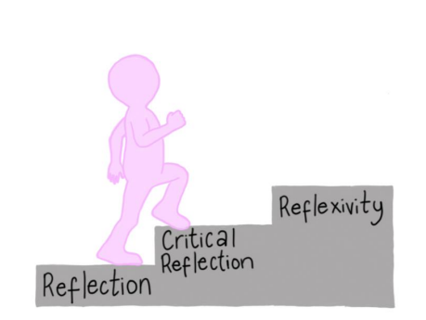
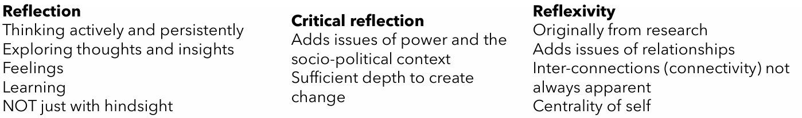
The journey from reflection towards reflexivity - YouTube
Notes:
Reflexivity A concept which originates from social sciences research and holds applicability to reflective practice in social work.
A form of self-reflection, or other reflection to make sense of social circumstances and social life, using this in a circulatory manner.
A process of looking inwards and outwards.
Adds issues of relationships, including inter-connections that are not always apparent. There is centrality of self.
Further broken down to three forms of reflexivity
Personal reflexivity - exploring the way our beliefs, experiences, interests, to shape practice and approach.
Relational reflexivity – being reflexive about relationships and how they are constructed.
Epistemological reflexivity - considers aspects such as design, the research method and how different approaches work differently.
An awareness of thinking, bias, or blind spots, which influence the way you interpret people and situations, in turn practice.

Slide 12
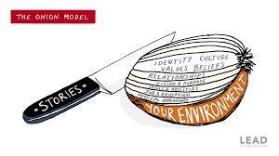
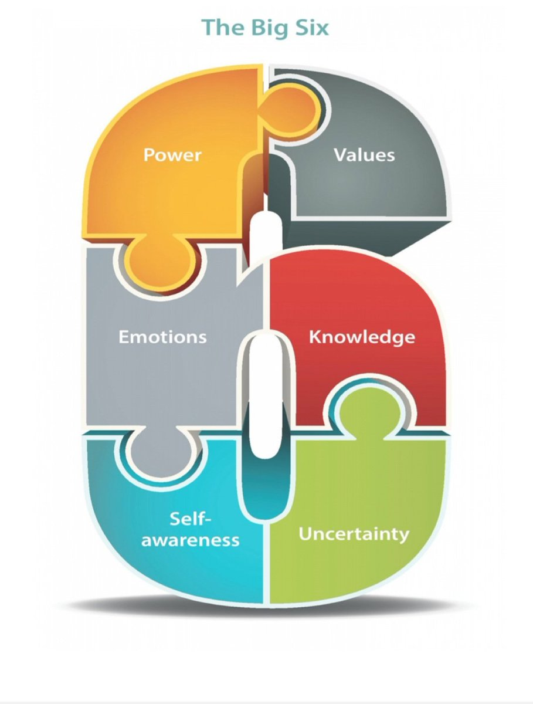
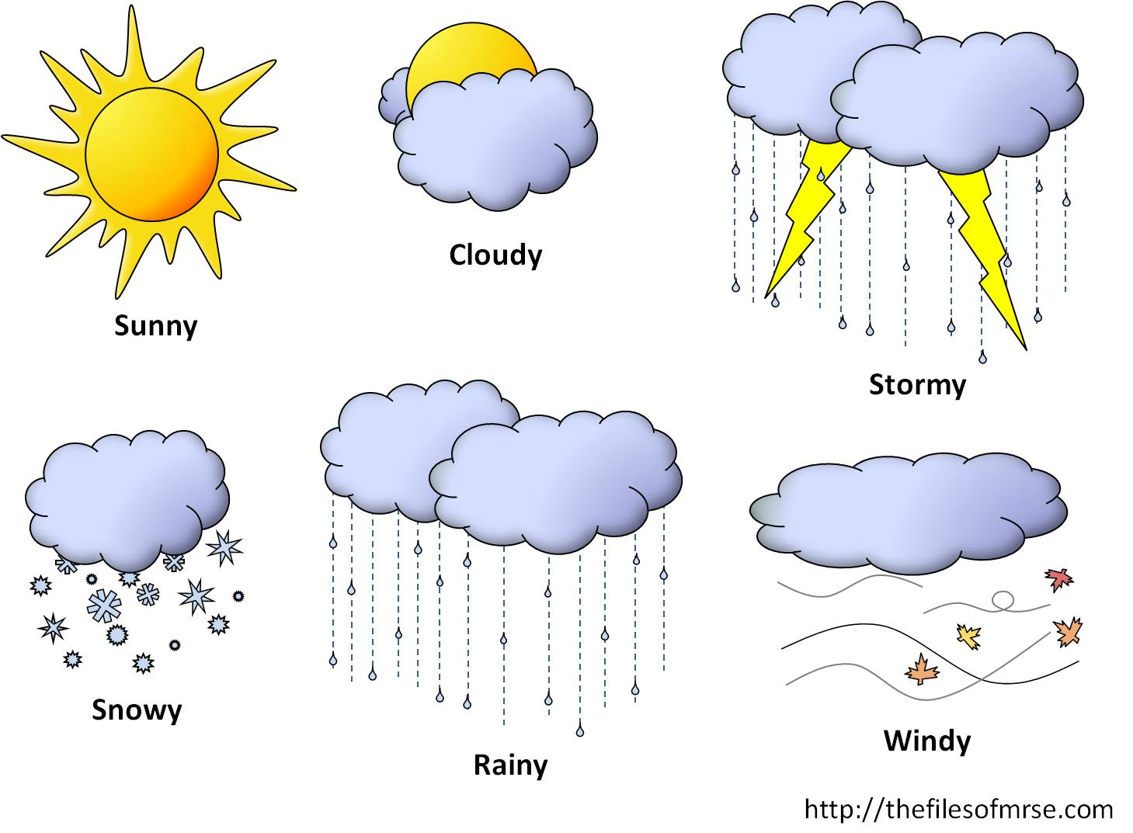
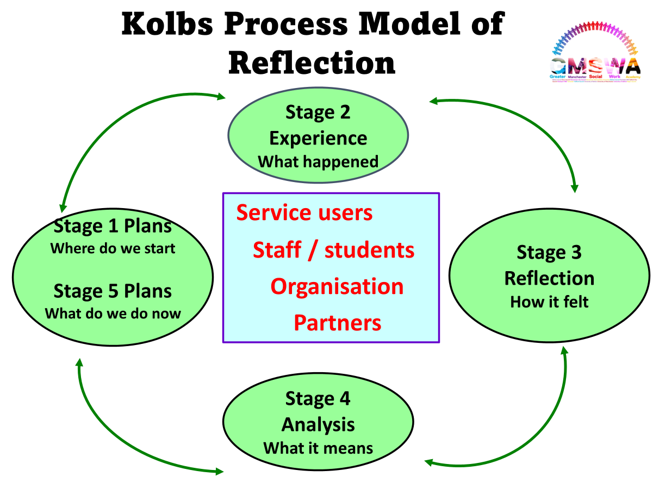
Reflective Models – Lets take a look….
Notes:
There are many methods and techniques to aid reflective practice, including:
Using supervision
A ‘critical friend’
Mind mapping ideas and thoughts.
Reflective written pieces.
Using reflective practice models.
Maintaining a reflective journal (reflective logs).
Considering theory to practice
Using reflective models can help to promote reflective practice. Models contain interesting prompts and questions, designed to make sense of a learning experience to develop a deeper understanding, to in turn promote positive changes in practice.
It is generally agreed that there are two types of reflective models, process models (for example Gibbs Cycle) which moves through a linear process; and component models (for example Korthagen’s onion) that can be used in any order and generally uses symbols as prompts for reflection, particularly to consider power relations – use one that suits your learning style….
Onion model – surface level, unpeeling the onion, not as it seems on surface level, links well with professional curiosity
Big 6 – Energises critical reflection
Head (knowledge), heart (feel), feet (value/standards), hands (skills)
Experiential learning – make sense and transformative change

Slide 13
Break Time

Slide 14
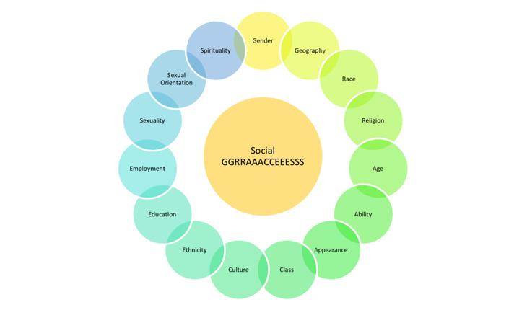
ASYE – Use of Social Graces for AOP
Notes:
A model and tool designed to address inequality
Developed by John Burnham & Alison Roper Hall (1993, 1998) – field of psychology
Originally ‘disgraces’ to highlight inequality, evolved into current mnemonic.
Used to describe aspects of personal and social identity, which afford people levels of power and privilege (also opposites).
Starting point to explore identity, not exhaustive, used fluidly and up for correction
Many layers of complexity and layers to identity, words mean different to each person.
Social constructions and how we perceive others and how they perceive us, influence of societal, political, media inflence…..
Why is it useful? Awareness of one’s own elements of identity allows us to reflect on how we see the world, biases and ‘comfort’ zones of what we share with others.
Awareness of other people’s identity allows space for us to ask questions, examine the impact on a person’s day to day life, functioning and well-being.
Practical tool to critically reflecting upon self in practice and the impact graces can have upon practice.
Bring self into the reflection, who you are, your identify, your past experiences are and what is important to you, will inevitably impact upon how you view the world including the people you work with.

Slide 15
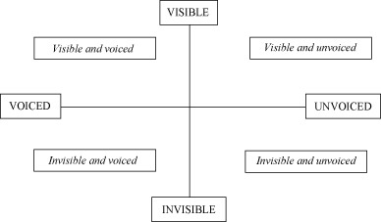
Visible-Invisible & Voiced-Unvoiced
Notes:
It highlights that there are elements of our identity which are: Unvoiced and hidden from view – so others cannot see it and are not aware of it as it is not voiced, such as spirituality. Sometimes things might not be spoken about but are visible to others (unvoiced, visible) such as someone’s age. Sometimes we speak about our social GRACES, particularly the ones which are visible to others such as attire (clothes we wear). Sometimes we speak about our social GRACES which are not visible to others, such as our abilities (e.g. dyslexia). The graces can shift into different quadrants by talking/not talking about them.
By posing questions about the effects of the social graces on the social worker and families’ experiences, you create a shift to build awareness of visible / voiced and invisible / unvoiced experiences

Slide 16

Using Social Graces
In supervision: Which of the social GRACES are important to you? Which ones have you not considered before? Which one of the social GRACES is impacting on how you view the adult or carer you are working with? Which social GRACES are visible to others? Which social GRACES are invisible which may need talking about? Which social GRACES do you have similar or different to the person you are working with? What impact does this have on your work?
Personally: Use the social GRACES to constantly reflect on the impact these have on your thoughts, feelings and actions within the world; what you are sharing and what you are not, and WHY. They are always present and could help either build a relationship with someone or be the reason you are struggling to do so.
Social Graces during ASYE – Reflect on Diversity and Issues of Discrimination
Question
Has anyone tried using Social Graces? What were the benefits?
If not, how do you think you could incorporate reflections on the Graces into your ASYE?
Notes:
5 minutes

Slide 17

ASYE – Portfolio Requirements
Portfolios can be described in many ways;
‘a professional scrapbook’ (Bryne et al. 2009)
‘a compendium of materials that document accomplishments’ (Swigonski, 2006)
‘a portfolio is a collection and cohesive account of learning that contains relevant evidence from practice; and critical reflection on this evidence’ (Timminis, 2008: 2)
‘A kind of autobiography of growth…to gain a deeper understanding of self’
Purposes of a portfolio;
Vehicle for learning, development and reflection
Samples of practice that demonstrate skills
Build professional confidence
Making sense of practice (light bulb moments)
Supporting the development of best practice with people
Holistic assessment of abilities
Triangulating feedback from an array of people and sources
Based on real experiences
Notes:
It would help if you could have a think about what you want to focus your critical reflective piece on….you’ll be working in pairs to share ideas and create a plan
A social work portfolio is a curated collection of evidence that demonstrates a practitioner’s skills, capabilities, knowledge, and professional identity
Benefits of Using Portfolios in Social Work
For Practitioners
Encourages reflective habits
Demonstrates professional growth
Helps identify strengths and development areas
Builds confidence
For Organisations
Ensures consistent assessment
Provides clear evidence for quality assurance
Supports a learning culture
Assists with workforce development planning
For Adults/Carers
Encourages practitioners to stay evidence‑informed
Improves professional accountability
Strengthens the quality of practice and decision‑making

Slide 18
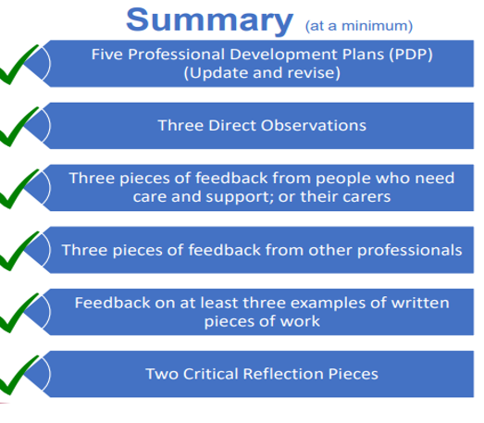

Notes:
Do the exercise

Slide 19

Personal Development Plans
When commencing ASYE, look at PDP from your pre-university course
IPDM, an opportunity to consider your development plan, what has been your previous experience and what do you want to achieve (hopes & goals)?
Write three - five learning objectives in a SMART way (i.e., Specific, Measurable, Achievable, Realistic and Timely)
Your learning objectives could relate to your practice;
o Development of critical reflection and analysis
o Development of self – experience, knowledge, skills values, confidence, resilience, emotional well-being
o Legislation, policy, and procedures
PDPs revised at 3, 6, 9 and 12-month point;
Make PDP personalized and meaningful to your development
Notes:
A Personal Development Plan (PDP) is a key component of ASYE. A PDP helps to provide structure, direction, and measurable goals to support the development and confidence for practice.
Should start with foundations of the Care Act (assessment, communication skills, relationship-based practice, understanding organisation, demographic and community services), then more gradually to more complex areas gradually – MCA and safeguarding
What opportunities are available to support you to achieve your identified learning objectives? Shadowing, use of supervision, peer and managerial support, increasing legal literacy (statutory codes/guides, case law), critical reflective practice, polices & procedures (especially safeguarding), self directed learning….
NOT JUST I WILL ASK MY MANAGER OR PEER

Slide 20
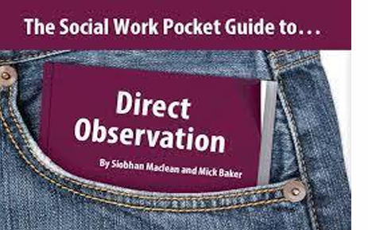
Direct Observations
Minimum of three, all completed by registered social workers, two by assessor
Most should be carried out face-to-face and with individuals we work with
To evidence progressive development in knowledge, skills and practice
Points to consider
o The prompting guidance in templates
o Plan and link to PDP
o Opportunities - Direct practice; meetings; presentations…
o Gain consent for observation; consider the individuals capacity
o Reduce and manage power dynamics
o Integrate critical reflection – issues of power, values, ethics;
o Theories, models and approaches
o Reflecting before and after, develop a deeper understanding
o Ensuring feedback is gathered by the observer
Notes:
Considering power relations, marginalisation and oppression.
Different types of power coercive, reward, legitimate, referent and expert…..
How do we promote empowerment and emancipatory
Making sure your write up is clear…..how did you apply your legal understanding
What theories, models and approaches do you plan to apply and why?

Slide 21

Verification of Work Product
Examples could include assessment, support plan, review, case recordings – show reasoned judgement
By end of ASYE one report for external body or MDT meeting
Do not include actual document
Remember the reflection part is key
Key principles of good record keeping?
Evidencing professional decisions/accountability?
Recording voice of the person?
What type of language do we use?
Legal literacy?
Good grammar and structuring?

Slide 22
Feedback from PWLE & Other Professionals
A variety of assessment methods are used to assess knowledge, capabilities and skills in ASYE including;
Feedback from individuals with lived experience
Other professionals and colleagues
These provide third party testimonials
Choose a variety of adults, carers, and professionals
Reflecting on the feedback gathered
Importance of gathering feedback……..
TRIANGULATION
Notes:
Huba and Freed (2000) highlight that a holistic assessment is the process of gathering and discussing information from multiple and diverse sources in order to develop a deep understanding of what the learner knows, what they understand and what they can do with their knowledge as a result of learning experiences.
Third party feedback (testimonial or witness evidence), is a strong form of evidence.
Triangulation has meaning and definitions, depending on context and disciplines (social sciences, psychology…). The purpose of triangulation is to contribute through the study of phenomena from multiple perspectives and is expected to produce new findings with deeper dimensions.
In order to assess skills, feedback is needed

Slide 23
What underpins and informs SW Practice
Values and Ethics
Theory, Models and Approaches
Research and Evidence Informed Approaches
Legislation (Including Statutory Codes, Guides and Principles)
Policies, Procedures and guides – National & ASC Info Hub
Learning from sources such as Case Law & learning from SAR
Frameworks for Intervention – Strengths Based
Good use of Self Care
Integration of critical reflection for transformative change
Notes:
BASW Code of Ethics
Care Act, MCA, MHA, Equality Act, HRA, Data Protection

Slide 24
Theories, Models, Methods and Approaches
Theory - Helps us to understand, describe, explain, and predict. Attempts to explain situations and social relationships.
Model - Guides our intervention and helps us to plan how to intervene and influence change.
Method - A tool or technique used in practice, generally drawn out of a model.
Approach - An overall way of way of working.
Notes:
Theories – Attachment, Human Development, Grief & Loss, Karpman's Drama Triangle, Ecological systems, Bronfenbrenner, Maslow
Models – Social model, medical model, assessment models, recovery model, task cantered, crisis intervention
Methods – Strengths-mapping, ecomaps, genograms, GEMS questions, communication methods, social graces
Approach – Strengths based approaches, Trauma Informed approaches, organisational approaches, Equality, Diversity Inclusion

Slide 25

Critical Reflective Piece
End
Middle
Beginning
Notes:
20 minutes
How would you start you written reflective piece? What is the dilemma, area of practice you are focusing on? Any choice of reflective model….
Middle – evaluation of what informed your practice?
Conclusions – main learning, future development needs, links to self care and resilience
Use theory cards

Slide 26

Critical Reflective Piece
Writing a clear introduction and link to question in hand
Detailing what is your understanding of critical reflection
Using a reflective model to shape written piece
Show growth in practice; talk about challenges/barriers faced
Talk in the first person ‘I’
Integrate your values and emotions, including any dilemmas or competing values
Talk about what you learnt and how the experiences shapes your future development; including self-care
Avoid too much description, focus on evaluation and analysis;
Discuss the why, what and how?
Avoid using ‘service user’, ‘patient’, ‘client’ or ‘case’;
Use Care Act & strengths-based language, ‘adult’, ‘adult in need of care and support’ or pseudonym or random initials
Demonstrate evidence informed practice, include references
Proofread, check structuring, grammar and use of abbreviations
Link clearly to PCF and KSS

Slide 27
Reading & Resources
Build critical reflection and analysis skills as foundations to effective practice | Research in Practice
PCF 6: Critical Reflection & Analysis - Developing Together Social Work Teaching Partnership
Learning Pathways | Research in Practice
Social Graces: A practical tool to address inequality | BASW
World Social Work Day 2026 – International Federation of Social Workers

