Slide 1

Salford Adult Social Work Student Safeguarding Session Thursday 2nd April 2026
Session facilitator: Shoyley Chowdhury (Social Work Development Lead)
Notes:
Welcomes and introductions. These sessions are aimed at providing with you with access to peer support as students.
Topics for sessions are aimed at being relevant to your learning and development
Safeguarding was chosen by the last group.
Uphold our Salford Adult Social Care (ASC) vision to “Work with Communities and Partners so every person can lead fulfilling, healthy, and independent Lives.”

Slide 2
Housekeeping
Time for Reflection
Listening and partaking
Respecting others' opinions
Self-Care
Confidentiality
Phones on Silent
Notes:
Self-care, certain discussions could invoke emotions and lived experiences of your own, please take care of selves and know we are here to support in a safe space.
Are there are any other housekeeping matters you feel need adding?
Location of toilets and reminder there will be a break

Slide 3
Session Aims & Agendas
Safeguarding means protecting people's health, wellbeing and human rights, and enabling them to live free from harm, abuse and neglect.
Part 1 – Introduction to Safeguarding Legal Frameworks
Part 2 – Core Principles for Safeguarding
Part 3 – Salford Safeguarding Adult Board (SSAB)
Part 4 – Referrals and Enquiry procedures
This accompanied by activities to complete in your own reflective workbook
Notes:
Session is an introduction to safeguarding and tailored to your development as students,
Useful info to use when you apply for SW jobs and do your ASYE.
During the session think about potential, theories and models.
As well as critical reflection, ethical dilemmas and competing values which can arise.
Session not exhaustive – safeguarding is a huge topic
Learning should be supplemented by shadowing, supervision, self-directed learning.
There is an optional workbook with reflective activities
Stat guide = Care Act 2014 Care and Support Statutory guidance – Last updated July 2025
This session is largely based on Safeguarding Protocols in Salford, therefore may vary slightly with areas.

Slide 4
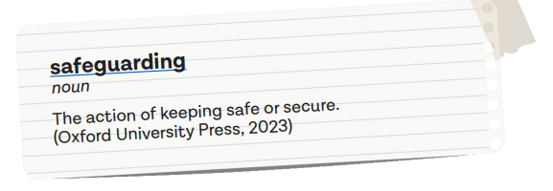
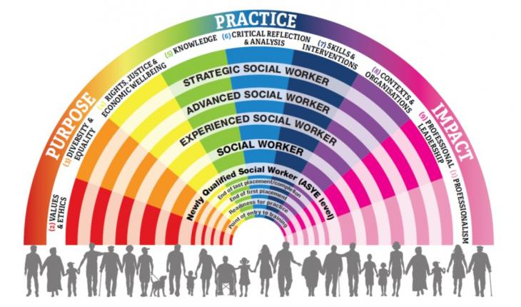
Initial Thoughts
What comes to mind when you think of the word ‘safeguarding’?
How do you think you can develop your knowledge and skills for safeguarding practice?
Which PCFs relate to safeguarding?
PQS/KSS 4 Social workers must be able to recognise the risk indicators of different forms of abuse and neglect and their impact on individuals, their families or their support networks and should prioritise the protection of children and adults in vulnerable situations whenever necessary. This includes working with those who self-neglect……
Notes:
10 mins – in silence or with a peer. Page 3 of workbook
Remember, there is no right or wrong answer.
Draw on experiences from observations, studies and practice
It's natural to feel unsure at this stage; but important to be professionally curious and take steps to increase your own learning, development and skills.
The PCF is the overarching framework for social work in England, from pre-qualifying to strategic levels, across all practice areas. PQS 4 seems the obvious one, but there are several areas which interlink
- SWs must take an outcome focused, person-centred approach to safeguarding practice; treat individuals as the experts of their lives.
- Enhance people’s involvement, choice and control, to improve quality of life, well-being and safety.
- Take necessary steps to safeguard people at risk of abuse or neglect, including promoting people to safeguard themselves.
- When working with adults take appropriate actions if there are situations where a child or young person may be at risk; sharing proportionate information with children services.
- Think whole family approach, one of the Care Act eligible outcomes (j)carrying out any caring responsibilities the adult has for a child. Think about if the adult with care and support needs, is struggling to carry out caring responsibilities, which is further confounded if the adult is experiencing potential abuse or neglect.

Slide 5

Part 1
Introduction to Safeguarding Legal Frameworks
Notes:
UK social care legislation informing practice in England.

Slide 6

Background – Safeguarding Adults (Pre- Care Act, 2014)
The need to safeguard adults emerged long before the Care Act (2014).
Immediately pre–Care Act, was ‘No Secrets’, providing guidance on organisational multiagency procedures for the protection of vulnerable adults (DoH, 2000).
No Secrets was only a policy and proved insufficient to legally compel agencies to work together.
Key events which changed the landscape of adult safeguarding and highlighted shortfalls of No Secrets included;
- Winterbourne View
- Francis Report (2013) Mid Staffs
- Death of Steven Hoskins
Safeguarding adults: lessons from the murder of Steven Hoskin (scie.org.uk)
https://www.criticalpublishing.com/asset/269061/1/sample_chapter.pdf
Notes:
First documents recording stats/themes related to elderly abuse, dates to 1975.
Action against elder abuse was set up in 1993. Patterns and themes related to other types of abuse became more understood and that action/interventions were needed to safeguard adults with care needs.
No secrets was introduced with good intentions; however, the voluntary nature of the framework was problematic and insufficient to make it successful. Needed a legal framework to compel agencies to work together.
Winterbourne View, panorama revealed adults in patients with learning difficulties were subject to ill treatment & neglect.
Mid Staffs, Malpractice, neglect and poor working culture. There were a high number of patient deaths. This also links to Freedom to Speak up agenda in the NHS, to whistle blow and raise concerns
Steven Hoskin was a young gentleman with learning difficulties who was targeted, financially abused and tortured by a group of individuals. Key agencies were involved (NHS, Social Care & Housing) and only working to their remit; there was a lack of communication, cohesive working and no agency taking lead/control. Steven’s body bore evidence of torture: cigarette burns, neck bruises from the dog collar and leash he had been dragged around in, a lethal dose of Paracetamol and alcohol, and footprints on his hands which finally caused him to fall to his death.

Slide 7
Definition of Adult Safeguarding
Chapter 14 Care Act (2014) Care and Support Stat guide 14.7 –
Safeguarding means protecting an adult’s right to live in safety, free from abuse and neglect. It is about people and organisations working together to prevent and stop both the risks and experience of abuse or neglect, while at the same time making sure that the adult’s wellbeing is promoted including, where appropriate, having regard to their views, wishes, feelings and beliefs in deciding on any action. This must recognise that adults sometimes have complex interpersonal relationships and may be ambivalent, unclear or unrealistic about their personal circumstances.
Notes:
The definition has been taken from the Care Act 2014, Care and Support stat guidance (Last revised in July 2025).
There is lots to unpack from this definition! Potential for conundrums and dilemmas
Enquiries should be led by the persons wants and wishes; however, there could be challenges, if what the individuals wants continue to place them at increased risk?
Balancing rights, risks, autonomy, self-determination and judging what would be proportionate response.
Multi-agency approaches.

Slide 8
The Care Act 2014 - Safeguarding
The Care Act made safeguarding a legal duty rather than a power.
The statement of 7 key aims in adult safeguarding, both intended to be proactive and reactive. Overarching Aims, Duties and Principles (trixonline.co.uk)
Sections 42-47 are specific to Safeguarding, include;
S42 Enquiry by Local Authority
S43 Safeguarding Adult Board
S44 Safeguarding Adult Review
S45 Supply of Information
Notes:
The Care Act repealed much of the old piecemeal legislation, for e.g. National Assistance Act 1948, which was punitive and contained oppressive language.
The Care Act strives balance between the need to safeguard adults from abuse and the protection of their individual rights.
There 7 key aims, all detailed on SSAB + stat guidance. Set of key statements to uphold.
Section 42 places a duty on LAs to carry out a S42 enquiry when an adult with care and support needs is experiencing or likely to experience abuse or neglect; and because of their care and support needs, they are unlikely to protect themselves
Section 43 requires all LAs to establish a Safeguarding Adult Board responsible for effective multi-agency safeguarding arrangements. Section 44 places a requirement on LAs to carry out a review when an adult dies or is seriously injured and it was felt partner agencies could have done more to protect the individuals.
Safeguarding aims (Do not read, but have to reference to if there are queries)
a. To prevent harm and reduce the risk of abuse or neglect to adults with care and support needs;
b. To stop abuse or neglect wherever possible;
c. To safeguard adults in a way that supports them to make choices and have control about the way they want to live;
d. To promote an approach that concentrates on improving life for the adult(s) concerned;
e. To raise public awareness so that communities as a whole, alongside professionals, play their part in preventing, identifying and responding to abuse and neglect;
f. To provide information and support in accessible ways to help people understand the different types of abuse, how to stay safe and well and what to do to raise a concern about the safety or Wellbeing of themselves of another adult; and
g. To address what has caused the abuse or neglect.

Slide 9
S42 Legislation to safeguarding in Salford
LEGISLATION
Care Act 2014 (Section 42)
NATIONAL GUIDANCE
The Care and Support Stat Guide – Chapter 14 provides guidance on the safeguarding processes LA should have in place
SSAB LOCAL POLICIES AND PROCEDURES
Salford Adult Safeguarding Board (SSAB)
Localised multiagency safeguarding policy and procedures
INTERNAL PROCESSES AND PROTOCOLS
Salford internal procedures, paperwork, pathways both for Salford NCA and GMMH. Safeguarding Team Triage all referrals. Salford ASC Information Hub
Notes:
The duties contained in the Care Act, translates across to local policies and procedures. Defines role and responsibilities, from an individual, organisational, and multiagency perspective.
Legislation – The LA must make (or cause to be made) whatever enquires it thinks necessary to enable it decide whether any action should be taken. Defines safeguarding duty.
Care and Support guidance – Provides guidance around practical application of legislation. Chapter 14 provides a guide on safeguarding principles and what all local safeguarding arrangements/protocols should consist of.
SSAB local policy and procedures - intended for use by all practitioners, volunteers, services, and partner agencies in Salford. Agencies and organisations working cohesively to provide preventative and effective safeguarding approach. Not static and continually reviewed, particularly following learning from SAR
Internal processes & protocols – paperwork for safeguarding, internal steps and mechanisms for receiving referrals, responses, safeguarding enquiries, meetings (all aligning with SSAB policies & procedures).
Terms of reference
Policy - Statement of intent and the basis for making decisions influenced by the legal framework
Procedure - How to implement the policy, what we do locally
Guidance - Additional supporting information that can help to follow the procedure
Non of these are manuals as social workers need to use judgement, reasoning and evaluation, along with values and ethics to inform decision-making. Briefly explain s75

Slide 10
Care Act 2014 – Section 42 safeguarding duty
The section 42 safeguarding duty applies where a local authority has reasonable cause to suspect that an adult (18 or over) in its area (whether or not ordinarily resident there) is an:
Adult with Care and Support Needs (whether or not the authority is meeting any of those needs)
Is experiencing, or is at risk of abuse or neglect and
As a result of those needs is unable to protect himself or herself from abuse or neglect or the risk of it
Complete Activity 1 as a small group
Notes:
Stat Guide 14.10 The Care Act requires that each local authority must: make enquiries, or cause others to do so, if it believes an adult is experiencing, or is at risk of, abuse or neglect. An enquiry should establish whether any action needs to be taken to prevent or stop abuse or neglect and if so, by who.
These three components need to apply to meet the criteria for s42 enquiries.
1. safeguarding duty applies regardless of whether a person's care and support needs have been formally assessed or not. Services could be commissioned by adults services, children’s (0-25 or education) or NHS (CHC). The adult could be receiving no care services, informal care or have privately arranged care. The need for a s42 enquiry could also highlight that a needs assessment is required (s9 of Care Act). An adult may have care and support needs arising due to physical health, mental health, learning disability, sensory impairment, and substance misuse (or other reasons). With consideration of what impact this has on the adult’s ability to maintain Care Act outcomes (well-being principles).
2. Different categories will be detailed in the next slide.
3. Do not have the skills, means, opportunities or ability to protect and safeguard self. Could lack the mental capacity to make decisions to protect self. There could be issues related to control or coercion. Or be reliant on a caregiver. There are personal characteristics and social factors which could increase someone's vulnerability
The threshold is relatively broad so that we can identify and act on potential abuse or neglect, based on reasonable grounds to suspect.
The safeguarding duties apply to other key agencies and stakeholders. Some of you may be undertake joint enquires with police if there are indications of a potential offence.
The LA can cause others to undertake enquiries, for example care providers if this is suitable to do so.

Slide 11
10 Categories of Abuse or Neglect
New categories added with intro of Care Act; reflects how different types of abuse or neglect have manifested in today's world…
Stat guide 14.17 Local authorities should not limit their view of what constitutes abuse or neglect, as they can take many forms and the circumstances of the individual case should always be considered.
Stat guide 14.17 Self neglect covers a wide range of behaviours neglecting care for one’s personal hygiene, health and surroundings (includes potential hoarding)
Complete activity 2 as a small group
Physical
Sexual
Psychological
Financial
Neglect / Omission
Organisational
Discriminatory
Modern Slavery
Domestic Abuse
Self-Neglect
Notes:
Radicalisation, fabricated / induced illness, cyber bullying, home invasion (previously known as cookooing)…..
We won't go through all of the different categories, but it is important to consider what could be the signs or symptoms to suggest abuse or neglect; Individuals could be experiencing different types of abuse/neglect, could interlink.
For example, signs of physical abuse could be a series of unexplained falls and injuries or bruises at different stages of healing or in unusual sites.
The Care Act 2014 does not provide definitions of abuse, only categories of harm as reference points
The descriptors in stat guide or SSAB procedure are not intended to be exhaustive.
14.18 Incidents of abuse or neglect may be one-off or multiple and affect one person or more.
Anyone could perpetrate abuse of neglect, including people in a position of trust.
Spotting signs of abuse – all agencies working with vulnerable adults, receive safeguarding training and that available through the SSAB is available to all professionals in Salford to raise awareness of safeguarding and reduce risk of missed opportunities.
Defining abuse can be complex, but it can involve an intentional, reckless, deliberate act by the perpetrator.
Some instances it would be unintentional, e.g carer stress or not understanding caring role due to own needs.
Grooming / on line abuse ⚫ Criminal exploitation and gangs ⚫ At risk of modern slavery, trafficking or exploitation ⚫ Coercive / controlling behaviour ⚫ Financial abuse ⚫ Bullying and cyber bullying ⚫ Disability hate crime etc. ⚫ Drug/alcohol misuse, mental health ⚫ Domestic abuse ⚫ “Forced marriage” ⚫ Female Genital Mutilation ⚫ Risk of radicalisation
Self-neglect is different to other categories because there is no third party perpetrator
Self-neglect may not elicit s42 enquiry; proportionate and timely steps before to engage person to accept support
Self-neglect case-by-case; all of us self-neglect? Dependent on severity of risks, persons acceptance of support and consequences attached
Self-neglecting behaviours could have serious implications or profoundly detrimental effects to persons health/well-being
Protecting adult at risk of self-neglect vs self-determination
s11 Care Act Refusal of Assessment: undertake assessment if (b)the adult is experiencing or risk of, abuse or neglect.
.

Slide 12
Care Act 2014 - other relevant sections
Section 1 – Well-being
Section 2 – Prevent, Reduce or Delay
Section 9 – Needs Assessment
Section 68 - Independent Advocacy (Safeguarding enquiries / reviews) Advocacy - Mind In Salford Mind In Salford
Section 11 - Refusal of Assessment
Complete activity 3 as a small group
Notes:
Section 1 The general duty of a local authority, in exercising a function under this Part in the case of an individual, is to promote that individual's well-being.
A broad concept which includes
personal dignity (including treatment of the individual with respect)
physical and mental health and emotional wellbeing
protection from abuse and neglect
control by the individual over their day-to-day life (including over care and support provided and the way they are provided)
participation in work, education, training or recreation
social and economic wellbeing
domestic, family and personal domains
suitability of the individual’s living accommodation
the individual’s contribution to society
How safeguarding practices can promote well-being -
Always assume that the adult is best placed to judge their own Wellbeing;
Enable the adult to participate as fully as possible in the process and in decision making;
Always seek and take into account the views, wishes and feelings of the adult before making any decision or taking any action;
If a person is unable to express a present view, wish or feeling always take into account any past views, wishes or feelings they have expressed;
Ensure that decisions made have regard for the things that are important to the person and are not based on assumptions, preconceptions or judgements;
Never advocate risk management measures that do not take account of individual Wellbeing;
Section 2 - A local authority must provide or arrange for the provision of services, facilities or resources, or take other steps, which it considers will—
(a)contribute towards preventing or delaying the development by adults in its area of needs for care and support;
(c)reduce the needs for care and support of adults in its area;
Section 6 – Duty to cooperate. A local authority must co-operate with each of its relevant partners, and each relevant partner must co-operate with the authority, in the exercise of
Section 9 and Section 11 - The Local Authority must undertake a needs assessment, even when the adult refuses, where:
it appears that the adult may have needs for care and support
and is experiencing, or is at risk of, self-neglect.
This duty applies whether the adult has the capacity or lacks the capacity to refuse an assessment.
Where an adult refuses a needs assessment, the local authority concerned is not required to carry out the assessment (and section 9(1) does not apply in the adult's case).
(2)But the local authority may not rely on subsection (1) (and so must carry out a needs assessment) if—
(a)the adult lacks capacity to refuse the assessment and the authority is satisfied that carrying out the assessment would be in the adult's best interests, or
(b)the adult is experiencing, or is at risk of, abuse or neglect.
Section 42 The Local Authority must make, or cause to be made, whatever enquiries it thinks necessary to enable it to decide what action should be taken in an adult's case, when the Local Authority has reasonable cause to suspect that an adult in its area:
has needs for care and support,
is experiencing, or is at risk of, self-neglect
and, as a result of those needs, is unable to protect himself or herself against self-neglect, or the risk of it.
Section 68
Advocacy is often under used in safeguarding situations.
It is important for practitioners working with adults to understand the requirements for advocacy.
The adult should be consulted if and who they wish to represent them
Advocacy is a way to ensure the person’s voice is heard; to empower and support represent views.
Advocates spend time with the adult before and after meetings, to support them understand the events.
They can challenge the professionals involved in the safeguarding process to make sure decisions are checked with the person.
Advocacy also links to the “I” statements when MSP.
Different advocates, depending on different circumstances
Advocacy principles 1. Clarity of purpose 2. Independence 3. Person-centred approach 4. Empowerment 5. Equal Opportunity 6. Accessibility 7. Support 8. Accountability 9. Confidentiality 10. Complaints 11. Safeguarding.

Slide 13
Other legislation….
Controls how personal information is Shared
Protect and empower who may lack capacity to make decision
Mental Capacity Act (2005)
Human Rights Act (1998)
Data Protection Act (2018)
Equality Act (2010)
Article 3, 5, 8…
Safeguarding to be least intrusive
Anti-discrimination laws
Notes:
Other pieces of legislation could be applicable depending on context and agencies involved
MCA relates to decision-making, there will be more discussion in a later slides.
The Human Rights Act 1998 brings the European Convention on Human Rights (ECHR) into UK law. It's important to consider how particular articles could be relevant to safeguarding enquiries. Ali’s training will have covered the differences between qualified and limited rights.
Some relevant articles could include
Article 3: Freedom from torture and inhuman or degrading treatment
Article 5: Right to liberty and security
Article 8: Respect for your private and family life
Safeguarding interventions should aim to support adults to maintain the above, however there could be practice dilemmas which arise if there are actions which contravene with rights (Example calling the police, resulting in a DVPO, contravening article 8).
Not all rights are absolute – meaning they can be overruled in certain circumstances – and frequently practitioners are required to balance competing rights.
Data Protection Act (2018) controls how personal information is used by organisations. Important to gain consent from the adult about how information is shared and who it is shared with. Appropriate information sharing with agencies is vital as it enables shared risk management and responsibility. There could be circumstances where information has to be shared proportionately or shared, due to certain risks to the adult or it is in the public interests (risk to others); even if the adult has not consented. If in doubt speak to your supervisor. The principle of confidentiality apply.
The Equality Act of 2010 brought together various anti-discrimination laws into one single act, so any unlawful treatment (discrimination, harassment or victimisation) relating to one of the Equality Act protected characteristics.

Slide 14
Mental Capacity Act 2005 & Safeguarding
MCA 2005 & New Draft Code of Practice Draft MCA Code of Practice: summary - GOV.UK
Empower people to make their own safeguarding decisions and outcomes
Protect rights and interests of people who lack capacity.
Section 1 Mental Capacity Act, principles:
Assumed to have capacity (unless reasonable grounds to doubt)
All practicable steps
Unwise decisions
Best interests
Least restrictive
The latter two principles apply if on the balance of probability person lacks capacity to decision in hand, then Best Interests approaches are led by the person’s expressed wishes, with due regard to proportionately and least restrictive principles.
Notes:
Mental capacity and decision making is an essential part when undertaking safeguarding work. It has come up in SARs, particularly the presumption of capacity being taken to literally.
New draft code of practice – summaries at beginning. Evolved with learning from case law
The three-stage test, diagnostic means there has to be evidence of an impairment or brain or mind, usually confirmed diagnosis, some type of opinion from the relevant health professional or long term evidence. Functional is if they can understand, retain, weight up and communicate. Three is causative nexus
1) Assumption of capacity 2) All practicable steps are taken 3) Unwise decision is still a decision
4) Best interests 5) Any decisions in BI must be least restrictive
Its integral to define what is the decision in hand that you are assessing; has the individual got capacity to consent and make decisions about partaking in an enquiry; can they decide the actions and outcomes they want to achieve?
The decision could be more refined, does the individual have capacity to make decisions about their finances and safeguard self in the instance of potential financial abuse.
The adult has to be provided information relevant to the decision; its not a memory test.
Your rationale has to be clearly recorded in safeguarding documentation.

Slide 15
Mental Capacity Act 2005 & Safeguarding
Three-stage test, functional, diagnostic & causative nexus
Functional – Understand, retain, weight up and communicate
Diagnostic – Impairment or disturbance of the mind or brain
Causative nexus – Is the functional related to the diagnostic
Be clear and define what is the decision(s) in hand
Provide relevant, salient information, include options (Nature, reason, consequences of decision)
Avoid Protective Imperative – Not making threshold for decision-making too high
Conclusions are on balance of probability. Not making broad statements i.e. “has full capacity” or “has fluctuating capacity”…..
Notes:
Are one or more of the 4 elements of capacity not present? (‘Functional’ test)
Does the person have an impairment or disturbance of the mind or brain? (‘Diagnostic’ test)
If 1 and 2 are both true, is 1 explained by 2? (‘Causative nexus’ test)

Slide 16

Mental Capacity Act 2005 & Safeguarding
Challenges when assessing capacity;
Alcohol use impairing decision-making abilities
Executive functioning (mismatch, words & actions),
Disagreements between professionals over capacity
Self-Neglect, perceived as unwise decisions?
Making decisions placing self at great risk
Understanding the impacts of trauma
Control, coercion & undue influence (DL v A Local Authority & Ors (2012))
Criminal offence of ill-treatment/wilful neglect of adults who lack capacity (S44)
The Office of Public Guardian (OPG) investigate concerns about EPA, LPA or Court of Protection appointed Deputies.
Safeguarding cannot override an MCA process
If someone is declining safeguarding support and has capacity to make decisions that are placing them at risk of abuse and neglect, the responsibilities and duties of local authority ourselves or partner agencies does not necessarily end….
Notes:
Capacity can be a challenging and grey area; it is important to triangulate information from observation, discussions with adults and use information from others involved.
Timing is key and sometimes you may need to revisit; for example DV concerns and someone drinks alcohol which could impair their decision-making when intoxicated.
Be aware of controlling, coercive situation, as this could render someone not being able to fully make decisions; even though seemingly evidence would suggest they have capacity. Case law is of an elderly couple who was subject to physical assaults and financial abuse, court favoured LAs decision for action to safeguard.
The police would need to be involved if there is a potential situation where wilful neglect for an adult who lacks capacity; neglect a care provider or carer giver.
At some point, there is likely to be a s42 enquiry where there are concerns about EPA, LPA or deputies and the OPG are involved. They will undertake certain enquires and if concerns are upheld, lead to the COP revoking the role and asking the LA if they would willing to become financial deputies to safeguard finances.

Slide 17
Other key legislation could include
Mental Health Act 1983 amended 2007 – Now 2025
Serious Crime Act 2015
Safeguarding Vulnerable Groups Act 2006
Sexual Offences Act 2003
Domestic Abuse Act 2021
Youth Justice and Criminal Evidence Act 1999
Public Health Act (1984)
Cross over with the Children Act 1989 (Think Family)
Immigration law & No Recourse to Public Funds
Clare’s Law Request information under Clare's Law: Make a Domestic Violence Disclosure Scheme (DVDS) application | Metropolitan Police
Notes:
Mental Health Act – The Mental Health Act (1983) is the main piece of legislation that covers the assessment, treatment and rights of people with a mental health disorder
Serious Crime Act – Stat guide 14.21 A new offence of coercive and controlling behaviour in intimate and familial relationships was introduced in the Serious Crime Act.
Safeguarding Vulnerable Groups Act - This Safeguarding Vulnerable Groups Act (SVGA) 2006 was passed to help avoid harm, or risk of harm, by preventing people who are deemed unsuitable to work with children and vulnerable adults from gaining access to them through their work.
Sexual Offences Act - The Sexual Offences Act (SOA) 2003 modernised the law by prohibiting any sexual activity between a care worker and a person with a mental disorder while the relationship of care continues.
Domestic Abuse Act – Supporting and empowering victims of domestic abuse, recently revised following a new bill (better rights for victims of DV)
Youth Justice and Criminal Evidence Act 1999 – Includes a range of measures to support witnesses to give their best evidence and help to reduce some of the anxiety when attending court.
Public Health Act (1984) s.31-32 – local authority environmental health could use powers to clean and disinfect premises but only for the prevention of infectious diseases.
Immigration rules (2020). The immigration rules determine things like ‘recourse to public funds’, visa requirements and the various restrictions to public services.

Slide 18

Criminal Offences
Stat guide 14.83 Everyone is entitled to protection of the law & access to justice
Physical or sexual assault or rape, psychological abuse, hate crime, wilful neglect, unlawful imprisonment, theft and fraud and certain forms of discrimination, often constitute specific criminal offences under various pieces of legislation.
The police are involved if there is potential a criminal act has been committed, and criminal investigations need to be undertaken; only they can decide.
Salford ASC are closely linked with Salford GMP: regular vulnerability hub meetings to share information and planning. Forums such as MARAC & MAPPA
Notes:
Police powers to initiate protective actions could include DVPN/DVPO or CPN
14.84 For the purpose of court proceedings, a witness is competent if they can understand the questions and respond in a way that the court can understand. Police have a duty under legislation to assist those witnesses who are vulnerable and intimidated. A range of special measures are available to facilitate the gathering and giving of evidence by vulnerable and intimidated witnesses. Consideration of specials measures should occur from the onset of a police investigation.
14.91 A criminal investigation by the police takes priority over all other enquires; still needs multi-agency approach to maintain persons welfare and risk manage.
160.The community protection notice is intended to deal with unreasonable, ongoing problems or nuisances which negatively affect the community’s quality of life by targeting the person responsible (
Criminal law has the ultimate aim of maintaining the stability of the state and society. Civil law aims to deal with disputes between individuals or organisations.
MARAC = Multi-agency risk assessment conference
MAPPA = Multi-Agency Public Protection Arrangements
MAPPA is a framework in the UK where police, probation, and prison services collaborate to assess and manage the risks posed by certain sexual and violent offenders.

Slide 19

Safeguarding and Information-sharing
Proportionate information can be shared during safeguarding procedures to protect adult and other potentially vulnerable individuals
Seven Golden Rules for Information Sharing
GDPR is not a barrier
Be open and honest
Seek advice if unsure
Share with consent where possible
Always consider safety and well-being
Necessary, proportionate, relevant, accurate, timely & secure
Keep a record
Stat guide 14.132 When sharing information about adults, children and young people at risk between agencies, it should only be shared under situations:
Where relevant and necessary
With the relevant individuals
When there is a specific need for the information to be shared at that time.
Notes:
UK GDPR sets out requirements for how organisations need to handle personal data, enhancing the rights of people whose data is held.
If unsure what information you can and cannot share, please liaise with your senior lead for advice
Data Protection 6 Principles
used fairly, lawfully and transparently
used for specified, explicit purposes
used in a way that is adequate, relevant and limited to only what is necessary
accurate and , where necessary, kept up to date
kept for no longer than is necessary
handled in a way that ensures appropriate security
1. GDPR is not a barrier
Remember that data protection and regulation law is not intended as a barrier to info sharing – it helps us to share the right information, in the right way, for the right reasons. Never put management or organisation interests before the safety of others. The principle of confidentiality is not absolute, especially when it is to safeguard adults or children.
2. Be open and honest
Right from the start, be clear with the people we support (and/or their families where needed) what we hold, why we might share it, who might need to know. Try and get informed consent from the beginning where possible.
3. Seek advice
If in doubt, ask! Have confidence in checking with others. Talk to your safeguarding lead, or line manager. You do not have to disclose personal or identifying information to get someone else’s view, even if you talk to the police or the local authority.
4. Share with consent wherever possible
But respect the wish of those who do not consent. It is their right as an adult, where they have the mental capacity to make that decision. However, you may still decide to share the information without consent, where you can evidence that the need is:
in the public interest (e.g. other adults at risk, staff are implicated)
the adult, or someone else, is at very serious risk of harm
a serious crime has been committed
you suspect coercion or duress is involved in their decision
the person lacks the mental capacity to make the decision
5. Always consider the safety and well-being
What is the risk of not sharing the information? What will be the impact of sharing / not sharing – on the person, on anyone else involved.
6. Necessary, proportionate, relevant, accurate, timely and secure.
Check these key words. Is it the right information for the purpose? Is it being shared in the right format, with the right people? Is it accurate and up to date? Are you sharing promptly enough for the purpose intended? Think “need-to-know”.
7. Keep a record
Be clear what you have shared or chosen not to share. Why have you shared the information? Evidence how you came to that decision, and who you shared what with.

Slide 20

PART 2
Core Principles of Safeguarding
https://new.basw.co.uk/sites/default/files/2024-04/basw-code-of-ethics.pdf
Notes:
Our practice is underpinned by core safeguarding principles.
We use both legal and ethical literacy to inform our safeguarding approach.

Slide 21
6 Principles of Safeguarding
Empowerment - People being supported and encouraged to make their own decisions and informed consent.
Prevention - It is better to take action before harm occurs.
Proportionality - The least intrusive response appropriate to the risk presented.
Protection - Support and representation for those in greatest need.
Partnership - Local solutions through services working with their communities. Communities have a part to play in preventing, detecting, and reporting neglect and abuse.
Accountability – Accountability and transparency in delivering safeguarding.
Complete activity 4 in pairs or small groups
Notes:
The six principles are embedded in the Care Act & listed in Stat Guide
These should inform the ways in which professionals and staff work with adults (applies to all health & care sectors).
The statutory guidance defines 6 principles that should underpin all safeguarding functions, actions and decisions
Each principle is accompanied by “I” statements, explaining what the principle would feel like in action to an adult affected by safeguarding
Attain feedback from exercise.
Empowerment: ‘I am asked what I want as the outcomes from the safeguarding process and these directly inform what happens.’ Prevention: ‘I receive clear and simple information about what abuse is, how to recognise the signs and what I can do to seek help.’
Proportionality: ‘I am sure that the professionals will work in my interest, as I see them and they will only get involved as much as needed.’
Protection: ‘I get help and support to report abuse and neglect. I get help so that I am able to take part in the safeguarding process to the extent to which I want.’
Partnership: ‘I know that staff treat any personal and sensitive information in confidence, only sharing what is helpful and necessary. I am confident that professionals will work together and with me to get the best result for me.’
Accountability: Accountability and transparency in delivering safeguarding. ‘I understand the role of everyone involved in my life and so do they.

Slide 22
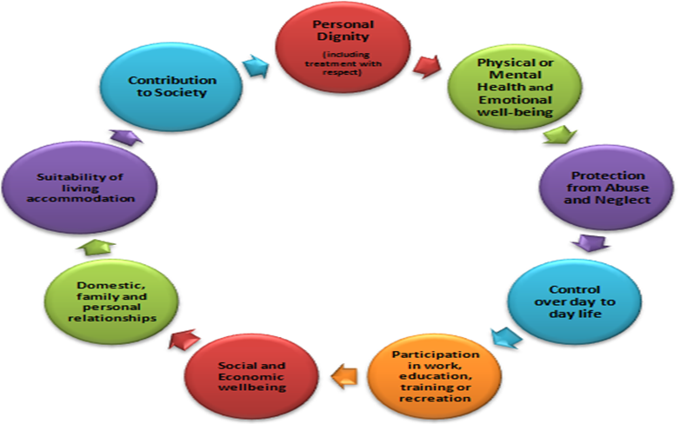
Well-being Principle
The Well-being principle is integral in the Care Act 2014 (Section 1).
The duty to promote individual Wellbeing always applies, this includes safeguarding.
9 well-being outcomes
Notes:
Under the Care Act the Wellbeing domains are all as important as each other. Any hierarchy can only be determined or described by the adult who's Wellbeing it is. This means that, even though the process is safeguarding, the 'Protection from abuse and neglect' Wellbeing domain may not be the most dominant area of concern for the adult. This could cause practice dilemmas? How would you manage such dilemmas….
How safeguarding practices can promote well-being –
Always assume that the adult is best placed to judge their own Wellbeing;
Enable the adult to participate as fully as possible in the process and in decision making
Always seek and take into account the views, wishes and feelings of the adult before making any decision or taking any action
If a person is unable to express a present view, wish or feeling always take into account any past views, wishes or feelings they have expressed;
Ensure that decisions made have regard for the things that are important to the person and are not based on assumptions, preconceptions or judgements;
Never advocate risk management measures that do not take account of individual Wellbeing;

Slide 23
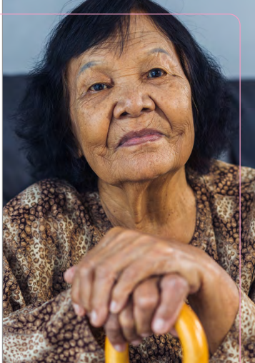

Making Safeguarding Personal (MSP)
Person-led and outcome-focused
Involvement, choice and control
Identifying ways for adults to protect themself
Adults are treated as the expert of their situation
Not a one-size fits all approach
Trust needed or people withdraw
Avoiding risk averse approaches
Promoting self-determination and autonomy
Being non-judgemental and showing empathy
Taking positive risks and proportionately What good is making someone safer if it merely makes them miserable? (Munby, 2007)
http://www.stopadultabuse.org.uk/home.aspx
“The Spoken Word”
Notes:
Previously the MPS was missing in safeguarding.
Denotes that the person is at the centre throughout
Engaging the person in conversation about how best to respond to their situation in a way that enhances involvement, choice and control as well as improving quality of life, wellbeing and safety.
Unfortunately, a lot of research has shown adults have not felt they have been listened to when enquiries have been undertaken; worse off.
Point of reflection – As practitioners we need to be aware of our own beliefs, values and bias to adopt an MSP approach. How can we achieve this?
- Film focuses on giving people a voice rather than an explicit account of what abuse is.
- People saying how people treat them as they are seen differently as targets of abuse, rather than society acknowledging difference and accepting it.
- Wishes and aspirations

Slide 24
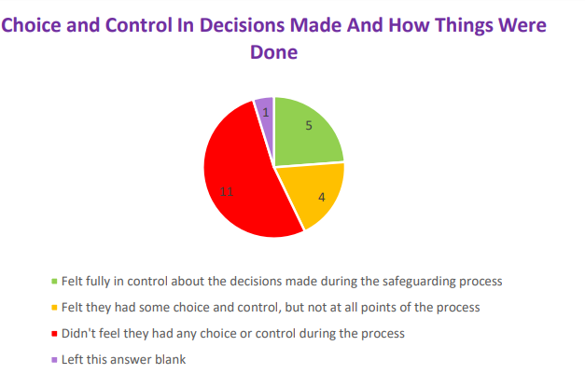
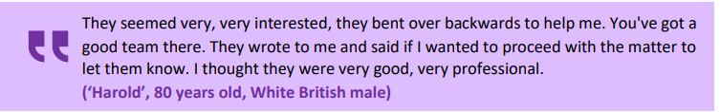
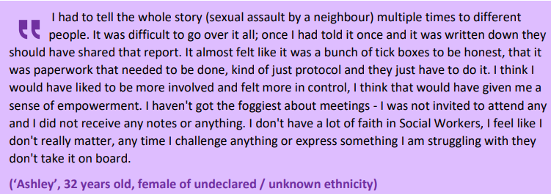
Voice of the Adult – Salford
Example of what went well
Example of what could have been improved
https://safeguardingadults.salford.gov.uk/media/3cclfqjt/sculpt_formatted_voice_of_the_adult_2024-2025.pdf
Notes:
Analysing the impact of the safeguarding support adults receive to make improvements
Imperative the voice of the adult is heard.
Research involved 21 adults and carers, who were asked various questions
The 'Voice of the Adult' is an ongoing process designed by the Salford Safeguarding Adults Board to listen to the feedback of adults (and/or their representatives, carers or advocates) who have had recent, lived experience of adult safeguarding in Salford.

Slide 25
Independent Advocacy
Advocates help the adult to understand information, make decisions and communicate their desired outcomes.
The Care Act (2014) s68 Independent Advocacy (Safeguarding enquiries / reviews)
Possible situations to consider advocacy;
Advocacy - Mind In Salford Mind In Salford Safe in Salford - Salford Foundation (IDVAs)
Individuals who cannot act as a representative (9.4) Responding to a Concern (trixonline.co.uk)
The adult is experiencing substantial difficulty understanding or participating in enquiry process (understand, retain, weight up and communicate)
The adult lacks capacity to partake in an enquiry, their expressed views are needed.
There would be a conflict of interest if a family member or friend advocated, as they may not fully represent the adults' views or may be the alleged source of risk
There could be external forces and undue influence which could prevent individuals from making decisions.
Notes:
Advocacy is often under used in safeguarding situations.
It is important for practitioners working with adults to understand the requirements for advocacy.
The adult should be consulted if and who they wish to represent them
Advocacy is a way to ensure the person’s voice is heard; to empower and support represent views.
Advocates spend time with the adult before and after meetings, to support them understand the events.
They can challenge the professionals involved in the safeguarding process to make sure decisions are checked with the person.
Advocacy also links to the “I” statements when MSP.
Different advocates, depending on different circumstances
Advocacy principles 1. Clarity of purpose 2. Independence 3. Person-centred approach 4. Empowerment 5. Equal Opportunity 6. Accessibility 7. Support 8. Accountability 9. Confidentiality 10. Complaints 11. Safeguarding.

Slide 26
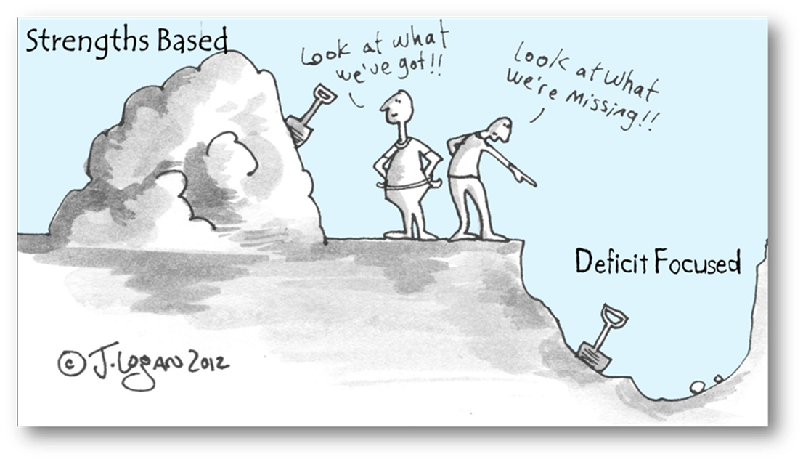
Strengths-Based Approaches
Safeguarding needs a strengths-based perspective, to empower adults to feel in control.
Anything within the adult’s own power that they can do to help themselves.
Anything within the power of their family, friends or community that they can use to help themselves.
Notes:
Taking a holistic view of the adult's needs, risks and situation in the context of their wider support network;
Helping the adult to understand their strengths and capabilities within the context of their situation;
Helping the adult to understand and explore the support available to them in the community;
Helping the adult to understand and explore the support available to them through other networks or services (e.g. health);
Exploring some of the less intrusive/intensive ways that Adult Social Care or other organisations may be able to help (such as through prevention services or signposting).

Slide 27
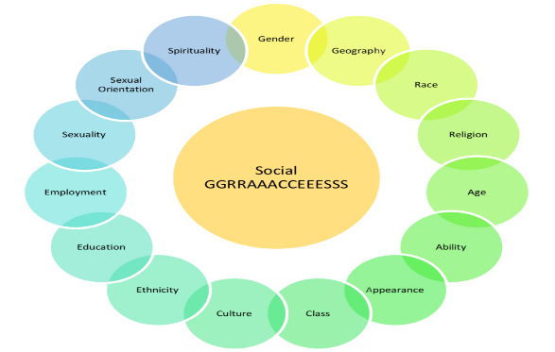
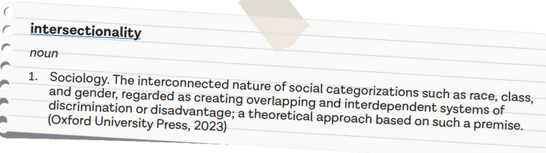
Equality, Diversity and Inclusion
Anti-discriminatory and anti-oppressive principles, link to MSP
Legal frameworks – Care Act 2014, Equality Act 2010, Human Rights 1994
Diversity is multidimensional including race, disability, class, economic status, age, sexuality, and gender (including transgender), faith and belief, and intersection of this and other characteristics.
Salford is a diverse area: How life has changed in Salford: Census 2021
Increasing the need to be professionally curious, challenge personal bias, and adapt safeguarding approaches (cultural consciousness & humility)
Notes:
EDI a core part of ethical, legal and effective practice
Important in safeguarding as Adults at risk face multiple layers of disadvantage – disability, poverty, language barriers or discrimination – EDI helps us embed cultural competence and person-centred interventions
Without EDI lens – missing risks and engagement with individual – withdrawal
EDI in safeguarding – Cultural sensitivity, accessible communication, challenging bias, person-centered, reflective practice.
Examples – working with Jewish Community in Salford, learning from SAR about abuse limited understanding of dynamic issues in same-sex relationships, safeguarding issues faced by Adults with sensory loss
Social Graces (Burnam 2013) - The acronym 'social graces' is used to represent aspects of difference in beliefs, power, and lifestyle, visible and invisible, voiced, and unvoiced, to which we might pay attention to in our practice
Understand the demographic of Salford.
Think about cultural identity, language, labels and the impact of ethnocentrism
Language and use of interpreters
Unconscious bias is the result of social stereotypes about certain groups of people that individuals form outside their own conscious awareness. Everyone naturally holds unconscious bias and we must be aware of it because it stems from our tendency to organise our own social world and is a result of our personal life experiences. Unconscious bias can mean that decisions are sometimes influenced by false beliefs or assumptions. It includes when a person thinks: − better of someone because they believe they're alike − less of someone because that person is different to them, for example, they might be seen to have ‘eccentric’ views, different race, religion, age or have different values of beliefs.

Slide 28
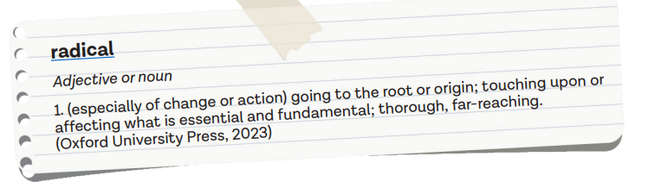

Professional Curiosity
The capacity and skill to explore and understand what is happening for an individual vs making assumptions
Professional curiosity helps to identify and respond to risk
Thinking ‘outside of the box’, including family and community approaches
Triangulating information from visits, conversations and observations.
Be willing to have difficult and challenging conversations
Build self-awareness, including the emotional impacts of safeguarding on self.
Consider own competing value bases and bias
Use reflective supervision to explore a deeper meaning and discuss different hypotheses, theories models and approaches.
Trust instincts, gut feelings, something might feel wrong…explore further
Complete activity 5 in groups
Notes:
Tricky concept to define
Reflection could be on surface level, but to add layers it like peeling the back the layers of an onion.
Consider wider socio-political context of power.
On the surface a situation may appear stable, however there could be more occurring than what meets the eye.
Gut feelings and intuitions, what are these telling you?
Professional curiosity involves:
Noticing when something feels off, even subtly
Asking deeper questions to uncover hidden issues
Respectfully challenging assumptions
Staying open-minded & reflective
Persistently following up concerns event if its uncomfortable
Benefits
Reveals hidden risk – abuse, neglect, coercion
Amplifies adults voice
Improves decision-making
Foster vigilance and accountability
Builds trust

Slide 29

Risk Assessment Principles
Hazard (Anything that can cause harm)
Risk (How great the chance that someone will be harmed by the hazard )
Risk assessments establish the nature ,likelihood and impact of actual or potential hazard (abuse or neglect)
Past, current, future and foreseeable risks (non-static)
The desired outcomes of individual are central to risk management
Strengths-based, protective & mitigating factors, safeguarding self
Proportionate and least intrusive.
SMART goals, accountability, professional judgements, not risk averse
Positive risk taking – important to recognise that risk is a normal everyday experience (includes empowerment)
Remember risk to other adults and children could require action
Notes:
Risk assessments should be created and reviewed with the individual
There are many theoretical perspective and models about risk
Positive risk taking can feel like a paradox during safeguarding this need to ‘protect’ vulnerable adults, however safeguarding is an empowering intervention to liberate and support individuals take positive risks
Risk is nuanced/subjective; establish facts and consider nature of risk.
Even in instances person is refusing safeguarding assistance and there are significant concerns re. welfare,

Slide 30

PART 3
Salford Safeguarding Adult Board
Salford Safeguarding Adults Board
Notes:
Section 43 requires all LAs to establish a Safeguarding Adult Board responsible for effective multi-agency safeguarding arrangements.
Sets out our polices and procedures, guides, toolkits
Multi-agency partnership – Safeguarding Adults
Effective safeguarding arrangements
Works with LA, health, Police, PVI, Housing
7 minute briefings
Learning from SAR – s.44 adult suffers serious harm/death, improve future practice – mandatory and voluntary SAR
Multi-agency training
SAR themes – professional curiosity, recognising self neglect, MDT, voice of adult, assessing capacity

Slide 31

PART 4
Referral and Enquiry Procedures

Slide 32
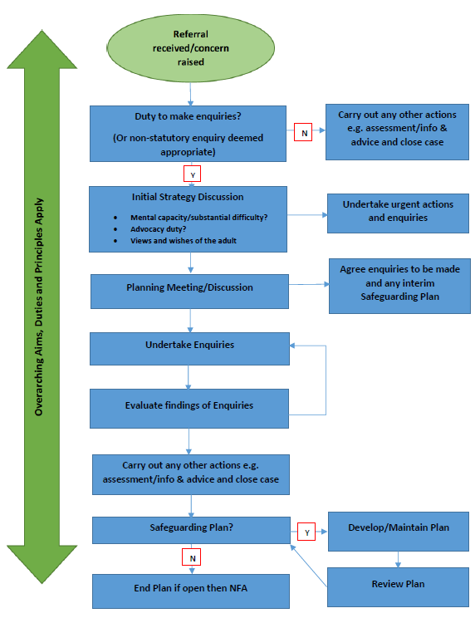
Safeguarding Process Map
Notes:
Show safeguarding template
Above is a chart taken from the Care & support stat guidance and is also on the SSAB website.
It shows the steps taken from when an initial referral is received.
There needs to initial preliminary screening and safeguarding discussion to determine if the duty for s42 is met.
There are various process maps available which are available; the one above is a general overview.
We will be exploring steps taken when an initial referral is received + initial strategy discussion; planning meeting; enquiries; evaluating findings

Slide 33
Referral & Initial safeguarding planning
Following info gathering & analysis, decision made if section 42 duty applies
Could include a single or a combination of responses, including s9 needs assessment
Urgent questions; If adult (others, incl. children) in immediate danger, initial safeguards
Police contacted if there has been indication of a crime/offence. Lateral checks
Consent, views and wishes of the adult at referral point
The adult needs to be informed of the decision for further enquiry (exempt circumstances informed at a later stage)
Next step initial planning meeting (no more than 5 days of receiving referral)
Safeguarding planning discussion to evaluate risks and deem key/general lines of enquiry
Safeguarding decisions and actions, need to be timely and proportionate
In Salford, referrals go to Contact Team via Portal system Safeguarding team for Triage Then possible community and hospital-based teams for further enquiry
Notes:
The decisions needs to be recorded “In the absence of further enquiries, it remains possible the alleged harm, neglect or abuse would still be on-going ”
More information can be found on SSAB website and practitioner guidance. (SSAB 2.0.3)
Duty applies if the three-part criteria is met
Combination of responses could include a statutory enquiry, assessment of need and/or a referral to Women’s aid…
Info sought at referral includes detail of person raising the concern; details of the adult; information about the abuse or neglect; detail of person alleged to have caused harm; immediate actions to protect adult.
Referral to Children’s made if there are grounds.
The referrer should have gained consent from adult, but there may have been instances they have not
It is only appropriate to make enquiries without consent if:
'Vital interests' are at stake;
The adult is being subjected to inhuman or degrading treatment which is having a serious impact on their wellbeing;
Other adults or children are at risk of being abused;
There are concerns that decision has not been made freely but been unduly influenced or subject to coercive control.
Safeguarding decisions and actions, need to be timely and proportionate
Risk assessment could include a judgement about;
Nature of the risk of harm (physical, emotional or otherwise);
Likelihood (and frequency) of the harm occurring;
Severity of harm should it occur;
Effectiveness of any current risk reduction measures; and
Impact on individual Wellbeing domains.
Note: When assessing the likelihood of harm occurring this should be an evidence based judgement.
The adult should be informed of the decision for enquiry, next steps and be actively engaged in the safeguarding process. Only in except circumstances they may not have been informed at the initial stages; for example speaking to the adult could exacerbate their situation further.
If someone’s needs have not met s42 criteria (not an adult with care needs) and there are grounds for concern regarding their safety, we would still give necessary advice, contact services if needed and signpost (non-stat enquiry).
Salford Safeguarding Team – Risk prioritise referrals, high, medium, low. S42 duty (3 stage criteria), info gathering, initial screening, liaisons, safety planning, decision if further enquiries needed, home visit, policing perspective, gather intelligence and themes (cuckooing, recurrent abuse in care homes, transferrable risk), subject experts (forced marriage, self neglect, DV….)

Slide 34
Different forms of enquiries
Multiple Agency
Police Led Criminal Investigation
Large Scale / Organisational Enquiry
Single Agency (LA or other)
Notes:
Single Enquiry – Could be social care as lead agency, or instructing another agency, including ICB, OPG, CQC, more detailed on the SSAB
Multiple Enquiry – Social Care with other agencies/professionals for example health or OPG
Police Led Criminal Investigation – Criminal offence is likely or has been committed (Lead agency supports where police need this)
Large Scale / Organisational Enquiry – Can be alongside the above the above, non-regulated service provider, regulated services, health settings (Edenfield)

Slide 35
Safeguarding Enquiries
Adapted from stat guide 14.94 – Objectives of enquiry
Establish facts & current well-being
Ascertain the adults' views & wishes; central to the enquiry.
Assess the needs of the adult for protection, support and redress
Protect from abuse & neglect in accordance with wishes of adult
Make decisions and follow up action should be taken
Enable the adult to achieve resolution & recovery
Explore the safeguarding measures the adult is willing to explore and implement
Notes:
Won't read all the descriptions but provide an overview of what enquiries could include.
Slide contains objectives of enquiry, examples of key lines of enquiry and overall principles (right side).
The main objectives of an enquiry are detailed in the Care & Support stat guidance
In general, these are key principles applicable, regardless of whatever type of enquiry is being undertaken.
The centrality of the enquiry should be focused on the person’s views, wishes and outcomes they want to achieve.
Local authority’s are the lead for making enquiries and coordinating, determining who is best placed to undertake. Safety and well-being of adult
It could be a muti-agency enquiry; s45 duty for other agencies to cooperate
Criminal investigations would be led by the police, with assistance of social care where required - Examples of offences include; Physical assault; Sexual assault; psychological abuse; hate crime; wilful neglect; unlawful imprisonment; theft/fraud
There are different key lines of enquiry that can be taken, above are a few examples. Enquiries and actions should be tailored and unique to the individual, remember MSP and avoid one size fits all approach.

Slide 36

Safeguarding Discussions & Skilled Conversation
Involve adult and/or representative/advocate in discussions & meetings where appropriate.
Consider individual differences, including communication needs
Ask professionals involved best ways to involve adult
Strengths-based conversation
Emotional intelligence & reflexivity
Questioning types
Assessing appropriateness of speaking to perpetrator of abuse
Being open, honest and transparent
Ascertaining desired outcomes -
1) Wants to achieve;
2) Wants to change;
3) Wants to stay the same
Notes:
RIPFA resource, having courageous conversation.
Speaking to adult alone in safe space if needed.
Three overall themes emerged – first: Recognising emotional complexity; second: Reflecting on emotional themes; and third: Exploring my own prejudices and preconceptions. The findings apply to both theoretical and practical social work, addressing the need to understand emotions as a central part of critical reflection and reflexivity.

Slide 37
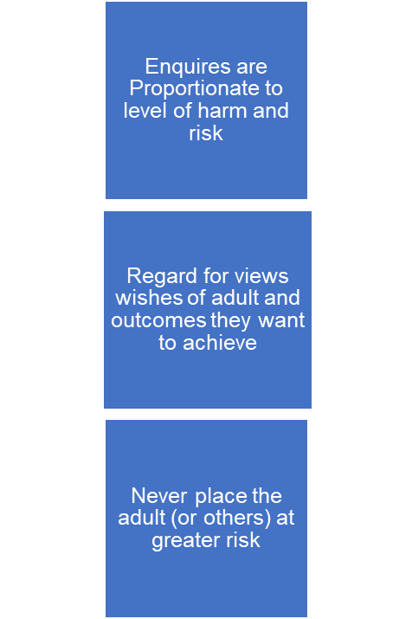
SSAB General enquiry actions could include –
A conversation with a carer or family member;
A conversation with a professional or organisation;
A conversation with anyone deemed to be a witness to what may have happened;
A conversation with the person alleged to have caused harm;
An examination of records, including electronic records, Care Plans etc.
An exploration into alternative options for meeting needs, including accommodation;
An exploration into available support services;
8. A review of equipment
Key lines of enquiry will vary based on the individual’s circumstances and nature of the alleged abuse or neglect.
Notes:
Where a police investigation is already taking place (or will be) the Lead Safeguarding Practitioner must establish from the investigating officer any potential enquiry actions that may/may not be carried out.
Under s45 of the Care Act, any professional or organisation asked to co-operate in the enquiry has a duty to do so.

Slide 38

Establishing information & evaluate findings
Adult's insight into the concern and situation? Capacity?
What does adult want to happen/not happen?
What was or is the impact of the abuse or neglect?
What is the nature/likelihood of the alleged concerns? Are there any other people at risk?
Who caused the alleged abuse or neglect? Do they still pose a risk?
Are there patterns of abuse? Chronology
Is the alleged abuse likely to happen again? If so, how can this be mitigated?
Has a crime been committed? Police advise needed?
Is the adult able to protect themselves from further abuse?
Consider what are you are trying to ascertain during the enquiry? This could change during enquires taking place
Notes:
The Lead Safeguarding Practitioner is responsible for monitoring the progress of enquiries being made.
Have there been any issues gathering the information?
Is everything on track to provide the information as agreed?
Is there any new information relevant to the concerns?
Is there a need to arrange an unscheduled planning meeting?

Slide 39
Safeguarding Scenario Activity 6
Notes:
20 minutes

Slide 40


Safeguarding & protective measures
Access to therapy, wellbeing or mediation services
Offer to call police. Policing support, safe & well checks, police protective powers
Training to paid or unpaid carers around specific needs of the adult
Information and advice about how to seek early help. Care on Call.
A period of monitoring by the Lead Agency, regulator or partner agency
Ongoing advocacy
Increased opportunities for decision making
Support to access a local support group
Specialist or further assessment
Measures to safeguards to finances
Checks by internal procurement assurance team
Supporting a service provider to develop effective procedures
Increased care to alleviate carer stress
Monitoring of a health risk by a health or medical professional
Building strategies to keep self-safe
Notes:
SSAB examples of protective measures
Proactive measures are ongoing measures that reduce the likelihood of harm occurring again.
Examples of proactive measures could include:
Being part of a community group to build networks of local support;
Training for a carer to support them to manage the adult's needs or carry out safe manual handling;
Access to a specialist health service to maintain and promote good health;
A sitting service for a carer to enable regular breaks;
Respite away from home to support the carer to take regular breaks;
Contacting an alternative care provider in advance to register with them in the event they are needed;
Assistive technology to increase security and safety at home;
Increased monitoring of a Direct Payment.

Slide 41

Safeguarding Plans
Stat guide 14.106 – Safeguarding plans enable the adult to achieve resolution or recover. To reduce risk of abuse or neglect
Plans developed at any point and for varying lengths of time
Includes risks of concern, actions to mitigate/reduce, timescales, person/agency responsible, review outcome.
Safeguarding plan is developed when
There is an on-going risk to the adult; and
There is a benefit to the adult in them having a plan; and
The adult consents to having a plan.
Caveats consent may not be required:
Adult lacks capacity to consent, plan needed in Best Interests
Other adults or children at risk
Control, coercion or undue influence
Notes:
Some individuals may have a safeguarding plan for a long time due to on-going risks.
A document that sets out the actions that will be undertaken to reduce the on-going risk of abuse or neglect.
There is a safeguarding planning process map, measuring outcomes and risk, updating, continuing, closing etc.

Slide 42

Multi-agency procedures
Stat guide 14.67 – Partners should ensure they have mechanisms in place that enable early intervention and assessment of risk, through timely information sharing and targeted multi-agency interventions.
Safeguarding multiagency approaches help to:
Build comprehensive risk management plans
Shares accountability
SMART goal planning
Each agency considers their own legislative framework (legal powers), expertise and resources
Devise contingency planning in the event of escalating risks
Lead Agency is LA (Social Care); communication and clarity of responsibilities are key to ensure actions do not go adrift.
In Salford, there is going to be a Multiagency Safeguarding Hub (MASH)
Notes:
All key principles of safeguarding apply, strengths-based, person focused and well-being.
The DASH (domestic abuse, stalking and honour based violence) risk assessment is a tool used to assess the risk that a victim is exposed to and can help in the action required. If a score of 14 or higher is attained, the victim should be referred to the multi-agency risk assessment conference (MARAC).

Slide 43
Multi-agency procedures
Multiagency approaches detailed SSAB Policies & Procedures
Further, other processes for complex situations where risks remain high (despite safeguarding interventions) or there are professional disagreements, include;
High Risk Advisory Panel | Salford Safeguarding Adults Board
Escalation Policy and Procedure | Salford Safeguarding Adults Board
Multi-Agency Risk Assessment Conference (MARAC) : Sharing relevant information about victims of high risk of domestic abuse to create a coordinated action plan to keep victims, other adults and their children safe.
Notifying agencies where the person causing harm us employed to work in any capacity with vulnerable adults: DBS, CQC, Professional Regulatory Bodies, DWP, OPG, COP, Trading Standards, PiPoT
Notes:
Allegations regarding a Person in Position of Trust (PIPOT) https://safeguardingadults.salford.gov.uk/professionals/people-in-positions-of-trust-pipot-whistleblowing/
Type of abuse or neglect
Agency that must be notified (if not already involved)
Any, where the person causing harm is employed to work in any capacity with any vulnerable adult (e.g. in domiciliary/home care, a care home, day service, hospital, social work, occupational therapy) – DBS
Any, where the abuse took place in a regulated care setting or hospital (including mental health facilities) - Care Quality Commission
Any, where the person causing harm is a professional (e.g. social worker, occupational therapist, nurse) - Professional Regulatory Body
Any misuse of an Appointeeship - Department of Work and Pensions (DWP)
Any misuse of a Power of Attorney - Office of the Public Guardian (OPG)
Any misuse of a Deputyship - Court of Protection
Modern Slavery - National Referral Mechanism
Any, where there has been a breach of Health and Safety Legislation -Health and Safety Executive
Financial abuse by rogue traders - Trading Standards

Slide 44
Safeguarding meetings
It is best for adult and/or representative to be involved in meetings, with suitable adjustments; or detail reasons/decision why not.
Opportunity for relevant individuals and professionals to be around the table
Chair would facilitate discussions. Confidentiality statement read.
Safeguarding meeting agendas vary and can take place at any time: initial stage; enquiry review meetings (ERMs); enquiry outcomes; safeguarding plans; and reviews of plan.
Example of agenda: Share information relevant to the enquiry; Agree the level of risk to the adult and others; Agree what enquiries need to be made; Agree which actions are required in order to reduce, remove or manage risk; including an interim actions (protective measures/protection plan). Process of review
Notes:
There are various stages a meeting could take place; only if proportionate
An initial planning meeting would occur after an initial referral has been received
There can be subsequent meetings afterwards, if needed
Minute taker, confidentiality and appropriate people around the table
Part 1 and Part 2 meeting; structuring

Slide 45

Professionals and agencies who could be involved in Safeguarding enquires and meetings
Representative from health (ICB/ NHS Trust);
GP;
Police;
GM Fire and Rescue Service;
Representative from education;
Psychologist;
Psychiatrist;
District nurse;
Speech and Language Therapist (SALT);
Care home managers;
Representative from care provider;
Care Quality Commission;
Department of Work and Pensions (DWP);
Housing officers.

Slide 46
Safeguarding Scenario Activity 7
Notes:
20 minutes

Slide 47
Safeguarding outcomes
Safeguarding outcome meeting check lines of enquiry undertaken; risk analyse; and measure outcome; how effective are protective measures in reducing likelihood and impact of harm to adult?
Outcome of a meeting could include;
Risk remains
Risk reduced
Risk removed
Safeguarding closed when there is evidence that the risks posed to the adult have been effectively managed or no longer exist
If risk remains (even if it has been reduced) the Safeguarding Plan could continue, particularly when risk is unstable, complex and on-going
Monitoring could be required post enquiry by lead agency or others.
The appropriate Manager / Advanced Practitioner would ratify decisions about closing (or not closing) a safeguarding. All decisions are recorded.
Notes:
Protective measures should be unique and tailored to the safeguarding concern in hand.
Safeguarding outcome meetings is a way to evaluate if any more actions are needed.
Risk remain – Example DV, the adult continues to retain contact with the alleged source of risk, there are further incidents and no reduction of harm.
Risk reduced – Example, falls in a care home, protective measures in place, further reoccurrences have reduced.
Risk removed – Example, financial abuse, someone suitable has applied for LPA or appointeeship and finances are safeguarded.
Examples of when an on-going plan is needed
Ongoing, complex, or unstable;
The risk of harm to the adult or others remains significant;
Other factors such as coercion, undue influence, or duress add to the complexity and uncertainty of the risk, and that the risk cannot be managed appropriately or adequately by other processes.
Safeguarding plans needs to purposeful, proportionate and person-centred.
We should only keep plans in place as long as needed; with consideration of the impact of such a plan on well-being
A safeguarding can also be closed if:
The adult has capacity to make decisions around safeguarding; and
They do not consent (or withdraw consent) to involvement (or further involvement) with the safeguarding process.
If this is the case the appropriate Manager / Advanced Practitioner must ensure that risks and risk reduction strategies have been discussed with the adult, and that they know what to do if they change their mind or circumstances change in the future.
With the adult's consent, information about risks and risk strategies should also be shared with anyone involved in monitoring. For example, an advocate, sw team, housing or health professional.

Slide 48

Safeguarding summary & conclusions
Write a mini synopsis to conclude…..
Route and referral reason
How s42 safeguarding duty was met
If the adult had capacity or not to partake in enquiry; of the latter who represented views (advocate), what were adults expressed views
Outline of key lines of enquiry
Analysis of findings; protectives measures; outline meeting outcomes; were safeguarding plans goals achieved? (risks reduced/removed).
Adults' well-being end of enquiry, were outcomes achieved?
How and who have safeguarding conclusions been communicated to (including proportionate info to initial referrer if appropriate)
How can adult receive safeguarding support if circumstances change?
Bring in your professional judgement and decision-making.
Short enquires still constitute as a s42 enquiry

Slide 49
Reading & Resources
Are we making safeguarding personal? | Research in Practice
Cooper, A., Cocker, C., & Briggs, M. (2018). Making safeguarding personal and social work practice with older adults: findings from local-authority survey data in England. British Journal of Social Work, 48(4), 1014-1032.
Impact of COVID-19 on adult safeguarding and social care | Research in Practice
Keith’s Story https://www.youtube.com/watch?v=fhmfptpwNZc
Making Safeguarding Personal – Outcomes Framework and Toolkit | Research in Practice
Making decisions on the duty to carry out Safeguarding Adults enquiries (Local Government Association).
Safeguarding adults: lessons from the murder of Steven Hoskin (scie.org.uk)
Safeguarding Adults: An independent life after abuse – YouTube
Starns, B. (2019). Safeguarding Adults Together under the Care Act 2014: A multi-agency practice guide. Critical Publishing.
Tools and resources to support Making Safeguarding Personal | Research in Practice
The importance of professional curiosity in safeguarding adults | Research in Practice

