Slide 1

Practice Education Training 2026 Initial Steps
Salford Adult Social Care Learning & Development Team
Notes:
Introductions. Session aimed for new PEs and refresh for others.
This year, a new application process of manager recommendation form & EoI;
To ensure individuals have transferrable skills, experience and knowledge to build on. Commitment to CPD and supporting students.

Slide 2
The importance of Practice Educators
Notes:
Think back to when you were a student, positive and negative experiences…..
Passionate about social work and want to mentor others.
Giving back and helping the newer generations of social workers entering the profession, future workforce
Support students to bring theory-based learning into practice to develop confidence, critical thinking, knowledge and practical experiences
Developing skills for supervision, coaching and facilitating practice-based learning.
Promotes reflective practice and ethical principles
Helps students to build emotional resilience and self-care
Raising the standards of social work education and builds a strong professional identity; values, ethics, responsibilities and sense of solidarity for profession.
Promotes our own self growth

Slide 3

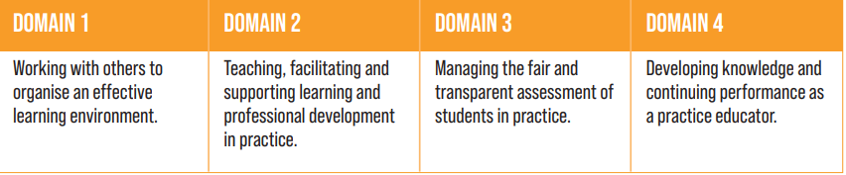
BASW Practice Educator Professional Standards
All Practice Educators uphold the Practice Educator Professional Standards (PEPS) and Statement of Values as set out by BASW
Notes:
BASW England Practice Educator Professional Standards for social work (PEPS) 2022 | BASW

Slide 4

BASW Practice Educator Statement of Values
All Practice Educators uphold the Practice Educator Professional Standards (PEPS) and Statement of Values as set out by BASW
Commitment to embed principles of Equality, Diversity and Inclusion (EDI) across Practice Education which align with BASW Code of Ethics (2021).
To promote anti-oppressive and anti-discriminatory practices, practice educators and supervisors supporting students will uphold the statement of values.

Slide 5
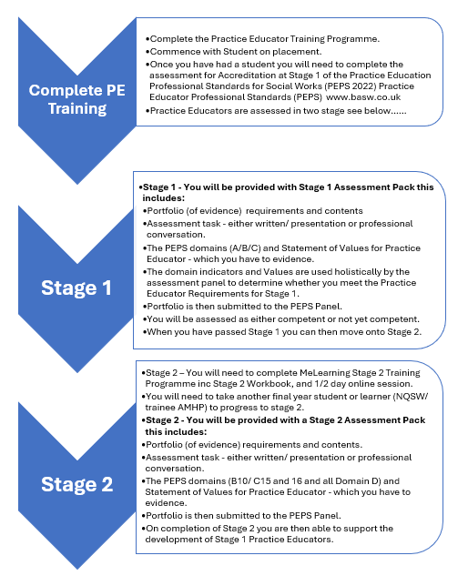

Slide 6

GMSWA Training Programme
In Salford Adult, the learning and development team do collaborative work with key partners of the Greater Manchester Social Work Academy (GMSWA) to provide training and on-going CPD opportunities for Practice Educators.
The Practice Learning Steering Group (PLSG) is made up of workforce leads and university representatives who develop and renew the programme in line with the BASW, emerging trends and the latest developments within the field of practice learning.
Current training is a blended learning programme 5 days
The Training guide provides an overview of the process.
https://gmswa.co.uk/practice-education/
Notes:
In 2022, the GMSWA moved to a blended learning programme, online and face to face; due to covid and benefits of flexible learning. Total of 5 days and 1 day

Slide 7
Aims of the Practice Educator Training Programme across GMSWA:
Following this programme, participants will be able to:
Plan, deliver and critically evaluate practice-based learning opportunities which support a student’s personal and professional development.
Assess and make judgements about the student’s performance in the workplace against agreed criteria using evidence from a range of sources.
Manage the student’s learning environment whilst ensuring the quality-of-service provision.
Demonstrate an understanding and application of adult learning theories in practice.
Apply and demonstrate a critically reflective approach to your own practice particularly regarding the application of an appropriate and professional value base.
Critically evaluate and integrate professional values in all aspects of practice-based teaching and assessment.
Clarity about your role as Practice Educator and the expectations and requirements of the role.

Slide 8
Permission
Discuss with line manager/learning and development team about progression training for Practice Education and availability for having a student.
Enrolment
Enrolment on Me Learning Practice Educator Programme by Learning and development team.
Training
Next Steps - Student
Completion
Providing you meet the eligibility and have approved consent, you will be enrolled on the programme by your Learning and Development Team.
You will receive a welcome email from Me Learning taking you to the programme, where you can download the workbook.
Complete all 9 digital modules and workbook activities.
Following completion you will then be directed to book on a face to face workshop.
On completion of the digital programme Me Learning will send you a certificate on completion.
On completion of the face to face workshop Me learning will send you a attendance certificate.
Keep BOTH Certificates as both will be required for your stage 1 portfolio.
You are now ready to take your first student,
discuss with your manager/ Learning and Development Team about beginning this process

Slide 9

5 days Initial Training – Readiness to support a student Days 1-4
There are 9 digital modules & workbook:
The Practice Educator Role
Preparing the setting
Placement Requirements
Supervision
Adult Learning
Assessment and Observation
Feedback and Assessments
Assessment Requirement and Marking
Working with struggling students
Notes:
9 modules and activities in accompanying workbook need to be completed.
Intended to be interactive to suit different learning styles with audio, video, activities and quizzes.
Must score 4 out 5 to pass the modules.
There are interesting activities and dilemmas included, especially SWE breaches.

Slide 10
Content of Face-to-Face workshop
Induction
Power and anti-discriminatory practice
Supervision
Working with struggling students
5 days Initial Training – Readiness to support a student Days 5
Notes:
The workshop will refer to activities that you will have completed in your workbook, therefore it is important that you bring your workbook with you on the day. You can bring it in either paper or electronic format.
The workshop is designed to provide an overview of the above topics and to give you the opportunity to discuss activities in your workbook as a group. In this way, you will consolidate the online training.
The workshop is intended to be a participative session, so please attend with any questions you may have and ready to actively engage in the activities and group discussions.

Slide 11

Let's look at the ME learning website and workbook….

Slide 12
Next Steps
1. Dates for training days - Speak with your individual manager and provisionally book 4 study days to complete the ME learning programme and workbook. Send us the provisional days via the MSTs channel
2. Enrolment onto ME learning programme - Once dates have been received, you will be enrolled on to ME learning to undertake online training. You will receive an invite email and link to create a password; further info is included on the GMSWA training guide.
3. Completion of ME learning and workbook - You will need to complete the 9 ME learning modules (including summary quizzes) and the attached workbook over study days. We will check progress of ME learning and you will receive a reminders if there is no activity.
4. Preparation before workshop - Forward your completed workbook and e-learning certificate to ASCWorkforcedevelopment@nca.nhs.uk one week before attending your chosen workshop date.
Notes:
Prior to your workshop, the trainer will arrange a briefing session to check in on your learning and discuss what to expect during the day. Take a copy of your completed workbook to the workshop as you will use this as a resource to partake in the activities during the day.

Slide 13
Other Information & FAQs
Time period - Complete the 4 days ME learning and 1 day face-to-face over a period no longer than three months (This could vary if you work part-time or extenuating circumstances).
Workshop dates – You are only able to book a place for a workshop after you have completed the ME learning modules
ME learning and IT - Should you experience any technical difficulties accessing or using the ME learning website and this is not related to an internal networking issue (in NCA or GMMH), contact us and we will make enquires with the ME learning helpdesk and advise on next steps.
Certificates: Keep hold of your two certificates, one you will receive following completion of the ME learning programme and the second, following attendance at the workshop. These are needed for Stage 1 PEPS.
Study days: The study days can be taken flexibly, but we suggest pre-planning and booking these in advance to ensure you have time to complete on-line training.

Slide 14
Questions?
Thanks for attending and good luck!

